Slide 1
Chat about chat: both sides of the story
Claire Wotherspoon, The Open University/SpringShare
@Lib_Claire
claire.wotherspoon@open.ac.uk
cwotherspoon@springshare.com

Slide 2
KEY GUIDANCE
Remember the ‘basics’
Terminology
Feedback
Image by Szabo Viktor on Unsplash

Slide 3
REMEMBER THE ‘BASICS’

Slide 4
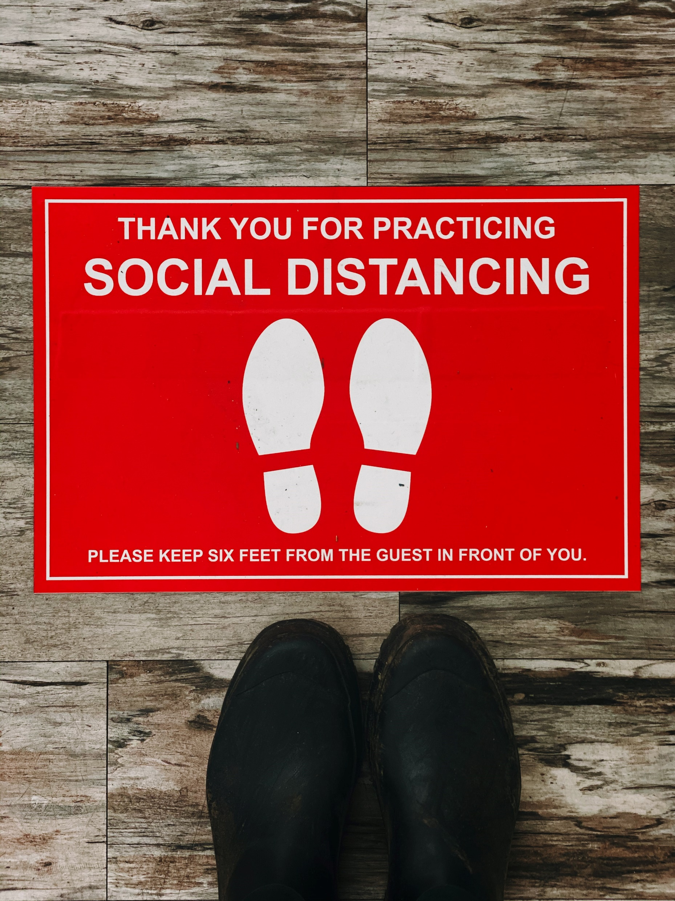
REMEMBER THE ‘BASICS’
Think of 24/7 librarians as library patrons
User expectations of after-hours
Varying practices
Pandemic planning
Interlibrary loans
Study space
Photo by Jon Tyson on Unsplash

Slide 5
TERMINOLOGY

Slide 6
TERMINOLOGY
Does you library have a collection of books that are usually available to students for a period of 2-4 hours?
If so, what do you call that collection?
Can you think of any alternative names that other organisations might call such a collection?
Add your thoughts to the chat

Slide 7
TERMINOLOGY
Here are some that I have come across:
Course reserves
High demand
Short loan
2-hour loan
Reserve
Reference

Slide 8
FEEDBACK

Slide 9
FEEDBACK
LibAnswers feedback option
Share how librarian could improve interaction
Two-way feedback: what can your library take from the interaction?
Remember the positives
Image by athree23 from Pixabay

Slide 10
THANK YOU
@Lib_Claire
claire.wotherspoon@open.ac.uk
cwotherspoon@springshare.com

