Slide 1
Creating and running a user experience project with front line staff
Joanne Booker
University of West London

Slide 2
Overview
Planning the project
Carrying out the research
Challenges faced
Lessons learned and tips for future projects

Slide 3
Planning and scoping the research

Slide 4
Research methodology
Focus groups
Interviews
Short survey for focus group/interview participants

Slide 5
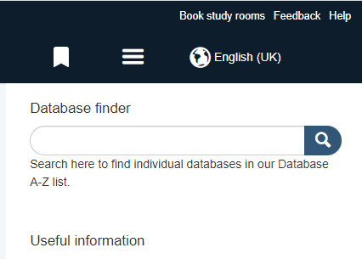
Recruiting participants

Slide 6
Running focus groups and interviews
Ice breaker
Poll
Open questions
Active listening
Follow up

Slide 7
Data
coding

Slide 8
Challenges
Determining scope
Research methodology
Staff participation
Recruiting participants
Potential influences on data

Slide 9
Lessons for future projects
Develop a clear marketing strategy for recruitment of participants.
Aim to engage more non-users.
Investigate other research methodologies.

Slide 10
Staff experiences and development
Gained experience in the research process.
Useful to hear student feedback.
Increased understanding of student needs for frontline members of staff.
Useful to know what is currently beneficial for students.

Slide 11
Tips and advice
Plan ahead.
Background research on user experience.
Offer incentives for participation (if possible).
Use your own experience of engaging with students.

Slide 12
Thank you for listening. Any questions?

