Slide 1
Have you ever thought about working in a Library?
Attracting diverse candidates to Customer Service roles
Mark Laws (mark.laws@manchester.ac.uk) The University of Manchester
This Photo by Unknown Author is licensed under CC BY-NC-ND
Notes:
I’m Mark Laws, he/him pronouns

Slide 2
Why is recruitment important in working towards a diverse and inclusive team?
Why did we want to address recruitment in our team?
What did we do?
Did it work?
What do we do next?
This Photo by Unknown Author is licensed under CC BY-NC-ND
Notes:
Running order of our talk today:

Slide 3
Why is recruitment important in working towards a diverse and inclusive team?
The first step to creating a diverse and inclusive team is the recruitment process and this is key in introducing knowledge and experience from a variety of viewpoints and perspectives
Potential employees need to be able to see themselves working and thriving in your team.
This Photo by Unknown Author is licensed under CC BY-NC-ND
Notes:
Important to note here, we’re aware that recruitment is just one element in the employee lifecycle, and diversity needs to be embedded throughout that lifecycle, but we were focusing on just this one element at the moment to see if we could make a positive impact.

Slide 4
Why did we want to address recruitment in our team?
We felt that our roles were attracting a narrow range of candidates.
The University has an increasingly diverse student body and having a frontline team that reflects that is a good thing.
We wanted to encourage people with little or no library experience, who might not have otherwise applied, but who had skills and experiences which would benefit our team.
This Photo by Unknown Author is licensed under CC BY-NC-ND
Notes:
Previously, our recruitment had attracted candidates from a Library background (not that this is a bad thing), but we wanted to encourage people with life experience and skills from other sectors to who previously might have felt underqualified to apply for a job with the Library.

Slide 5
What did we do?
This Photo by Unknown Author is licensed under CC BY-NC-ND
Notes:
We tried to break down these perceived barriers – we thought we needed to encourage people to see the space, meet the team so we introduced a recruitment open days. We wanted to make sure these open days were accessible for everyone, so we took the decision to host and online and in person open days. I’m going to mostly talk about the in person open day today – however the online version covered the same points.

Slide 6
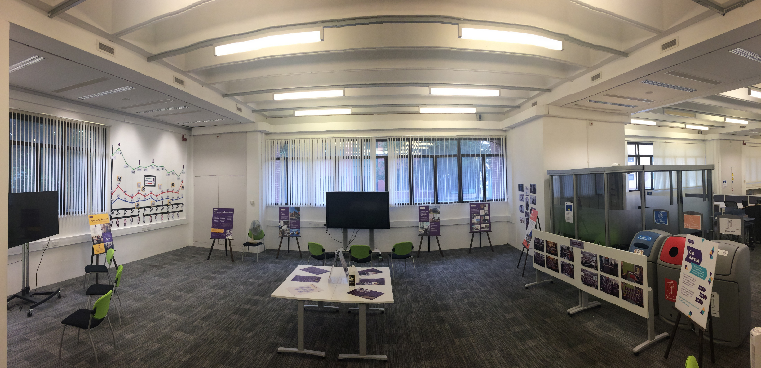
Open Day Image
Notes:
1. ‘A day in the life of a Customer Services colleague’ (video)
2. Graph showing the number of enquiries from different channels at different times of the year.
3. Application form (video)
4. ‘What qualities make up excellent customer service’ Qualities not qualification.
5. ‘Who are our customers’ Highlights diverse customer base.
6. Imagine 2030 (The University of Manchester Library’s vision and priorities for the next period of it’s development.

Slide 7
Open Day Image
Notes:
Gave potential candidates an insight into the type of working environment to expect and the daily tasks at hand. We wanted to show an environment that potential candidates could relate to.

Slide 8
Open Day Image
Notes:
1. ‘A day in the life of a Customer Services colleague’ (video)
2. Graph showing the number of enquiries from different channels at different times of the year.
3. Application form (video)
4. ‘What qualities make up excellent customer service’ Qualities not qualification.
5. ‘Who are our customers’ Highlights diverse customer base.
6. Imagine 2030 (The University of Manchester Library’s vision and priorities for the next period of it’s development.

Slide 9
Open Day Image
Notes:
Video highlighted the parts of the application form that candidates need to address (for example, essential and desirable criteria) to reflect candidates as best as possible.

Slide 10
Open Day Image
Notes:
1. ‘A day in the life of a Customer Services colleague’ (video)
2. Graph showing the number of enquiries from different channels at different times of the year.
3. Application form (video)
4. ‘What qualities make up excellent customer service’ Qualities not qualification.
5. ‘Who are our customers’ Highlights diverse customer base.
6. Imagine 2030 (The University of Manchester Library’s vision and priorities for the next period of it’s development.

Slide 11
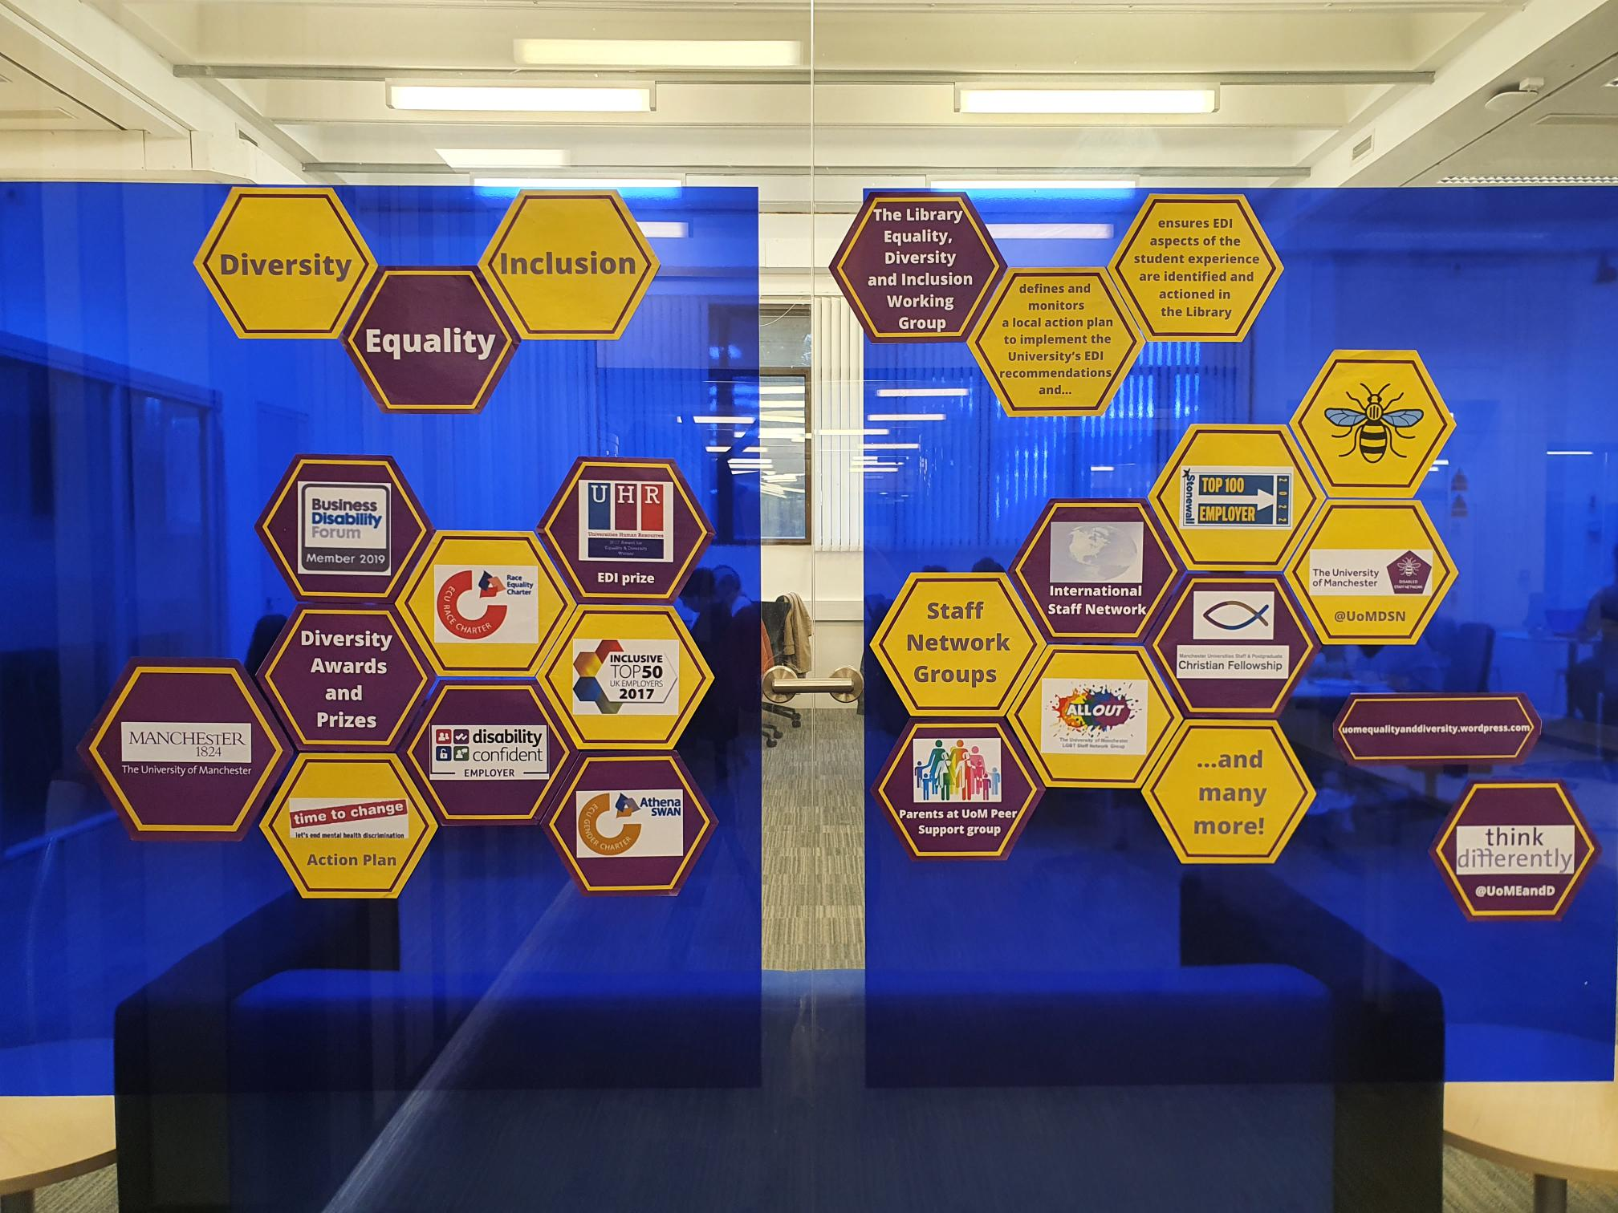
EDI Wall
This Photo by Unknown Author is licensed under CC BY-NC-ND
Notes:
Presented a snap shot on how the University addresses equality, inclusion and diversity and how the University support people if they became a member of the team. For example ALLOUT group, International Staff Network and Christian Fellowship - this hopefully demonstrated that the University echoed what we were trying to achieve.

Slide 12
Did it work?
“It encouraged me to apply as before the session I was hesitant I wouldn't meet the requirements of working in a library. Being able to discuss this with [staff] in person, and get a feel for what the job was… really helped.”
“[Speaking to staff] helped me to visualise myself in the role and understand its requirements.”
“The most surprising information was…that I did not need previous library experience, as I thought this would put me at a disadvantage.”
“My concerns about not having experience to tick every requirement were eased by speaking with staff.”
“Good to have a variety of [information] formats: video, text, images and people to ask.”
“It worked well as it was open plan, colourful and impactful. It was also physically accessible being on the ground floor.”
This Photo by Unknown Author is licensed under CC BY-NC-ND
Notes:
Feedback.

Slide 13
The percentage of disabled candidates was higher in 2021
The percentage of applicants under 20 doubled between 2019 and 2021
The percentage of applicants older than 60 also doubled
Applicants from the LGBTQIA+ community increased slightly
However, we’re aware there is still work to be done particularly in the areas of gender and ethnicity
Did it work?
This Photo by Unknown Author is licensed under CC BY-NC-ND
Notes:
Important to reflect, take stock of success and areas to improve.

Slide 14
What do we do next?
Continue to gather feedback.
This is only the beginning – continually look at ways to improve the process.
This Photo by Unknown Author is licensed under CC BY-NC-ND
Notes:
We continued to gather feedback and recognised that this new process of recruitment is continually evolving.

Slide 15
What do we do next?
What do you think are the challenges for recruiting diverse candidates in your area?
How could these be addressed?
This Photo by Unknown Author is licensed under CC BY-NC-ND
Notes:
What do we do next.
No doubt there are unique challenges in your teams or areas. What they are and how you might overcome them. Please feel free to share your thoughts and if you have any questions, please contact me at this email address. Thank you.

Slide 16
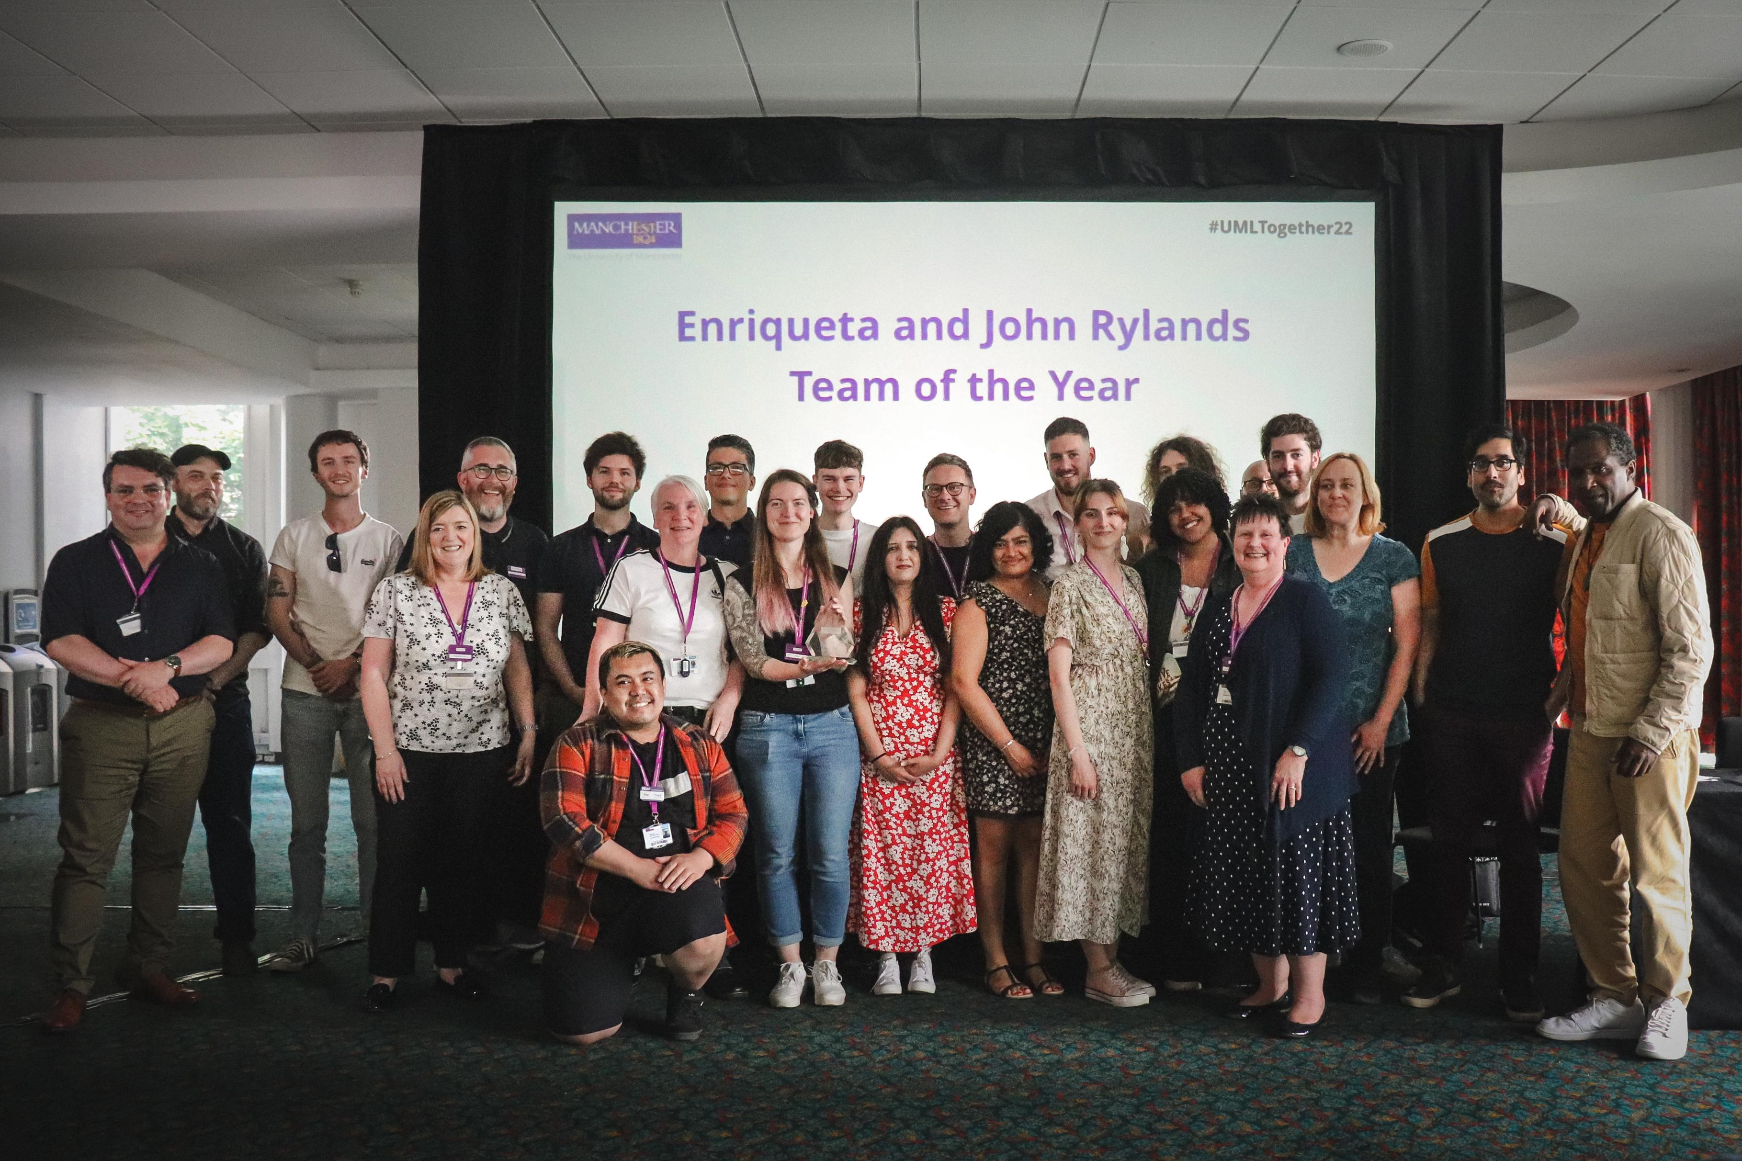
Any questions?
mark.laws@manchester.ac.uk
Notes:
No doubt there are unique challenges in your teams or areas. What they are and how you might overcome them. Please feel free to share your thoughts and if you have any questions, please contact me at this email address. Thank you.

