Slide 1
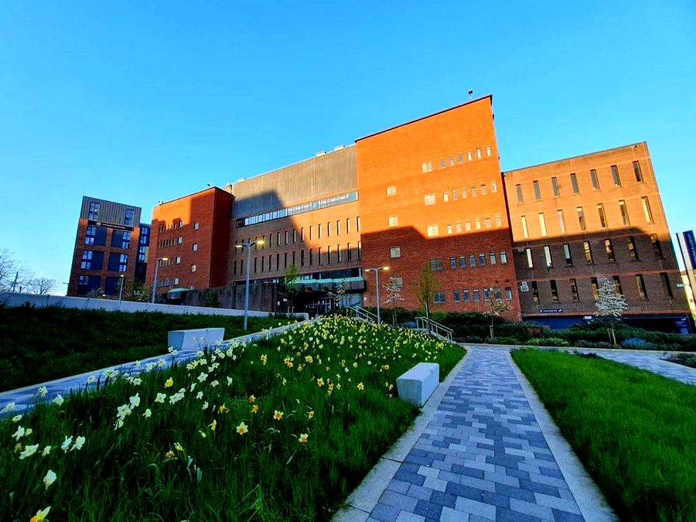
Library Lounge: Virtual Study Sessions (VSS) -
Recreating Library Vibes in a Virtual Environment
Jessica Biondo
Darcy Spiller

Slide 2
Session Outline
Background to the Virtual Study Sessions (VSS)
What, When, Who of the VSS?
Response & Feedback
Winning an Award – VSS case study
Our Future Plans

Slide 3
Library Vibes: How you would define “library”?
Cambridge Academic Content Dictionary: “a building, room, or organization that has a collection of books, documents, music, and sometimes things such as tools or artwork, for people to borrow, usually without payment”.
Collins COBUILD Advanced English Dictionary: “[…] is a building where things such as books, newspapers, videos, and music are kept for people to read, use, or borrow”.
The library as a community hub and sharing place

Slide 4
The beginning of our journey
Importance of a sharing place during the pandemic
Awareness of student isolation during pandemic
Not all students able to visit the physical library
Group study options were not available in person
Another way for the Library staff to support students

Slide 5
Inspiration
CSGUK conference Nov 2020:
University of Sheffield Virtual Library Commons
"Come together, Write now" sessions

Slide 6
What is a VSS?
Online study sessions facilitated by Library staff
Sessions run on Zoom
Two 2-hour sessions per week
Introduction, break in the middle, and summing up at the end
Students study solo and use the Zoom Chat for any queries

Slide 7
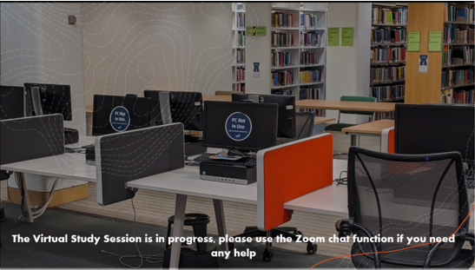
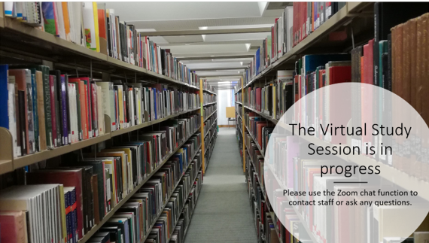
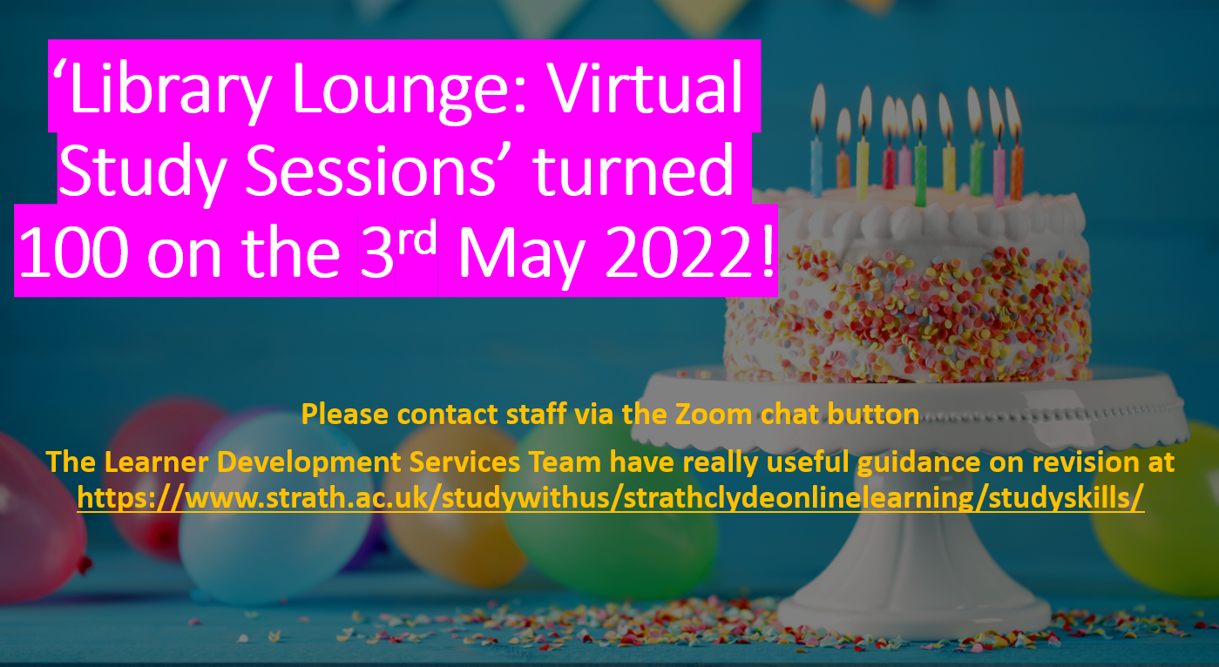
Virtual Study Session 'Session in progress' slides...

Slide 8
When are VSS run?
Sessions run twice a week
Tuesdays 2 – 4pm
Thursdays 10am –12pm
Bookable via online booking system
Same Zoom details used for each session

Slide 9
Who attends VSS?
First sessions ran in the pre-exam diet in April 2021
Between April 2021 – 3rd May 2022 = 713 attendees and 100 sessions run!
Expectation that students studying for their exams would attend BUT
Majority of attendees have been PGRs and Masters students
The sessions allow them to connect with students at a similar stage of study/research

Slide 10
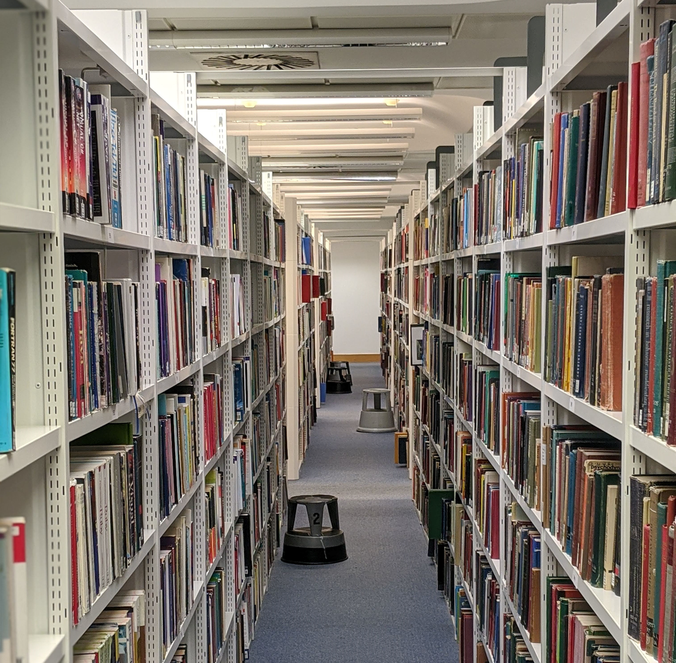
Response & Feedback 1: What do our attendees say?
It is an amazing experience. It is really nice to communicate with other students and share our feelings and difficulties. The most beneficial part was that I could ask the staff immediately during my work. This support really helped me today.
I think the session is very helpful as it's not 100% formal and we are encouraged to ask any questions and get the support needed straight away.
The session is pretty good. It recreates the library feeling at home and brings a sense of community.
Good. I feel motivated studying on zoom with other people together.
This is just nice, I mean, get used to working virtually and also know people from other research groups.
It really improved my efficiency, hope there could be more sessions!

Slide 11
Response & Feedback 2: What do our attendees say?
I found I lost a lot of motivation to work on my dissertation after classes/ lectures ended. I think the virtual study group is a good way to help structure my studying again and boost motivation.
I like the format which allows me to share goals at the start of the session and report on them at the end. It really helps as I've been having issues holding myself accountable recently.
Thank you for your help with finding sources for my essay. It's great to have support from others.
Thank you, I found it helpful to know that others were also working at the same time, which helped keep me motivated. It would be nice to have a morning session too.
I really enjoyed the session. It helped motivate me to complete my tasks and I enjoyed meeting new people and hearing what they were planning to do in the Zoom.

Slide 12
Testimonials
https://strathprints.strath.ac.uk/79203/
This link will take you to 3 student testimonials, answering questions set by library staff, regarding their opinions on the Library Lounge Virtual Study Sessions in the summer of 2021.

Slide 13
The Award
STEPS – Strathclyde's Teaching Excellence Program – Award
Virtual Study Sessions case study submitted for the "celebrating innovation and resilience at Strathclyde" Award
VSS case study won the Administrative and Professional Services category
Award funding will be used to develop VSS initiative further

Slide 14
Sharing our Knowledge
VSS Toolkit:
Help other institutions create their own virtual study sessions
Will be openly available via Strathprints by Summer 2022
Present VSS story at conferences
Article for CILIPs 'Information Professional' journal

Slide 15
Expanding our Service
Design branding/marketing to help reach more participants
Follow up on participants' suggestions
Breakout rooms
Timing the study sessions – online countdown display
Longer sessions
More sessions
Longer breaks
Music in the sessions!

Slide 16
Questions and further information?
Are there any other questions or comments?
Please get in touch if you would like further information:
jessica.biondo@strath.ac.uk
darcy.spiller@strath.ac.uk
lynsey.sampson@strath.ac.uk

