Slide 1
Transforming Library Customer Services
Lorna Bastow, Head of Customer Services L.Bastow@leeds.ac.uk
Beth Parry, Senior Operations Manager e.a.hardy@leeds.ac.uk

Slide 2
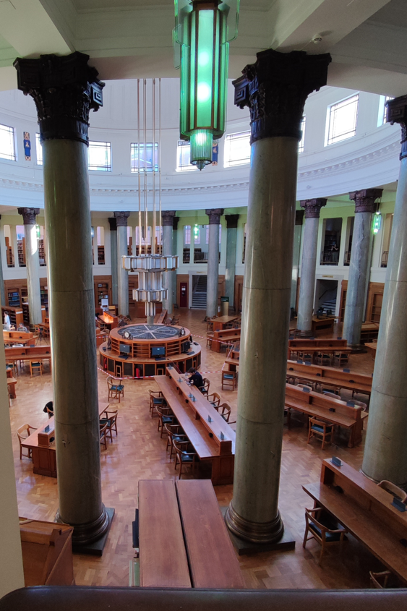
Background
University of Leeds Libraries:
2.8 million items in the library
~30,000 undergrads
~84,000 library members
5 libraries (one is only tiny)+ 4 stores
~126 customer service staff

Slide 3
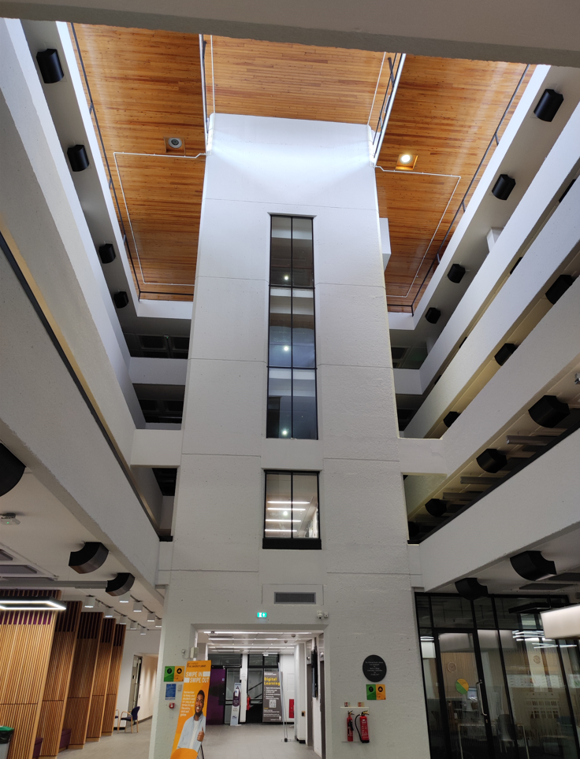
Background, a collection of challenges
Customer Services:
Opening hours ≠ CS staffing
Global pandemic
HoCS
HR
False starts
gd2≠gd3≠gd4
Term time v Vacation
Morning/daytime/evening and
2x weekend teams

Slide 4
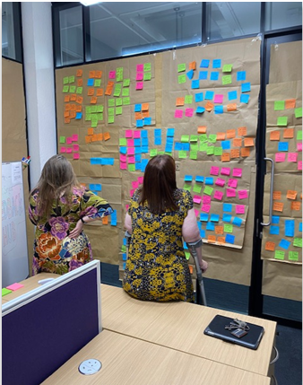
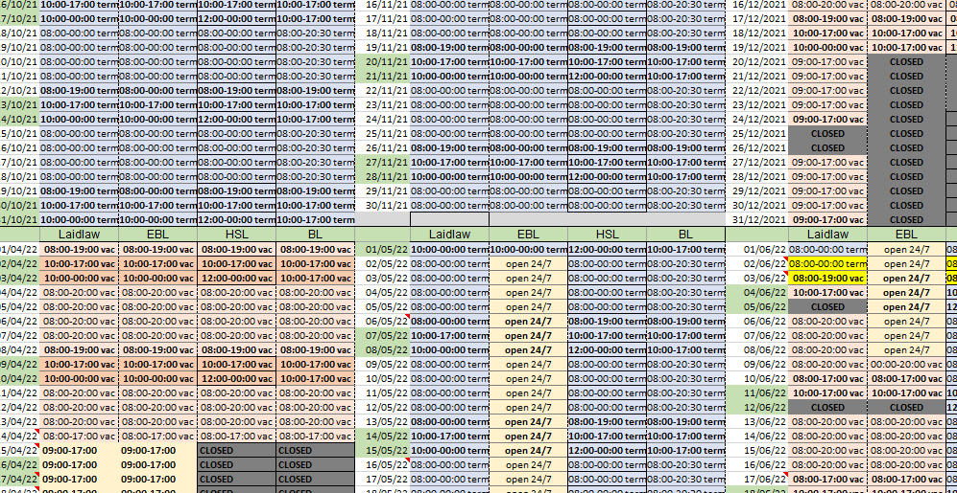
First steps/Phase 1
“Consultation”
Consultation
HR + Union
Opening hours
Bid for £££
JDs
Minimum hours

Slide 5
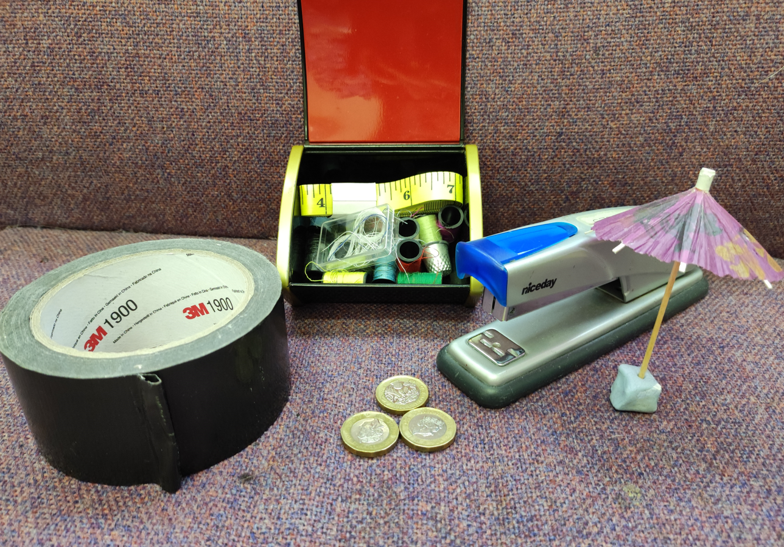
Cost of living

Slide 6
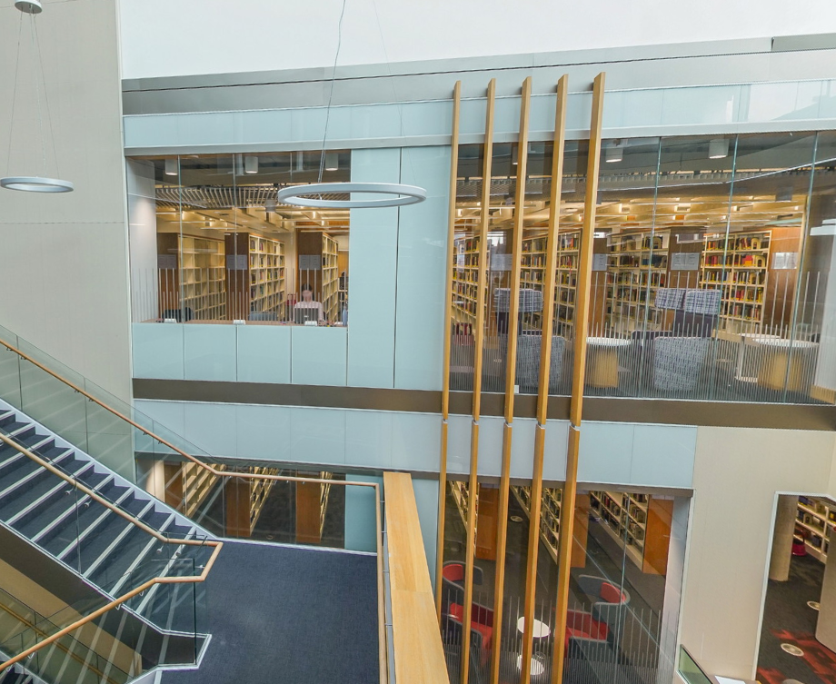
Next steps
No one had to change
Gd2 Gd3
New job titles
8 colleagues moved from pt ft
Move towards 1 weekend team
Move towards 1 team
Cross site working as a norm
Workstreams
(some departures)
Our review became a transformation

Slide 7
Next Steps (2)
Library site | Mon-Fri (Term-time) | Sat-Sun (Term-time) | Mon-Fri (Vacation) | Sat-Sun (Vacation) | Bank Holidays & Closure Days
Laidlaw | 24 hours | 24 hours | 24 hours | 24 hours | Open 24 hrs on all bank holidays and closure days apart from Christmas closure period when open 9am -5pm
Edward Boyle | 8am-midnight | 10am-midnight | 8am-8pm | 10am-8pm | 9am – 5pm during Easter closure period, early May bank holiday, and Spring bank holiday Mon & Tues closed day
Health Sciences | 8am-midnight | 10am-midnight | 8am-8pm | 10am-8pm | Closed
Brotherton | 8am-8pm | 10am-8pm | 8am – 8pm | 10am-8pm | Closed
St James | 9am-5pm | Closed | 9am-5pm | Closed | Closed

Slide 8
Looking forwards

Slide 9
Lessons learnt
What would we do differently?
What’s still to be done?

Slide 10
Any questions?

