Slide 1
Wellbeing Support from Libraries and Learning Resources
Olivia Beards, Library Customer Support
April 2024
o.a.beards@bham.ac.uk

Slide 2
Please be aware that this presentation contains references to mental health disorders, mental health crises, and mentions of suicide. If anyone feels uncomfortable at any point, please do leave the room.

Slide 3
Hello!
Senior Library Assistant in Front of House team.
Service Improvement Group for Wellbeing and Community
Previously worked as an HCA (Healthcare Assistant) in mental health wards, working with patients with personality disorders and co-morbidities
An undergraduate and postgraduate of UoB
Achieved Level 2 in Counselling Skills

Slide 4
What role can academic libraries play in mental health and wellbeing?

Slide 5
Factors that contribute to mental health issues amongst university users
Moving away from home
Developing a new social identity
Workload pressures
Financial pressures
Chronic physical health problems
Social Deprivation
International students
Non-binary and other gender
LGBTQ+
BAME
Institute for Employment Studies and REAP, 2015; Expert Review Comment, 2020; Hubble, 2020; The Insight Network, 2020, as reported by NICE

Slide 6
In 2022, there were 5,642 suicides registered in England and Wales (10.7 deaths per 100,000 people); this is consistent with 2021 (5,583 deaths; 10.7 per 100,000).
The suicide rate for higher education students in the academic year ending 2020 in England and Wales was 3.0 deaths per 100,000 students (64 suicide deaths); this is the lowest rate observed over the last four years, although the small numbers per year make it difficult to identify statistically significant differences.
(These statistics have been reported in line with Samaritans advice. Samaritans is a listening service that can be accessed 24/7 by calling 116 123)

Slide 7
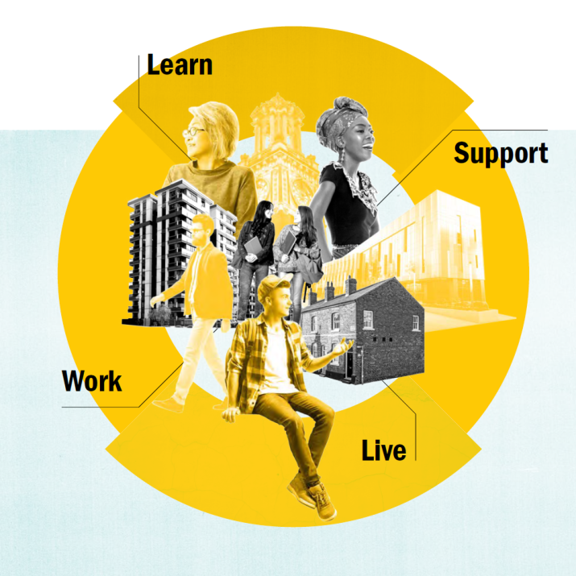
"A whole university approach recommends that all aspects of university life promote and support student and staff mental health. Good mental health enables learning, work and community. It is fundamental to the core mission of universities."
Universities UK
"In the context of the whole university approach, it [the library] represents an interesting case study"
Andrew Cox and Liz Brewster, 'Taking a ‘whole-university’ approach to student mental health: the contribution of academic libraries', 2022
Stepchange: Mentally Healthy Universities, by Universities UK

Slide 8
"The significant development of our Wellbeing offer has happened over the last 6 years. We obviously looked after our users before that, but for most staff, wellbeing would not have been something that they felt was part of their core role.
We began by responding to student feedback. They saw wellbeing as a key issue across the University. It was beginning to be a higher profile nationally and a lot of development work was being done by many institutions.
We also knew from our own service delivery experience/data that we were having many more requests for help from vulnerable and distressed students..."
Teresa Jordan, Head of Library Service Delivery, UoB Libraries and Learning Resources

Slide 9
What do we do now at UoB Libraries and Learning Resources?
Soft Interventions
Wellbeing Spaces
Wellbeing champions
Activities and themed events and displays

Slide 10
Soft Interventions:
Our soft inventions are a tried and tested system that involves engaging with the person to identify their needs, signpost them to an appropriate service and then follow up with gentle check-up and alert staff in wellbeing services (if a student).
This is done with one goal in mind: to keep the person safe for now.
As a signposting service, we need to be able to give information out in a tactful and respectful manner, whilst also being cautious as to how a situation may develop. We also need to signpost to, and potentially act as, a service that can prevent, intervene and offer post-event support.

Slide 11
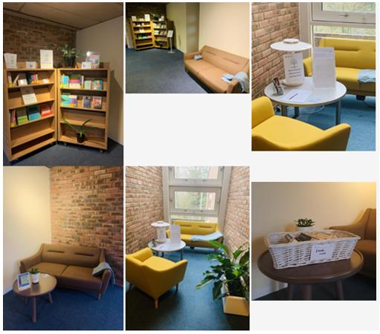
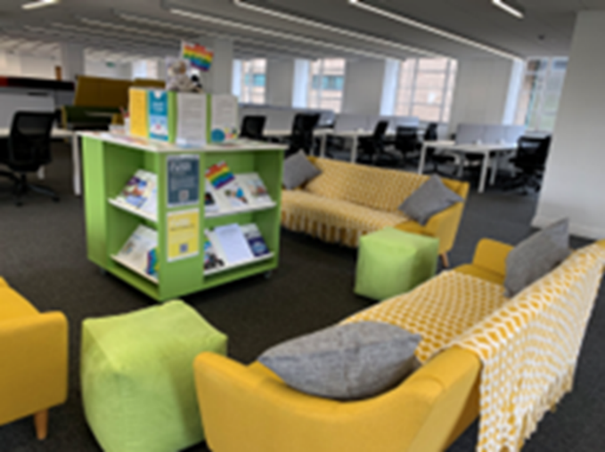
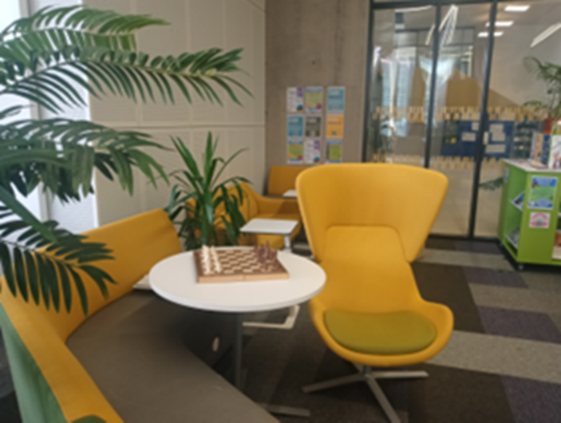
Wellbeing Spaces

Slide 12
Wellbeing Champions
"The role of the Wellbeing Champion is an informal, voluntary role within Library Customer Support. The purpose of this sub-group is to help further strengthen our wellbeing provision to support both users and colleagues in the library environment, but still ensuring we remain within the boundaries of support that we can offer as frontline staff. The role is also to help colleagues understand the need to make an appropriate referral during wellbeing interactions, and to help ensure colleagues do not take on more than they should when helping students."

Slide 13
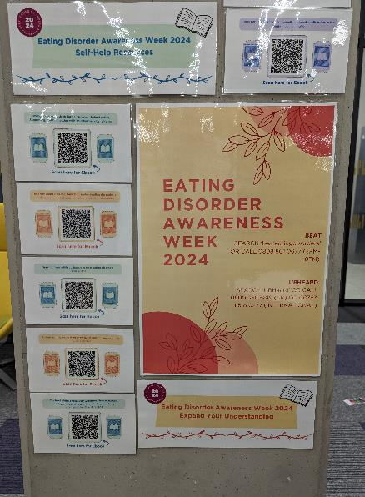
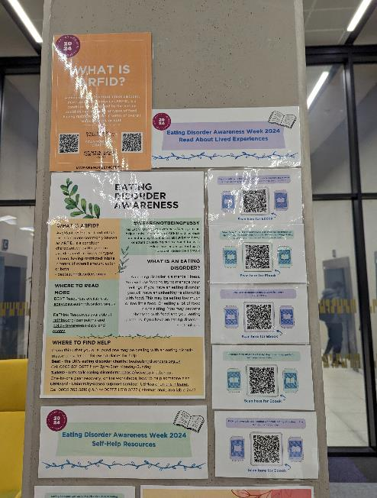
Activities and Themed Events + Displays

Slide 14
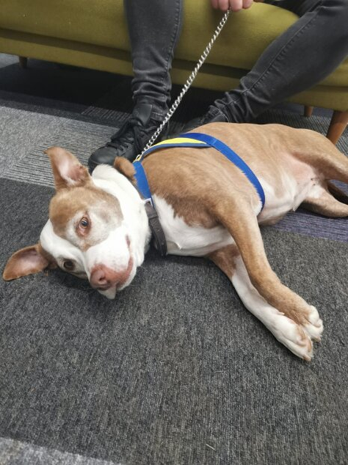
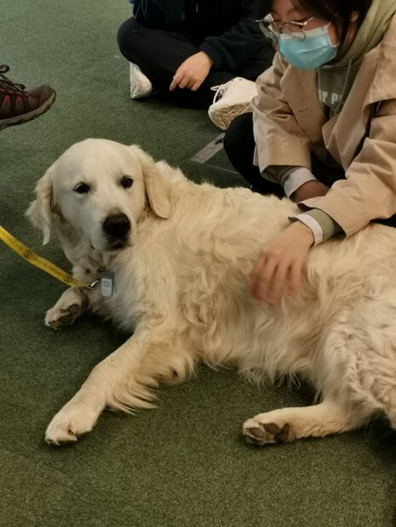

Slide 15
How do we keep ourselves safe?

Slide 16
What's next?
To continue listening to student voices, from undergraduates, postgraduates, distance learners and mature students
Advocate for staff initiatives to prioritize staff mental health and wellbeing
To maintain and improve our wellbeing spaces
To make sure we deliver an inclusive events calendar and displays

Slide 17
What are you going to do today to look after yourself?

Slide 19
Thank you.

