Slide 1
Delivering customer service workshops to library colleagues.
Gemma Price. University of Sussex Library.
Image- https://www.bizmanualz.com/wp-content/uploads/2009/04/customers-300x236.png
Notes:
My name’s Gemma Price, from the University of Sussex library. I’m here to tell you about customer service workshops that I devised and ran for colleagues across our library.
I’m going to tell you about why the workshops were run, what was covered and show you some of the slides I used in the workshops and about the ideas and comments that were raised by it.
We were happy for people to contribute to the session and give opinions about anything covered.
There will be a copy of these slides available online for you to look at afterwards.

Slide 2
Why did I run the customer service sessions?
Library management asked for a volunteer.
The broad theme of ‘customer service’.
The aim- to provide knowledge and raise discussions.
Around 50 members of staff have attended.
For staff from many different sections and grades.
Image- http://www.outsideinview.com/wp-content/uploads/2012/12/why3.jpg
Notes:
My colleague Douglass Broadbent-Yale joined this project and we came up with additional ideas and we ran these workshops together. Unfortunately he has since moved away.
The workshop theme of ‘customer service’ was broad and gave me scope to devise various work significant to all staff.
The aim was to provide knowledge and give an opportunity for staff to discuss our work practice. The ideas raised would then be collated.

Slide 3
Customer Service Excellence scheme
The University of Sussex Library participates in the Customer Service Excellence award scheme (C.S.E.).
The C.S.E. scheme’s aim- meeting criteria to prove you are customer centred.
Contact with staff in other University departments.
Focus on improvements and interactions with customers.
Notes:
The C.S.E. scheme’s aim is to show through your work, as individuals and as an institution as a whole, that you meet criteria to prove you are customer centred. For this award your organisation needs to show that you continually improve and that delivering services to your customers is at the focus of what you do.
What we do as a service is assessed by criteria and you submit evidence to show you have been compliant in different areas.
These customer service workshops were aimed primarily at staff development, but they also tied in well with C.S.E.
3) There has now been input with staff in other University departments, who want to focus on customer service and potentially participate in the C.S.E. scheme.
4) The workshops enabled people to think about what we do as a service & how they respond to people and situations as individuals. It showed willingness by people to explore how we can aid interactions and communication to improve the services we provide.

Slide 4
What was covered in the sessions?
Positive and negative customer service.
Their experiences as customers.
Dealing with commonly recurring problems.
Team work and wellbeing.
Discussing equality, inclusion and communication.
A quiz covering some of the topics from the session.
Image- https://thecustomboxesuk.files.wordpress.com/2017/09/shutterstock_326731535-e1506075017270.jpg
Notes:
The next few slides are some that were used in the workshop so you can see what we did.

Slide 5
Some of the slides from the sessions…
Image- https://cdn.pixabay.com/photo/2015/10/31/12/07/business-card-1015416_960_720.jpg

Slide 6
COMPLAINTS AND PROBLEMS
Activity:
Answer the following questions on Post-Its and stick them on the flipchart pages.
What types of complaints or queries do you currently deal with and how do you address them?
How can we improve the way we deal with problems and complaints?
How do you deal with issues that are not solely within Library control?
Image- http://2.bp.blogspot.com/-Ncs6ayK44dQ/TWVikSr1kvI/AAAAAAAABxo/Bx6-JIDiUe8/s1600/BLOGComments.jpg
Notes:
We discussed complaints and problems that arise within the library- and how we can improve the way we address them.
We reminded people to focus on ideas & solutions to problems too.
Issues that are not solely within Library control could include printers, Wi-Fi, temperature etc.
People wrote their own ideas, then walked around the room and added star stickers to ideas they agreed with or thought were important.
People knew the feedback would be shared amongst all attendees and management, but people could be open and honest as feedback would be anonymous.

Slide 7
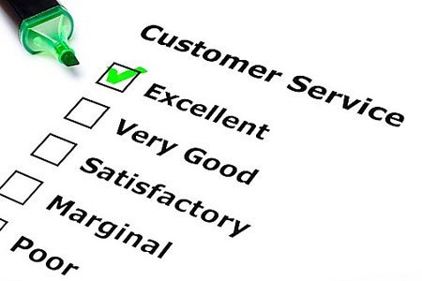
Your customer service experiences
Activity:
In pairs, think about positive and negative experiences you’ve had as customers.
What was your good experience?
How could the bad experience have been improved?
Image- https://i1.wp.com/www.tanveernaseer.com/wp-content/uploads/2016/12/Doing-regular-customer-service-performance-reviews.jpg?resize=450%2C300

Slide 8
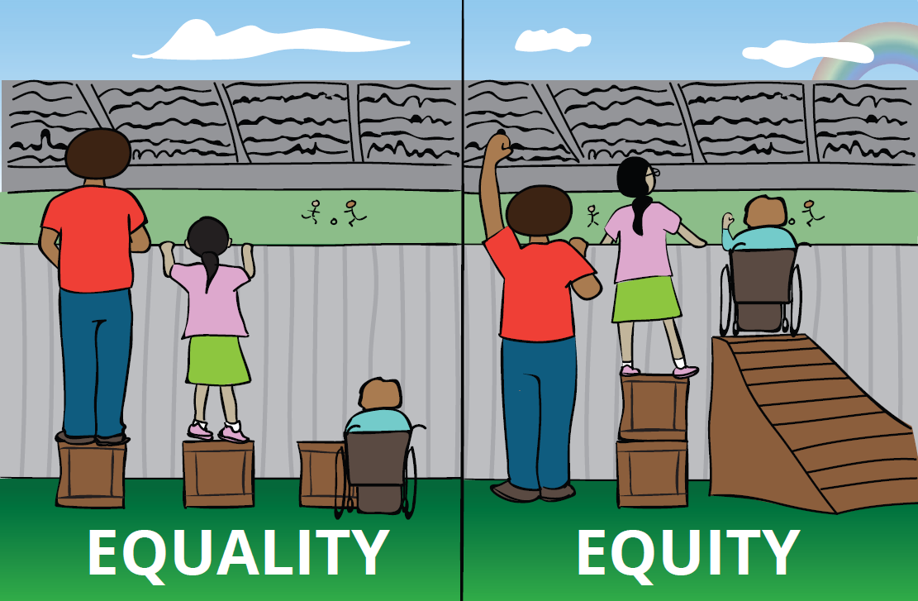
Inclusion - Overcoming barriers
Image- http://secondlineblog.org/wp-content/uploads/2016/11/Equity-vs-Equality.png
Notes:
The next slides show some of the work we did in the workshops, around inclusion and equality, to give you an awareness and overview of the topics covered.

Slide 9
Equality & Inclusion
Discussed making our service more inclusive.
Protected characteristics within the Equality Act.
We spoke about disability awareness, cultural awareness, deaf awareness and Autism Spectrum Conditions.
The importance of the same access and rights for all.
Image- https://www.igmena.org/images/scr_image13_1.png
Notes:
The next slides show some of the work we did in the workshops, around inclusion and equality, to give you an awareness and overview of the topics covered.

Slide 10
Equality.
All Library users and staff are individuals with different needs.
Don’t allow differences to be a barrier to equal treatment.
Pitching your communication to be inclusive.
Image- http://notenoughgood.com/wp-content/uploads/2011/05/disability-symbols.png
Notes:
All Library users and staff are individuals with different needs and ways of communicating.
It is about not allowing differences to be a barrier to equal treatment.
Pitching your communication to be as inclusive as possible will be beneficial to everyone and enable all users to engage with the service.

Slide 11
Inclusion.
Be clear and clarify understanding.
Write information down or show locations.
Go to quieter, clearer areas if needed.
Helps students who may not admit they do not understand.
Be flexible with your support and communication.
Doing this makes it an inclusive service to all people.
Image- https://c2.staticflickr.com/8/7352/9538877714_c643f5ab4a_z.jpg
Notes:
You could take people directly to places, or show them information step-by-step online.
Go to quieter more spacious areas if needed- useful if a person is lip reading, or has anxiety.
Not all students will say if they do not understand. -So it helps to offer to explain or demonstrate things.

Slide 12
Communication & disability awareness.
Disabilities may not always be visible or obvious.
Be clear and concise.
Explain and show how to do things clearly.
Be sensitive to individual needs.
Ensure the environment is accessible.
Try to avoid stereotyping.
Be flexible and adaptable.
Communicate in an area clear of distractions.
Image- https://yvonnechase.com/wp-content/uploads/2014/08/communicate.png

Slide 13
Autistic Spectrum Conditions (ASC)
People on the autistic spectrum are all individual.
Some things to be aware of though are:
Use clear specific language.
Don’t rely on body language.
Give warning about changes.
Offer a quieter area to talk.
Giving time to process information.
Information can be taken literally.
Don’t change topics too quickly.
Highly sensitive to sensory stimuli.
Notes:
People on the autistic spectrum are all different and will vary in how they communicate, behave and perceive things.
We do quiet routes tours, led by the membership team in the Library. These are for current students with autism, or anxiety or other conditions where being in a loud and busy environment is uncomfortable. We show them a walking route in the Library where they can use quieter enclosed staircases and walk through silent study areas, to pass through areas with minimal people and noise.

Slide 14
Deaf awareness
Hearing loss is not always obvious.
Deaf or hard-of-hearing people will often be lip-reading.
Be aware lip-patterns made without sound can look very similar!
Keep spoken and written language clear.
Offer to write information down.
If they don’t understand - re-phrase what you say.
Be aware of backgrounds, lighting and noise.
Image- https://upload.wikimedia.org/wikipedia/commons/thumb/a/af/Deafness_and_hard_of_hearing_symbol.png/300px-Deafness_and_hard_of_hearing_symbol.png
Notes:
Part of my work background is British Sign language and communication support work.
Hearing loss is not always obvious and a person may not let you know and may be lip-reading.
Try and communicate face-to-face and look at people and clarify they have understood.
British Sign Language has different grammar.
Keep spoken and written language simple and clear – this also good for students with dyslexia or English as a second language.

Slide 15
British Sign Language
Some Deaf people use British Sign Language (B.S.L.).
Remember- speak to the person, not their interpreter.
It is a rich and diverse language and culture.
There are regional variations in signs.
Your facial expressions and body language change meanings.
Many places you can learn B.S.L., ideally from a Deaf person.
Image- http://upload.wikimedia.org/wikipedia/commons/a/a4/Sign_Language_Interpretation_1.JPG
Notes:
You can express different time frames and periods. The past, present and future can all be conveyed through the location used on your body. For example the past is behind you and the future is in front of you.
There are many places you can learn B.S.L., ideally from a Deaf person. There is one link on the references page, to find places to learn in your area.

Slide 16
Notes:
Fingerspelling is used for spelling out the alphabet.
It is mostly used for nouns- e.g. people’s names or places.
Letters are spelt out using your fingers.
The vowels are pointing to the tip of each individual finger.
Left or right hand.
-Your dominant hand leads in B.S.L., including with fingerspelling.
Image- https://www.british-sign.co.uk/fingerspelling-alphabet-charts/

Slide 17
Staff wellbeing
Looking at customer service is also about how we interact and look after ourselves.
This is something that is being explored within our Library.
Some ideas for maintaining wellbeing at work include:
Mindfulness
Taking screen breaks & stretches
Talking with colleagues
Going out for a walk
Remembering some problems are out of our control
Image- https://libraryheatherdotcom.files.wordpress.com/2018/11/28863045_s-e1541700884846.jpg?w=636
Notes:
If we are comfortable and confident then we can give excellent customer service to all library users – stress makes many difficult situations worse.
There have been events set up or promoted within the University of Sussex Library for staff and their wellbeing. These include: MIND’s time to talk day, lunchtime walks and mindfulness sessions for staff during the University Wellbeing week.

Slide 18
Feedback
Feedback gathered through: post-its, flipcharts and forms.
Collated and sent to attendees and senior management.
Many people said they really enjoyed:
Talking to staff from different sections.
Learning new information informally, from a colleague.
A better awareness of disabilities and communication.
Image- https://educationalaspirations.files.wordpress.com/2015/01/feedback-01.png?w=300&h=229

Slide 19
Outcomes- what were the benefits?
Positive interactions and conversations amongst a variety of staff.
Being able to collate many ideas and views from a breadth of people.
Opportunity for staff input on working practices and making potential improvements.
Staff said they felt more aware of how they interact with others.
Image- http://www.thebluediamondgallery.com/handwriting/images/benefits.jpg

Slide 20
Useful references
University of Sussex Organisational Development courses https://www.sussex.ac.uk/organisational-development/courses
Disability Awareness
Bridging the Gap with Our Chinese Students
Enhancing our Intercultural Competence
Finding Balance – In the Mind-set- Part 1. Finding Balance - In the Mind, Body and Emotions- Part 2.
http://www.sussex.ac.uk/wellbeing/
https://www.equalityhumanrights.com/en/equality-act/protected-characteristics
https://www.signature.org.uk/where-can-i-learn British Sign Language courses
https://www.customerservicemanager.com/leap-to-solve-customer-issues/
Academic article on feelings of Chinese Students in UK Universities
Wang, Isobel Kai-Hui (2018) Long-Term Chinese Students’ Transitional Experiences in UK Higher Education: A Particular Focus on their Academic Adjustment. International Journal of Teaching and Learning in Higher Education. 30(1), pp.12-25.

Slide 21
Any questions?
g.h.price@sussex.ac.uk
Image- https://cdn.pixabay.com/photo/2016/06/01/00/57/thank-you-1428147_960_720.png
Notes:
I have been asked to do more of these workshops to colleagues and it may be rolled out further.
It went down really well with attendees and managers and I personally found it worthwhile and enjoyable.
I’d recommend doing these kind of workshops in your own places of work.
If there are people from other institutions doing something similar or are interested in this, it would be great to be in contact and liaise with you.
Thanks very much for listening.

