Slide 1
The World Turned Upside Down
Rethinking Our Service
Nick Barratt
Director, Learner and Discovery Services
The Open University

Slide 2
About the OU
Since its foundation in 1969, the Open University has transformed the lives of millions through its social mission. We currently support over 170,000 students across all four nations.
Behind its success lies half a century of pedagogic excellence in distance learning, represented by the Institute of Educational Technology.
Learner and Discovery Services support the University’s faculties deliver high quality learning at scale across all curriculum areas.
At the heart of this knowledge ecosystem sits the Open University Library

Slide 3
‘Supporting student success’
Delivering a world class innovative Library to the whole OU community and beyond

Slide 4
INTEGRATED SERVICES
Delivering a world class innovative Library to the whole OU Community and beyond.
Digital Capabilities
Library Research Support
Enquiries
Engagement
Library Services
Digital Archives
Content Licensing & Intellectual
Property
Subject Specialist Librarians

Slide 5
LIBRARY SERVICES FOR THE WHOLE COMMUNITY
A few examples of how Library Services impacts different audiences.
Skills provision
Teaching support
High quality content
Associate Lecturers
Students
24/7 web chat
Tutorials
High quality content
Learning design
Research support incl. OA & REF
High quality content
Academic
Staff
Library Services
Skills development
High quality content
Open Access
Workspace
Open space
Open resources
Helpful staff
General Public
Researchers
Professional
Staff
Culture of partnership
Skills development
Event and meeting space

Slide 6
SPECIALIST EXPERTISE
‘The most valuable asset exits the University every night’
Knowledge Management
Archiving, Preservation and Reuse
Information Management and Metadata
Accessibility
Curation and Discoverability
Intellectual Property
Copyright
License Negotiation
Learning Design
Digital Capabilities
Teaching and Training
Open Access
Research Support
User Insight
Access & Authentication
Information Systems
Knowledge Sharing
Digital Development and Design
Data Storage and Analytics
Real time Support

Slide 7
THE ONLINE LIBRARY
Showcasing the University Library to the whole world.
Library Websites
Content
Skills
Support
Overview of library content available to anyone.
Open Access research available to all.
Access to licenced content (e.g. eBooks) for Students and Staff.
Digital Archive
Digital Capabilities
Information Literacy
Live online training
Video resources
New student induction
24/7 Webchat
Help and Support articles
Specialist accessibility support
Document conversion
Research support
Every 6 seconds an OU student or staff member download a book chapter or journal article. That’s over 5 million downloads a year!

Slide 8
UNIVERSITY GENERATED CONTENT
Management of strategically valuable OU Assets.
OU created research and research data
The Open University Archive
Student generated research
Open Educational Resources
Digital Assets
Scholarship
Over 5,000 OU authored research papers are downloaded from Open Research Online every single day

Slide 9
LICENSED AND OPEN ACCESS CONTENT
Management of trusted, quality resources.
Appropriate content for students, academics and researchers is selected, licensed, delivered (via external websites and/or the Virtual Learning Environment) and managed by experts within Library Services, in liaison with Faculty.
Books
Journals
Articles
Databases
AudioVisual
Number of items by type

Slide 10
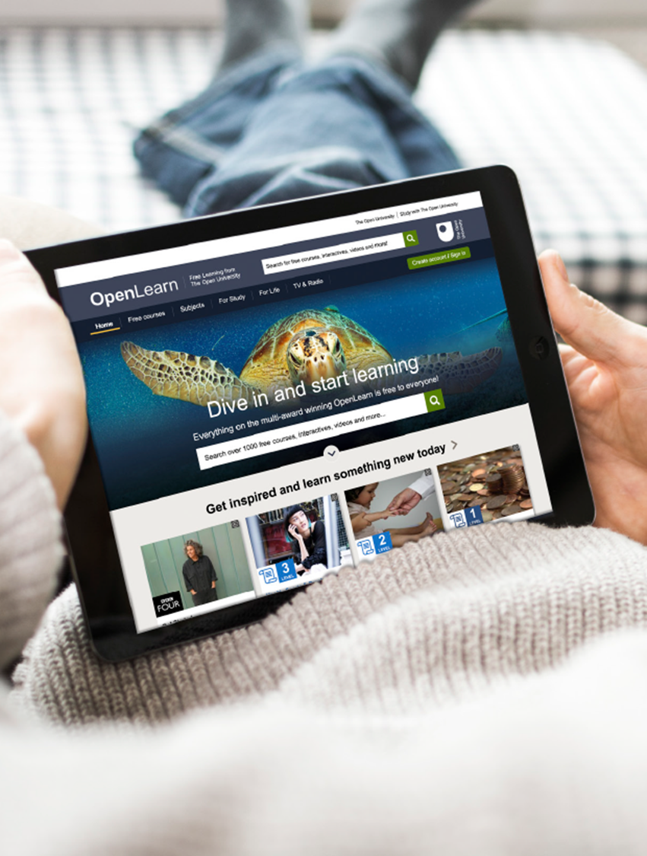
Then came Covid…
Face to face tutorials and assessments ended
Limited telephony support
Increased digital poverty
Concerns over wellbeing and mental health – how do we support vulnerable students?

Slide 11
What we did in LDS
Already working on a new operating model, within a new strategic framework...
Our People & Culture group led the way, helping us prepare ourselves for lockdown
Our Service & Support group refocused on how we deliver services differently
Our Recovery Group enabled a partial return to campus by 1 June, the first part of the OU to do so
We joined various Emergency Management groups, which brought us into closer proximity with the mainstream academic life of the OU – highlighting the value of LDS and the Library, and our services.

Slide 12
‘Learning and Teaching Reimagined’ A blueprint for a new service model

Slide 14
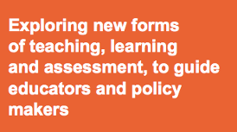
INNOVATING PEDAGOGY
The innovations described in this report are not technologies looking for an application in formal education. They are new ways of teaching, learning and assessment. If they are to succeed, they need to complement formal education, rather than trying to replace it.
http://www.open.ac.uk/blogs/innovating/

Slide 15
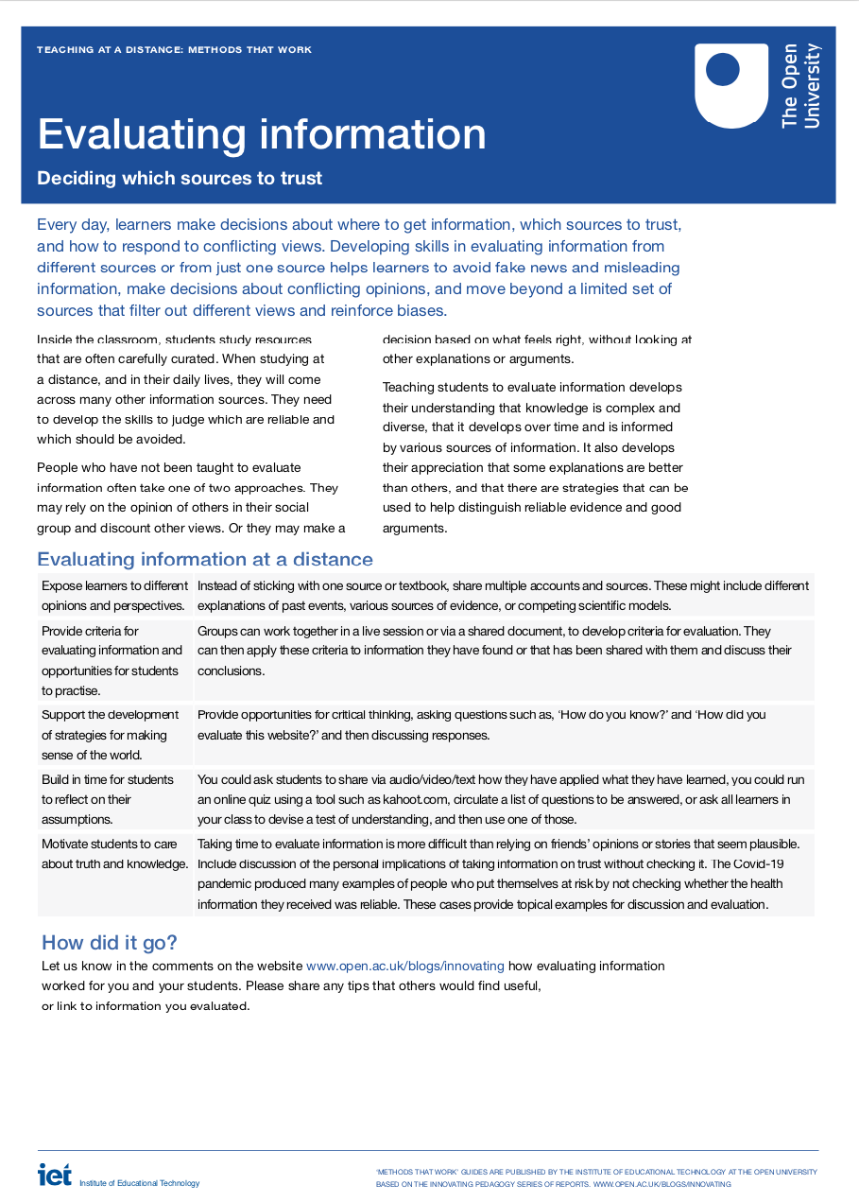
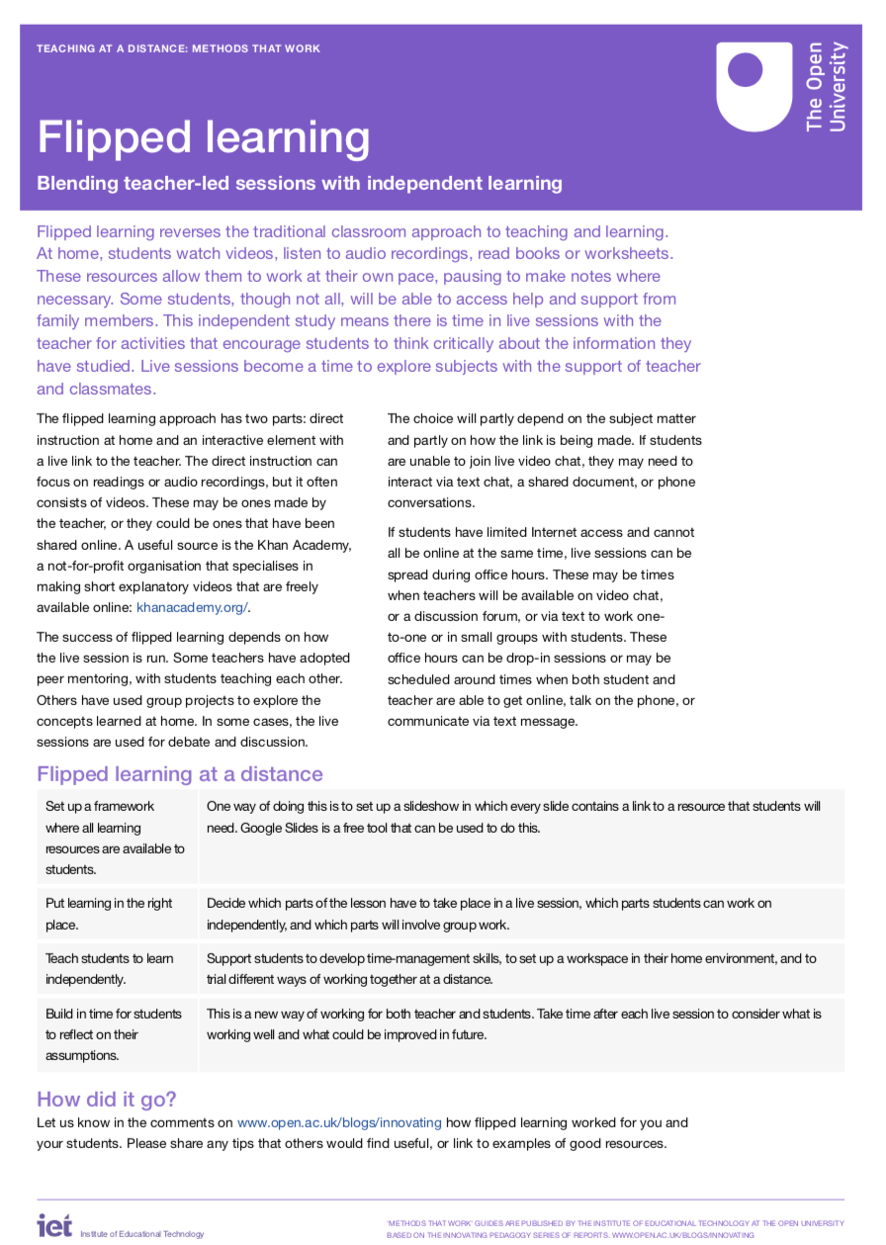
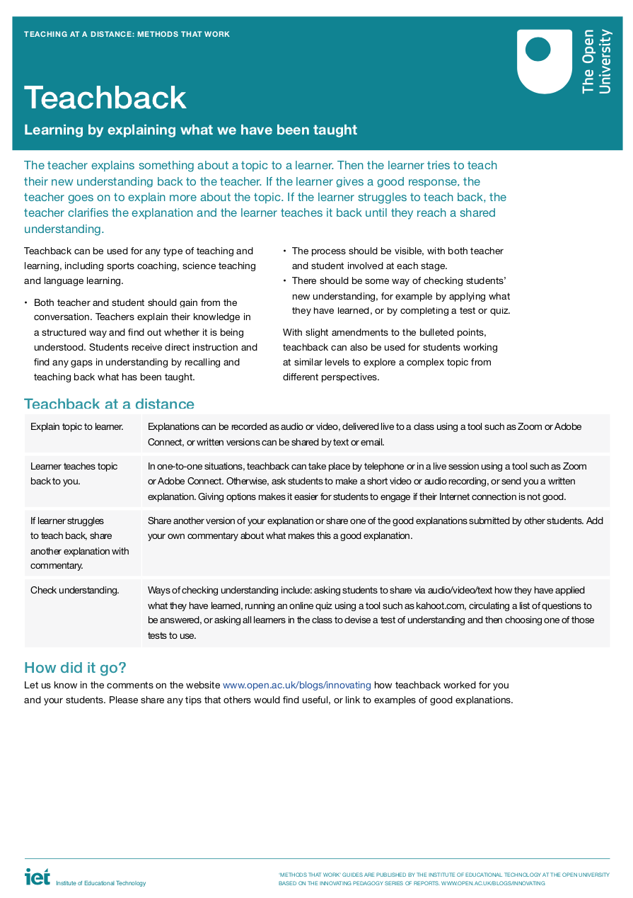
METHODS THAT WORK
Flipped learning
Teachback
Seamless learning
Learning to learn
Evaluating information
Making thinking visible
Personal inquiry learning
Science in remote labs
MOOCs to support language learning
Maker culture
http://www.open.ac.uk/blogs/innovating/

Slide 16
What next?
Redesigning Production
Knowledge & Information Management
A service redesign?
Lessons learned…

Slide 17
Do you have any questions?
nick.barratt@open.ac.uk

