Slide 1
Blended Working: IS Enquiries Team at Strathclyde
Elaine Borland
Briony Willis
YOUR
LIBRARY
YOUR
LEARNING...
Notes:
Hello everyone,
So, my name is Elaine Borland and I am the Information Services Enquiries Supervisor based in the library at the University of Strathclyde. Briony Willis and I would like to share our experiences on how the Information Services team of 10 have managed to adapt to our blended way of working. I should mention here that we are a converged service -- answering both Library and IT enquiries received by phone, email, and face to face.

Slide 2
Blended working
Dates determined by the Scottish Government
March 2020
Library closed – remote enquiry service only
August 2020
Library opened – on campus and remote enquiry service
January 2021
Library remained open – remote enquiry service only

Slide 3
Library closed: Remote working
March 2020
We each left the Library with a laptop. We had Skype for Business set up with a dedicated number for our telephone enquiries
We assumed that we would communicate with each other via email.
We had no experience of using Teams or Zoom, and only a few staff had experience using Skype
Notes:
On our first day we had a rota agreed, and we started responding to emails and phone calls - without any discussion really, we all started using WhatsApp to ask each other for advice or 2nd opinions. We started to use Zoom for staff meetings, training, and screen sharing, and then the University rolled out Teams. We did some training and looked at how we could use Teams but it wasn’t until August 2020 that we moved from WhatsApp to Teams, allowing the staff on campus to communicate with us while they were working on the enquiry desk PCs.

Slide 4
Library open with an enquiry service on campus: Blended working!
August 2020
Two members of the team on campus each day offering an enquiry service from 10:00 -16:00. The rest of the team continued to work remotely, responding to phone and email enquiries from 09:00-17:00
Practical issues could be dealt with on campus
Keeping up to speed with changes to services and the physical environment
Safety on campus.
Notes:
Practical issues could be dealt with e.g. help with discussion rooms – so that could be resetting a keypad or helping with the equipment in the rooms. We could help with printing issues – it’s hard to try and help someone with a printing issue when they were at the other end of a phone. Staff working remotely could ask a member of staff on campus to check e.g. a self-issue kiosk after we received an email from a student who was unable to issue their books at the kiosk. We could ask a student who was having problems with a laptop to come in and see a member of staff e.g. help to install software, or if they were experiencing Wi-Fi problems.
Keeping up to speed with changes - e.g. a had a new Click and collect service, changes to borrowing rules, updates to our standard operating procedures. We also had changes to the physical environment. - Spacing and the way both staff and students moved around the library.
Safety –on campus. All of the team have felt safe on campus, we have all the correct equipment, so we have Perspex screens, masks, hand sanitiser etc. Also, management continue to make regular patrols to ensure students were following the COVID rules.

Slide 5
Library open but no enquiry service on campus: remote working
January 2021
Remote enquiry service and working closely with our Library Operational Assistants (attendants) on campus
Notes:
And then in January 2021 we had another change – this time the library was open, but we had no enquiry service on campus.
Challenges – we had to work with the LOAs, so that could be asking them to fill printers with paper, check for paper jams, help with discussion room keypads and check the payment keypads on the self-issue machines, as we have a legal compliance to check these daily. The LOAs had to have some training, and we had to be mindful that we were asking them to do tasks that we were normally responsible for. It might be that a student phones us as they have a problem with their word document, and we can’t say just come up to the enquiry desk in the library and we will help you.
Communication with the LOAs
Students can phone us to report that equipment in library isn’t working, or that they have been working on a PC and it has crashed…. these types of enquiries are hard to deal with remotely, and you also have to be able to communicate some these problems to the LOAs and ask them to make checks and gather details before you can respond.
Sometimes an immediate response is needed, and we need to phone, or Skype the LOAs– this could be because someone has called who is standing outside a discussion room and can’t get it, and we have actually call from a student who couldn’t get out of a room ….and that was worrying for both the student and the member of staff who was sitting in their dining room!
Looking ahead – we will to continue to be adaptable and agile as we move out of lockdown and into the different tiers and we will be working together to help all our customers. (students expectations?)

Slide 6
Training
FreshService
Teams
Comm cells
Windows virtual desktop
Training week
CSE retained accreditation
This Photo by Unknown Author is licensed under CC BY-SA
Notes:
Throughout this time new services and new ways of working have been introduced and we have had to undertake training to help us deliver these.
Examples include the introduction of a completely new enquiry logging software called Fresh Service . This month we have also launched Fresh Chat which allows our customers to get in touch instantly with us and ask us questions.
Using teams as our main communication tool to each other in the IS Enquiry Team. We’ve uploaded all our useful resources that we might have at one time around us on our desks onto teams for easy access
Both staff and students are encouraged to use the windows virtual desktop to access software- the virtual desktop was installed on all library pcs and we had to produce troubleshooting guidance for our users and get used to accessing software in a different way
We’ve attended am online training week where we met up with other library colleagues outwith our team and learnt what they had been doing
We have attended training from an external provider on” getting the best from working from home” and managing student behaviour- lots of money in training budget as no one going anywhere for training and conferences!
In November we went through our CSE review online and we retained our accreditation and received more compliance pluses for CSE

Slide 7
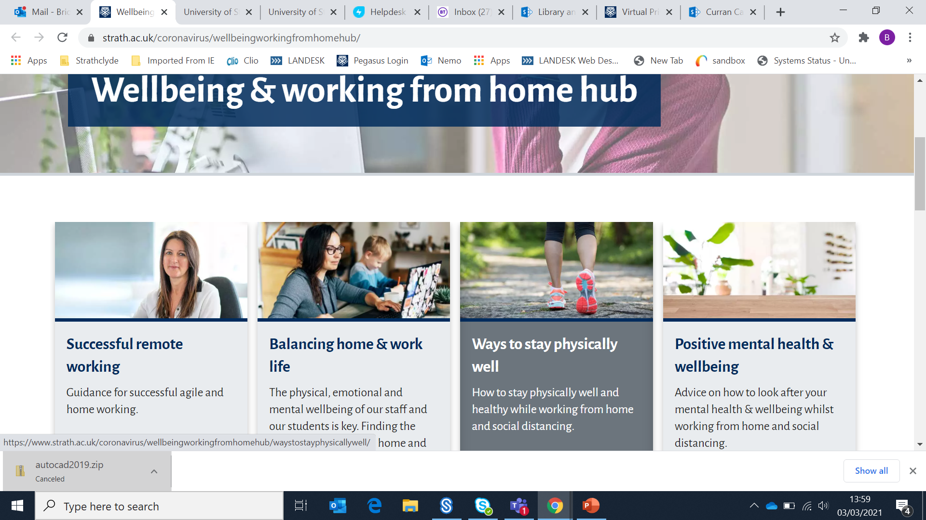
Staff wellbeing
Rest days/Wellbeing and working from home hub
Rota that includes breaks
Next day coffee mornings to check how being on campus was for everyone
Accommodating childcare issues, home schooling, caring responsibilities
Flexibility – we all have an understanding of our colleagues working environment and personal circumstances
Notes:
I have to say we feel quite lucky at Strathclyde- principal awarded us one rest day a week,We also have access to a wellbeing and working from home hub
we have a set rota that allows for breaks from screen and lunches
When we first moved back on campus we had online coffee mornings with whoever was on campus that day to make sure they were ok!
Safety on campus had changed when we went back – more Perspex screens , PPE , hand sanitisers etc
We’re all juggling –between us in the team we have a variety of kids at different ages, dogs at different ages, elderly parents to shop for. We were a close team before but have become closer and more supportive.

Slide 8
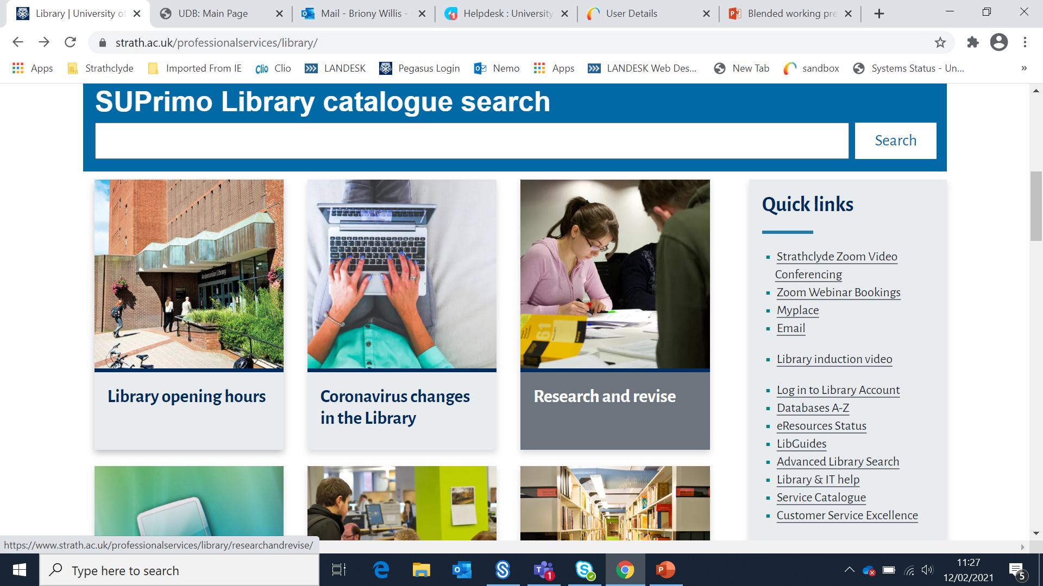
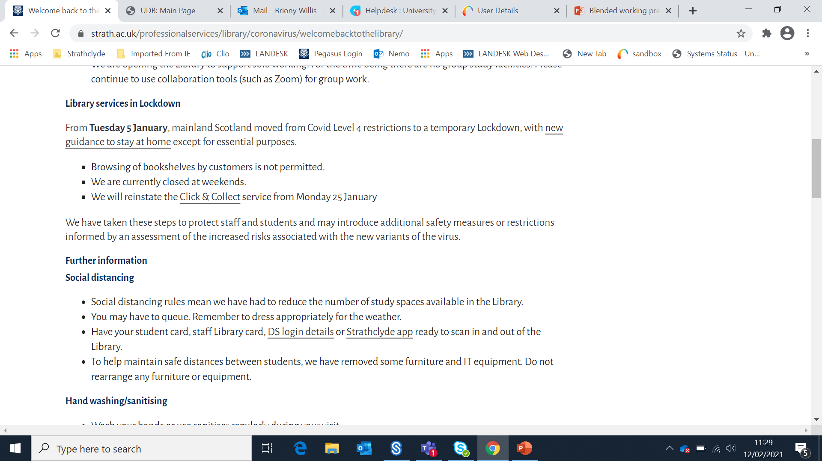
Communicating to our customers
Twitter
Library webpages
Notes:
Like everyone we have had to deal with changes in our services happening sometimes at very short notice. We’ve predominately used twitter and our library webpages to inform customers.

Slide 9
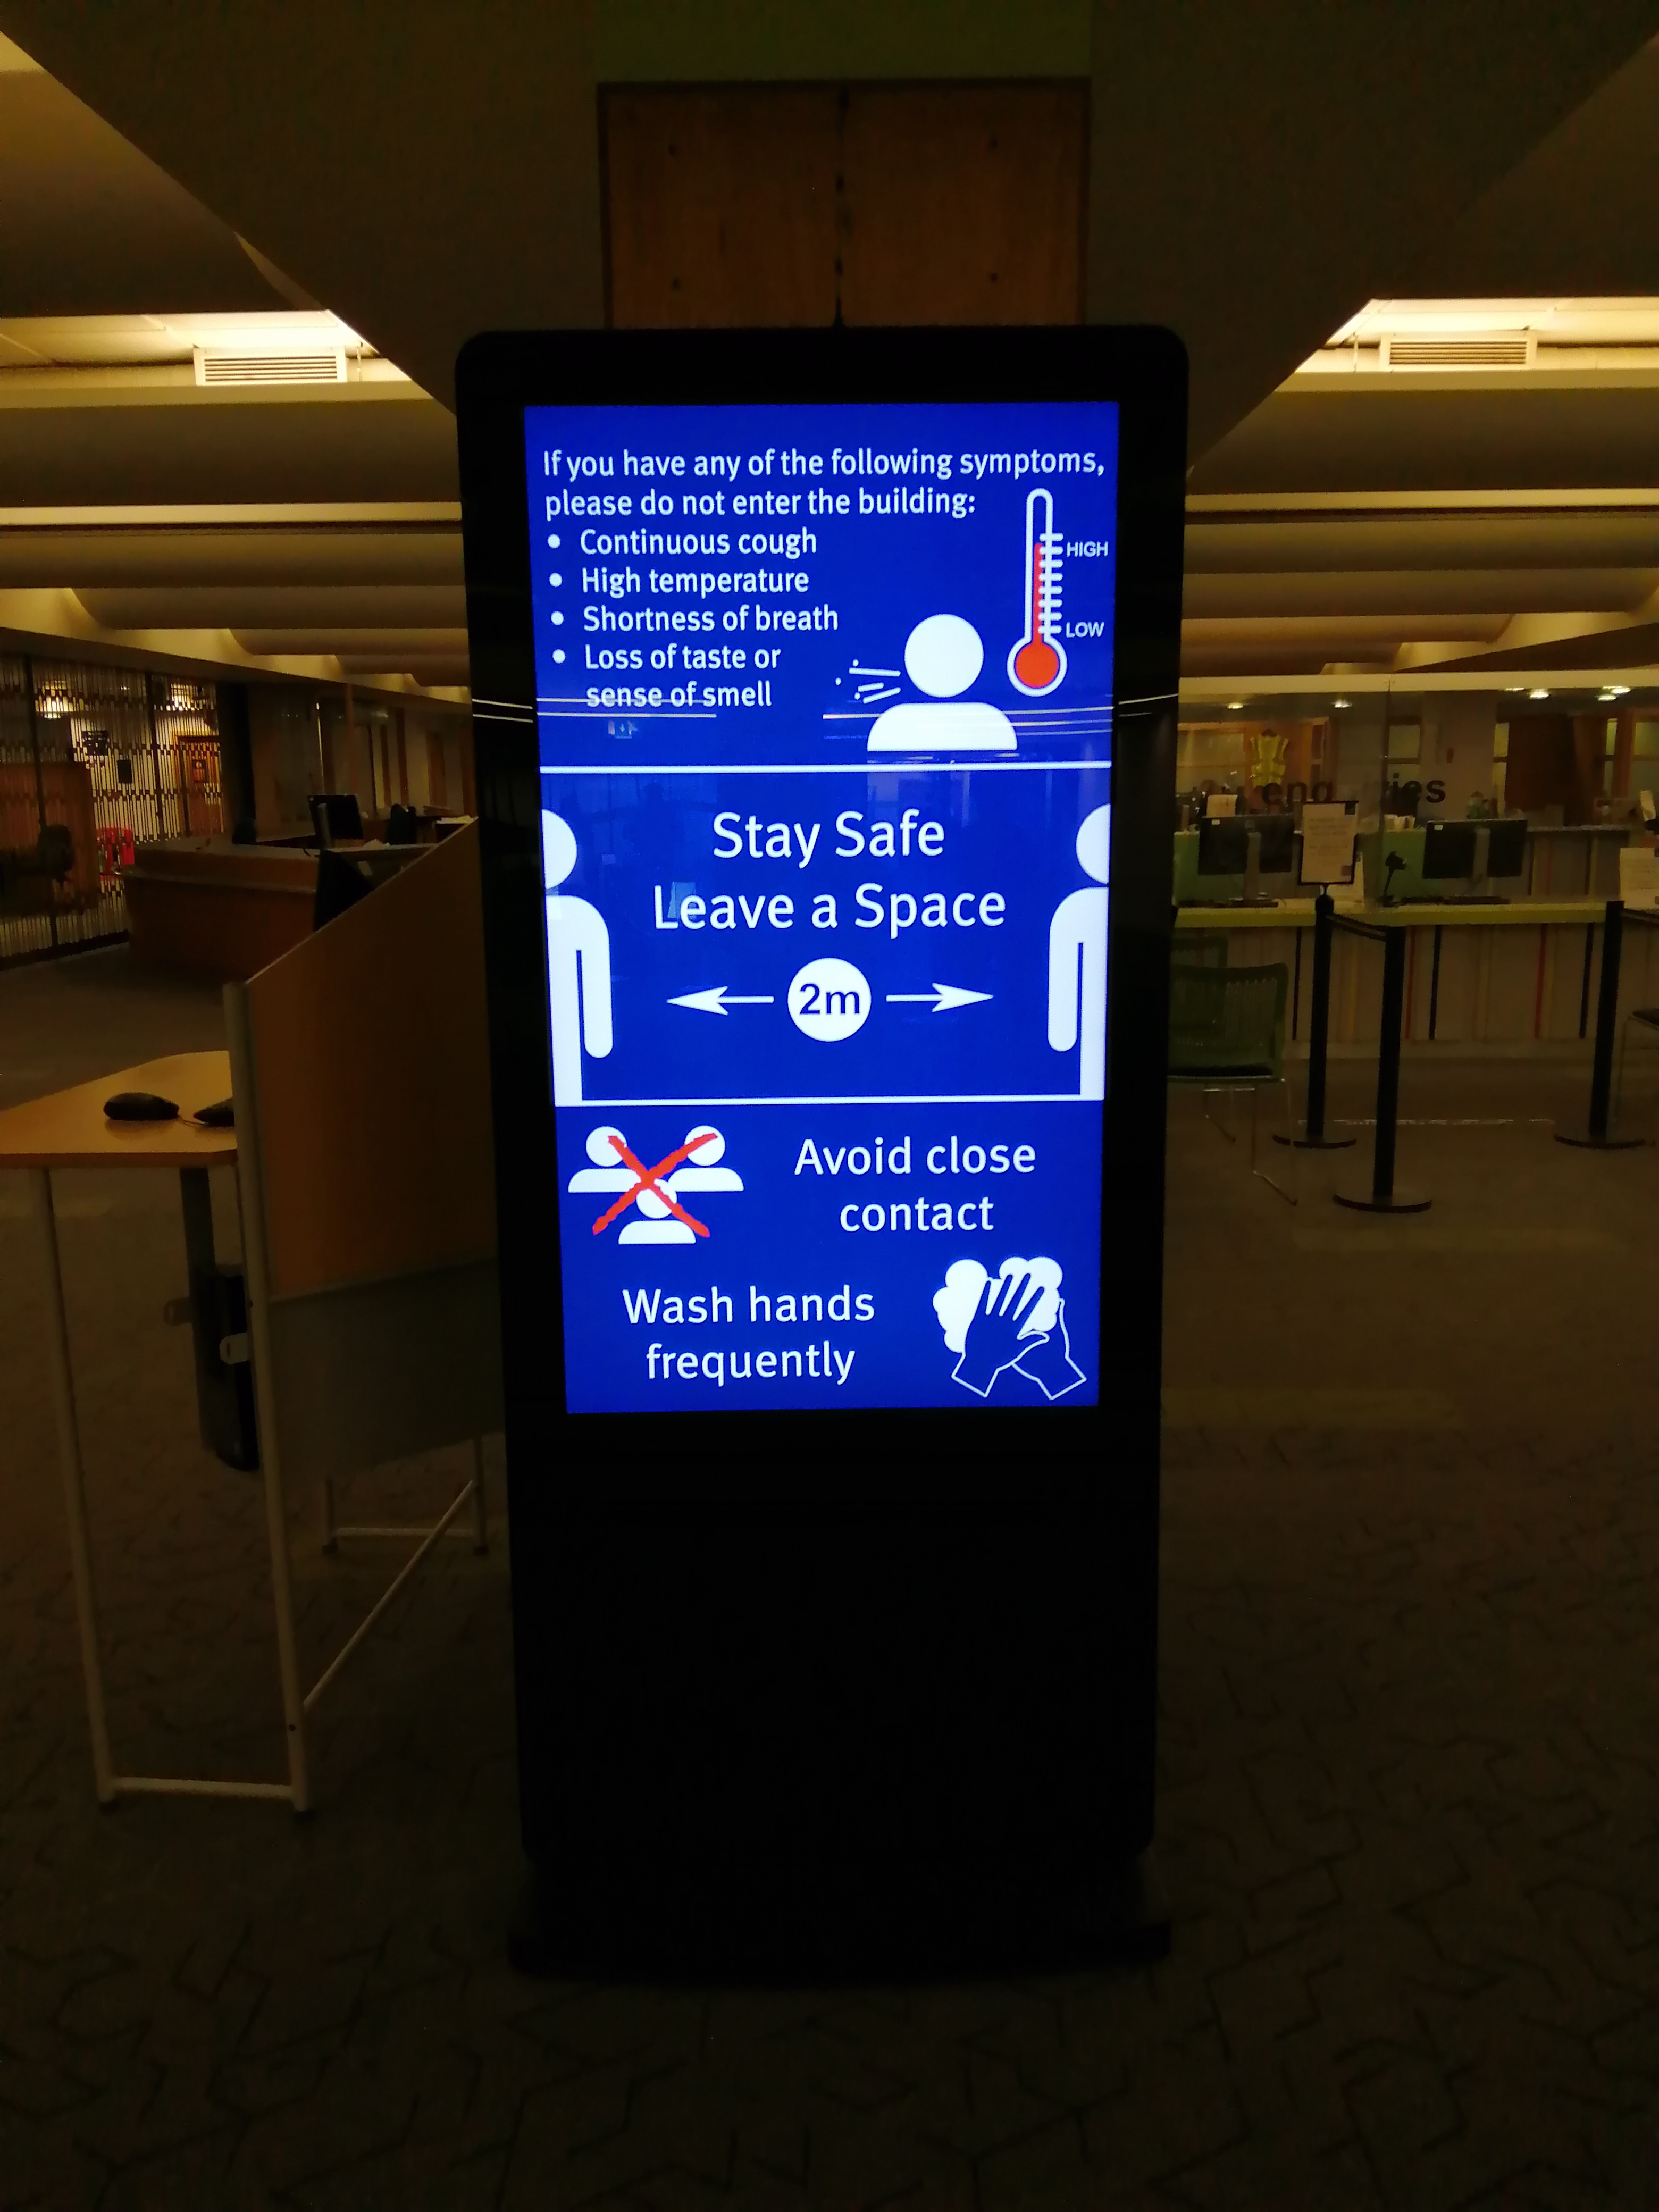
Notes:
Onsite we use the totems in the library to remind students and staff of rules and

Slide 10
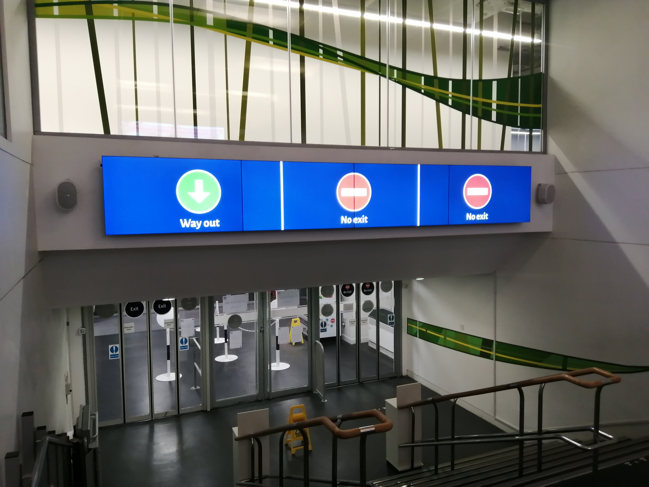
Notes:
And also how to move around the library

Slide 11
Positives and Challenges of Blended working
Staff happy to leave the house and see “ real” students and staff
Get to fix practical problems, change signage etc
Makes you still feel connected to the library
Made team stronger- support wise and enquiry answering wise
Less staff to cover working from home rota
Doesn’t work for staff who have to home school kids
Hard to help students on site with practical issues when you’re off site
Technical challenges
Notes:
I’ll start with the challenges first as always good to end on a high!
So when staff started going on campus that leaves less staff to answer emails and phoens from home
Going back on campus coincided just about with the schools going back so wasn’t that hard to manage in that respect but being at home has been difficult with kids around
At the moment we’re in the slightly odd situation where students can be in the library building but there are no staff there and so if they phone with an issue re printing for example its quite difficult when youre at home to talk them through
We’ve had technical challenges from time to time- internet provider at home being rubbish . We also wanted staff on campus to be able to attend any meetings that were happening remotely when they could so used one of the offices as a room staff could go to
There are lots of benefits to blended working for me. I love being on campus and seeing students again. Its great to be able to fix any practical issues when you’re there- changing signage, rebooting machines, counting paper stocks
I think as a team we have all become so much more mindful of each other- we are more communicative and more supportive . Our problem solving skills have increased as we have had to think on our feet so many times .
I asked my colleagues in my team what they thought of blended working and reactions were split down the middle. Half the team were happy to go back on campus full time as they really missed the face to face interaction with students and other staff . The other half felt that by having days at home where they didn’t have to commute and could do wee jobs around the house at lunchtimes was beneficial to their wellbeing and the daily balance of their working lives.
The reality is that we are a small team that run a very busy service when on campus and so it might be hard to offer staff maby working from home days.

