Slide 1
Meeting Increasing User Expectations
with no additional budget
Image: pixabay
Alison Craig & David Moore | @HullUni_Library | #CSGUK18 | 26/11/18

Slide 2
The case for change
A developing building, new leaders, developing teams and higher expectations
Image: pixabay
Notes:
The Library Redevelopment: £30million pound investment placed in the building to establish the library at the heart of the university, our flagship building
New Team management team established from non library backgrounds, to deliver new ideas and ways of working and ultimately an outstanding customer experience.
Meeting the University expectation: Placing students at the heart of what we do – creating a transformative student experience.
The existing library assistant team was not ready: not only the redeveloped building would demand but the increasing demands of students in a competitive marketplace, including 24/7 opening and plans to relocate accommodation currently off site onto the main campus.
Preparing Staff mind-set from moving from old library through difficulties of working through the redeployment to engaging with the new building and new ways of working

Slide 3
The start of our journey
Business need, recruitment, working patterns and contract changes
Image: pixabay
Notes:
Embed a new 5/7 contract to form the basis of all future recruitment.
5/7: Prior to 2015 all staff had either been recruitment on contracts that were predominantly Monday – Friday with limited scope for weekend work, crucially this had not been used to full extent which had formed Custom and Practice Monday to Friday working and would require consultation just to maximise the existing contract. A separate pool of weekend staff supported the team through Saturday and Sundays although there was a clear knowledge, communication and operational issue with this set up. (Part of the Team)
Coming from a retail background and having working on a 5/7 basis for nearly 20 years there was a clear need for this type of contract to match how we needed to staff the library moving forwards.
NEW 2015 for all future recruitment: Hours of work in the Library vary according to the requirements of the Library service, Customer Service staff hours fall between 0800 and 2000 from Monday to Friday and Saturday/Sunday between 0900 and 1730
It should be recognised this unintentionally created a divide in the team which did cause conflict, original contract members v 5/7, 5/7 feeling they were the only flexible team members and having resentment of ‘unsupporting’ colleagues.
It was only following this key step in creating a new contract that we could start to think about the future of the rest of our team on their old contracts and how we deliver against the strategic priorities set for the library.
Empowering our people – placing students at the heart of what we do – creating a transformative student experience
Delivering an outstanding customer experience in the Brynmor Jones Library
Ensuring a sustainable future
These were three of the key drivers to inform what we had to do next.
Deliver efficiencies through new ways of working by deploying staff in a different way, no money!
One team that is equitable and flexible to meet the business needs

Slide 4
Consultation & engagement
...and trade union recruitment
Briefing - d0ppler https://www.flickr.com/photos/d0ppler/2572684236/
https://creativecommons.org/licenses/by-nc/2.0/
Notes:
The Trade Unions Met with the Trade Unions to discuss in detail the steps being proposed by the library at the start of our journey. This was welcomed by the Trade Unions to be involved at the very start of the process, it was recognised this could be a long road ahead but at least formed a basis for future discussions.
Commence with a Development Phase to inform the full team of changes suggested, the reasons for change and invite alternative ideas and solutions.
Expand the pool of staff who are available to work on both days at weekends from 11 to 34, creating a team working on a common basis.
Deliver better, more consistent customer service throughout the week, aligning this with the quality of the refurbished building.
Provide full Library service to students across weekends instead of using security staff.
Accommodation developments on campus are anticipated to increase footfall in the Library across the week, and particularly evenings and weekends.
Provide adaptability to meet changing and emerging University requirements.
To deliver one library assistant team with one central contract wording.
To fully align the contract wording to reflect the staffed hours of the library.
Proposals made
A proposal was suggested that all staff could work on a 5 over 7 contract, this was to inform the development phase
A proposal from non 5 over 7 staff was suggested to work 1 in 6 weekend days, with no change to their contracts
A proposal derived from feedback during the development phase.
Feedback Channels
Over 2/3rds of the team had joined a trade union by this time, while this provided challenges it did assist with providing one clear voice on behalf of members
Continue with staff meetings as normal through a difficult time for all
Deliver workshops with an external staff member from the process to allow critique of proposals and inform new ideas.
Confidential HR contact for staff to feedback anonymously
Individual 121’s, while some were keen to engage there were challenges and working on an agreed 121 format with TU colleagues to break deadlock of TU members not wishing to engage.
A full detailed staff survey of preferred working patterns recognising the different suggests made. This was critical to informing the end solution.

Slide 5
Taking the Final steps
Consultation, close TU joint working and disputes
Image: pixabay
Notes:
Consultation Meetings
Through out the process we maintained regular consultation meetings with all trade unions and HR representatives, these were both challenging but informative but allowed progress when some staff relations were strained.
Disputes
We had two official disputes during the process but these were handled respectfully by Trade Union colleagues and Library Management and no strike or disruptive measures were taken.
TU Working
As we moved towards the final meetings we had reached a position were the need to change was recognised by all parties, and there was ability in the team to work in rotational patterns . A big part of this was the full staff survey jointly conducted by library management and TU representatives, this gave clarity to issues and also showed staff who were willing to be more flexible now the need for change had been proved.
Several working rotations had been worked through, a large part of David life had been consumed with this!
Incentives
A contractual payment to cover Sunday lost earnings assisted in the delivery of a new contract wording that allowed Saturday and Sunday working to be available to all members of the library assistant team.
How we look today.
We now have a full team of 40 library assistants available to work on all 7 days of the week on a rotational basis.
All costs incurred have been negated by savings made on security coverage due to enhance evening & weekend staffing levels

Slide 6
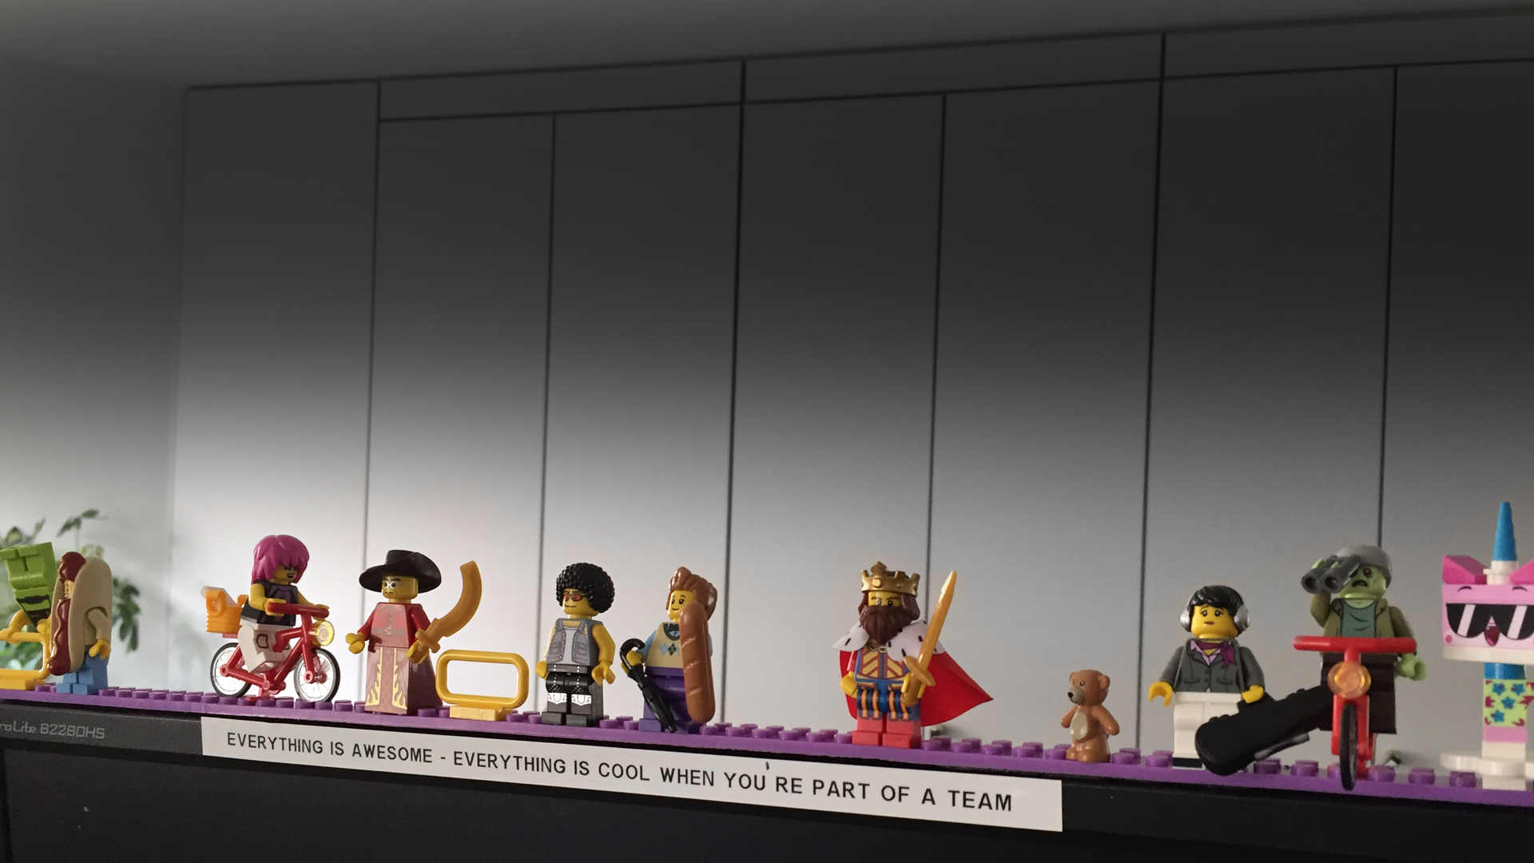
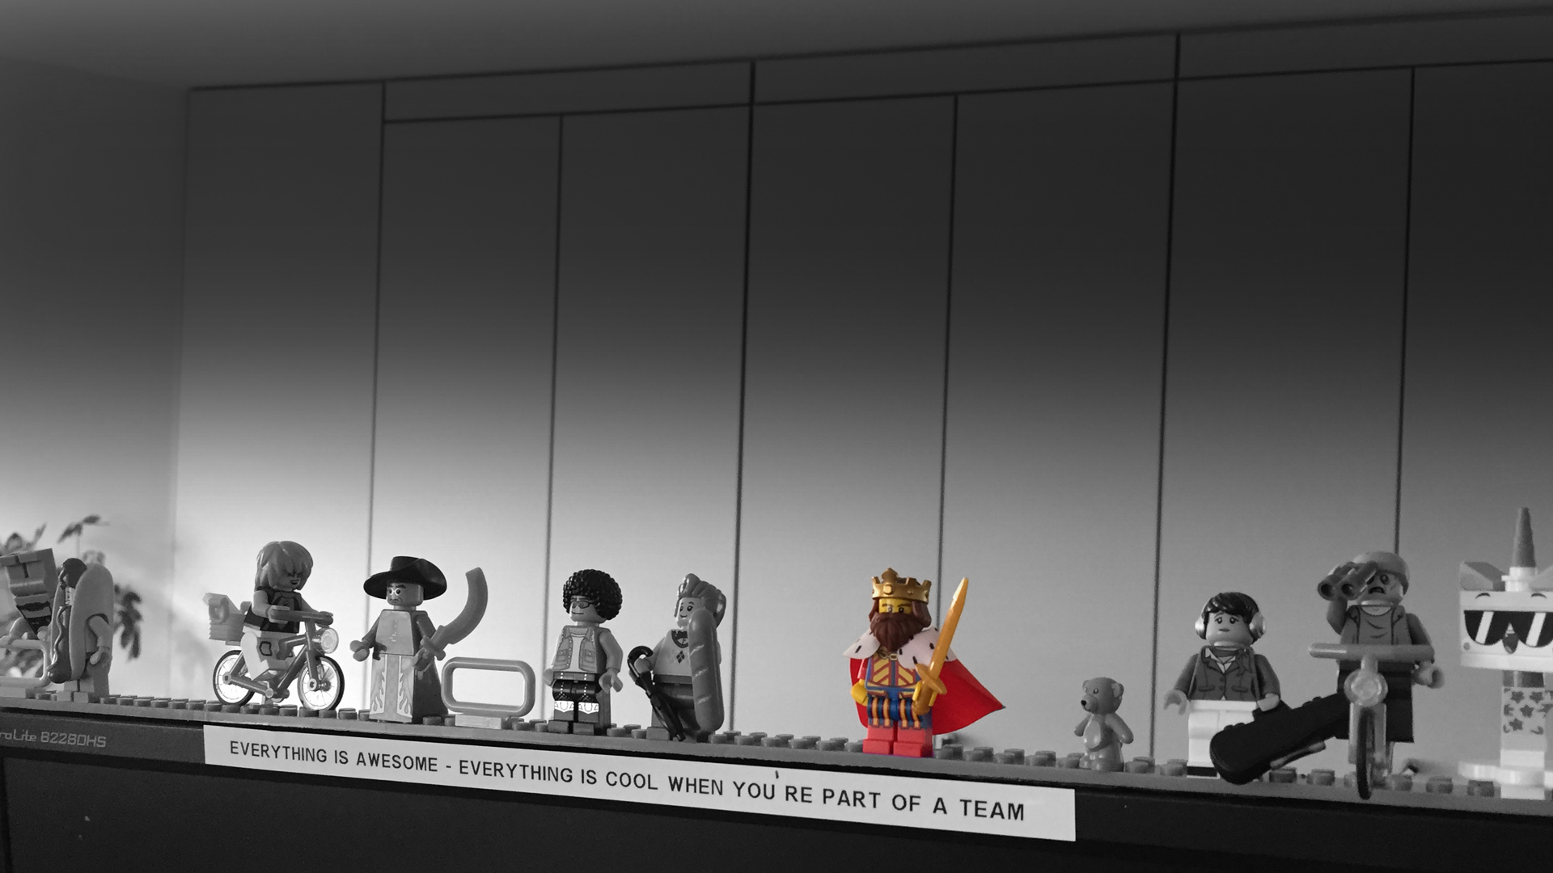
So, what has the impact been?
Everything is Awesome - Everything is cool when you’re part of a team – Well, almost
Image: Carl Barrow
Notes:
The right staff in the right place at the right time to meet the customer needs
Finalists in University Team category Excellence Awards
Currently over 50% of the team involved in delivery of CSE (Customer Service Excellence Award)
Re-established staff moral evidenced through staff survey
More staff involved in more projects than ever before!

Slide 7
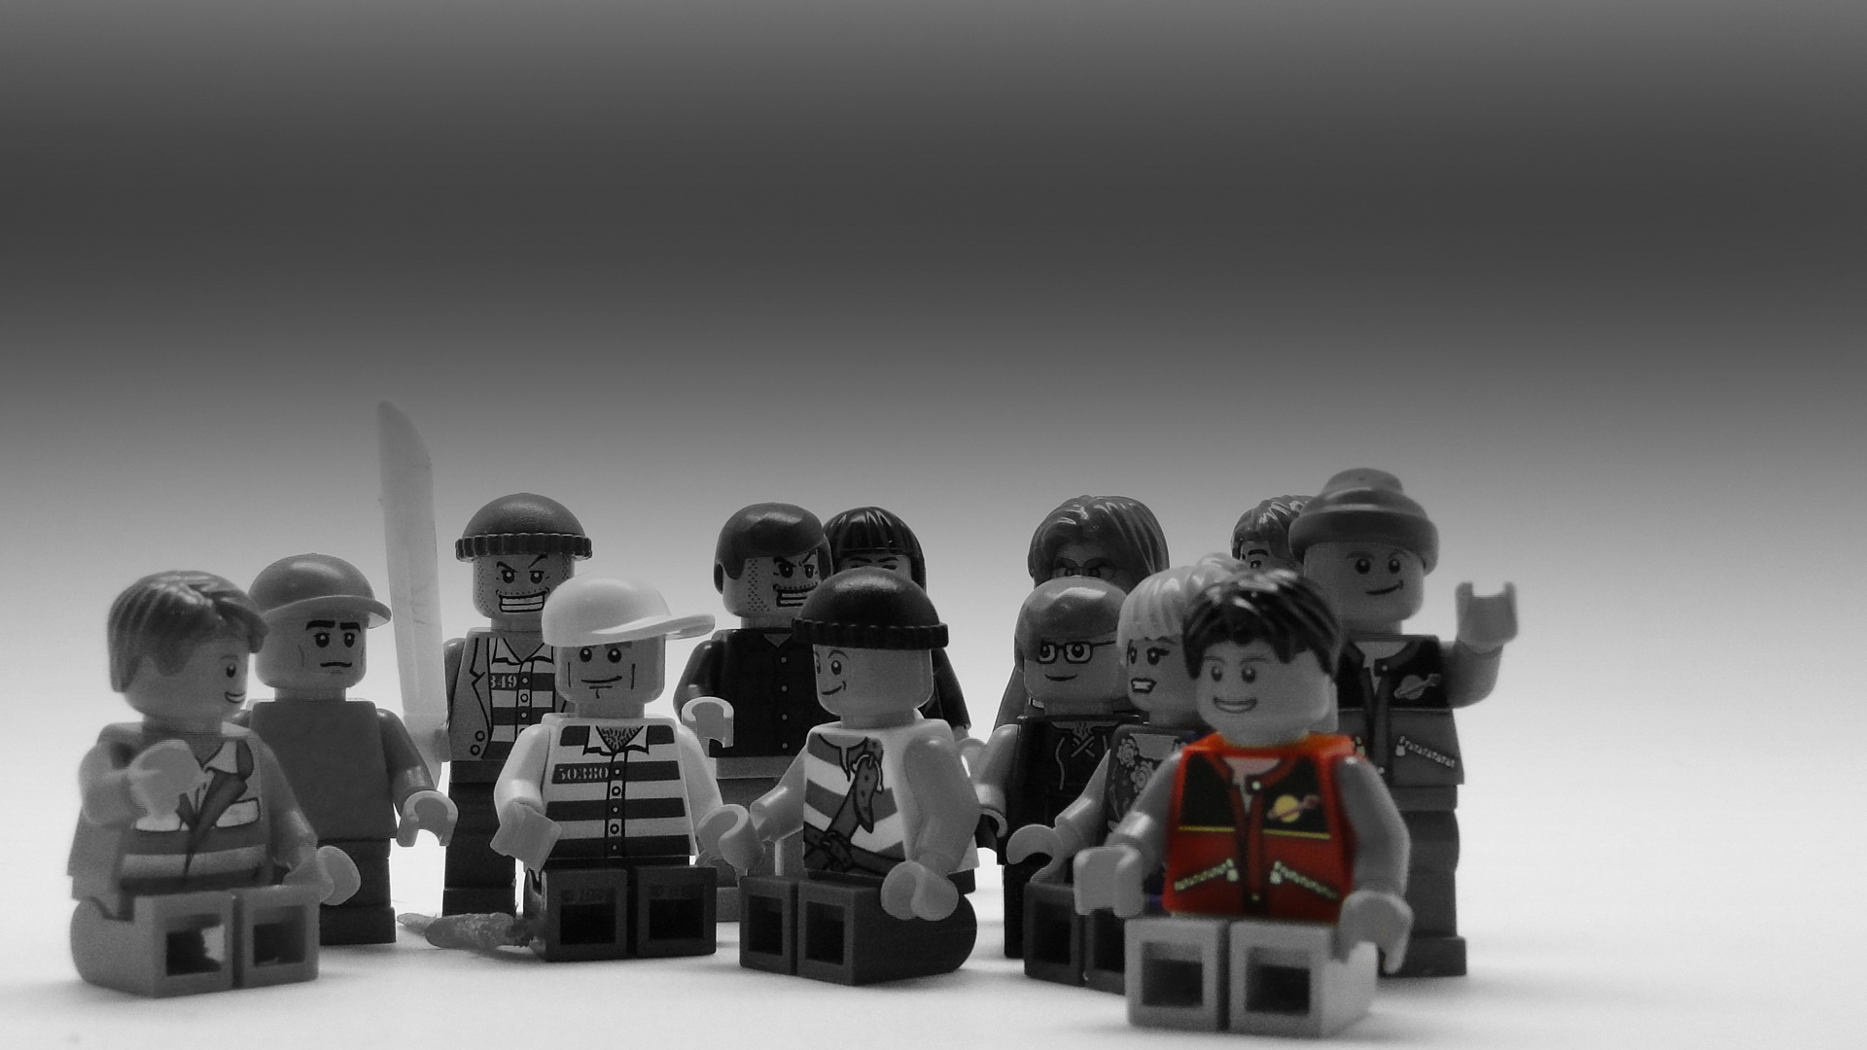
Over to YOU
Any questions or thoughts?
Image: pixabay

