Slide 1
Bibliotherapy, Bristol style or How to make a book-hedgehog
by
Julia Elliot
Library Assistant
University of Bristol
Notes:
Hello. My name’s Julia Elliot and I’m a Library Assistant, here at the University of Bristol.
This session is something between a presentation and a craft-session. It’s hands-on, because I’m going to ask you to get your hands on some books and destroy them! (It’s quite cathartic!) Don’t worry, these are all unwanted books which have been withdrawn from the library and were going to be relegated, or which were going to be sent to pulp by charity shops.

Slide 2
INTRODUCTION
WHAT ARE BOOK-HEDGEHOGS?
WHY?
HOW?
PRACTICAL SESSION
HOLDING YOUR OWN HEDGEHOG-MAKING SESSIONS
ANY QUESTIONS?
Notes:
I’m going to show you some book-hedgehogs, which are what we’re going to make, then I’ll talk about why we’re so into them, here at the library.
Next, I’ll explain how to do it and then you’ll all have a go. You’ve got the materials there on your tables. We’re not expecting to finish them this session, but you can take them home, if you want, and finish them there.
Then we’ll have a look at how you can run making sessions in your own libraries, and round off with questions if you have any.

Slide 3
What is a
book-hedgehog?
It’s the folded pages of a book, with buttons stuck on for eyes and nose.
Notes:
What is a book-hedgehog?
It’s the folded pages of a book, with buttons stuck on for eyes and nose. They are very simple to make.
[SHOW A WILLS HEDGEHOG:] Here’s one that now lives in the Wills Memorial Library.

Slide 4
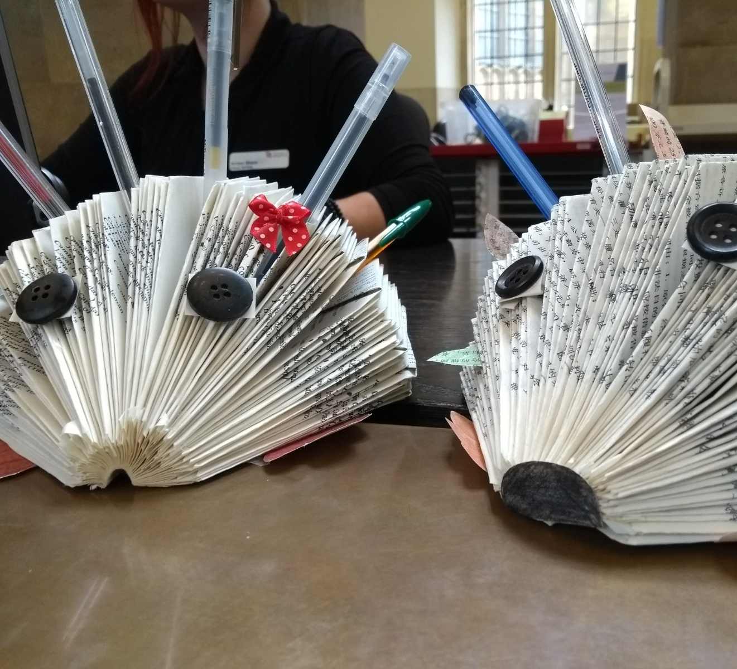
It can be used as a desk-tidy, as here, or to hold pens, postcards, or anything you want.
Notes:
And here are two of them, being used as desk-tidies. They can hold pens, postcards, or anything you want.

Slide 5
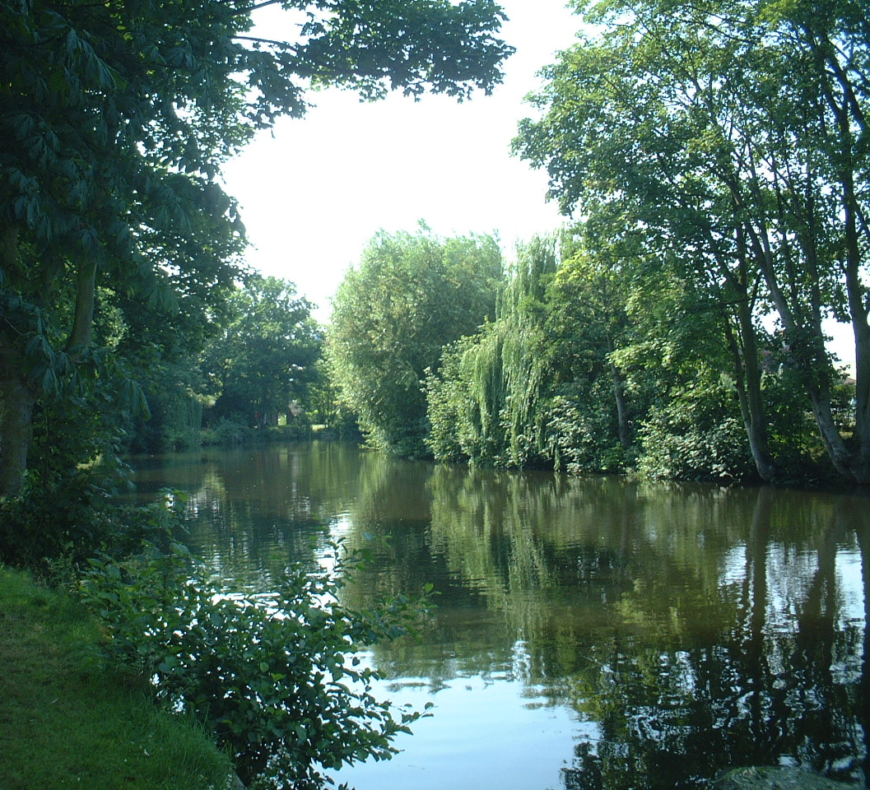
Why?
It can be used as a mindfulness exercise for students and staff.
It is a simple, physical activity, involving no screens.
It's light-hearted and can be sociable.
You can even do it whilst listening to a podcast, music, a talking book, or a radio programme.
Notes:
So, why are we into book-hedgehogs, here at the library?
We use it as a mindfulness exercise for our students.
As we all know, students in academic libraries are often very stressed, especially during exams and in the revision period beforehand.
During those times, we do our best to remind them of how to take care of themselves and where to get help. We have lots of advice and websites for them, and we also try to help in more low-key ways.
One of the things we do that is low-key is to put out tables out with activities, so that students can spend a few minutes doing something other than studying.
This gives people a chance to wind down. Doing something physical like folding paper takes people away from their screens and uses a different part of their brain. It's just a bit of fun.
On your own, you can do it whilst listening to music, a radio programme, a podcast, or a talking book. Or, you can do this with other people and have a chat at the same time.

Slide 6
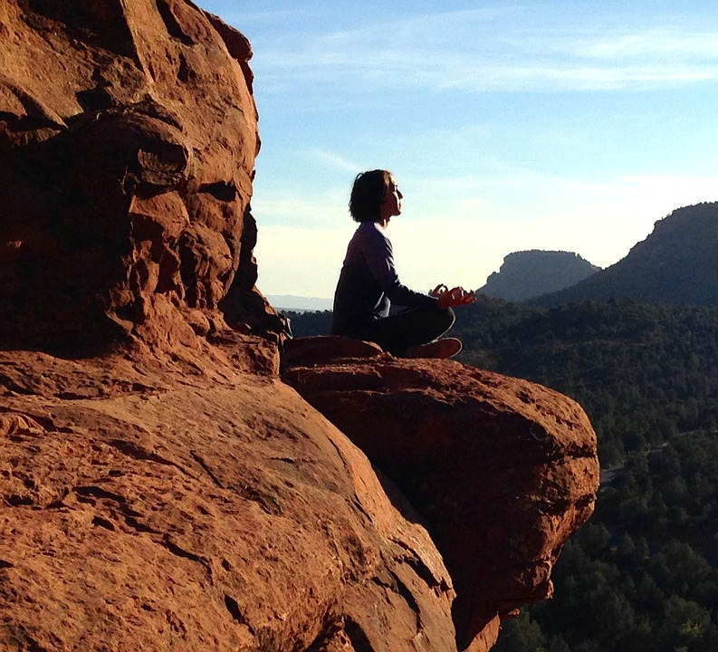
As a mindfulness exercise, we can link it to the “Five Ways of Wellbeing”:
connecting
being active
learning
paying attention
giving.
Notes:
If we think about the “5 ways of Wellbeing”, we can even link this activity to some of those. The 5 ways are: connecting, being active, learning, paying attention and giving.
You can also connect with others while making your book-hedgehog. I would not make great claims for it being a physical activity, but it is at least a manual one. Similarly, what you are learning is extremely simple, but it can be fun all the same. Most of all, it can be regarded as a mindfulness exercise, whereby you pay attention to the current moment And when you have made one, you can give it to someone.
I’m not saying that making a hedgehog out of a book is going to help anyone who’s having a mental health crisis. It’s just another small way of de-stressing.

Slide 7
It’s also a way of recycling books that are otherwise going to be pulped.
This Photo by Unknown Author is licensed under CC BY-NC-ND
Notes:
It’s also a way of recycling books that are otherwise going to be pulped.

Slide 8
How do you make a book- hedgehog?
Notes:
So, how do you actually do it?
DEMO – PAPERBACK BOOK.
You take an old book – one that your library has relegated, or that even a charity shop can’t sell – and you fold back the cover.
Then, you just make three folds in each page. Here’s a video of the folding process.
SHOW VIDEO – TWICE.
There are instructions on your table, if you’re stuck.
DEMO – MY HEDGEHOG WITH NO EYES.
You should, eventually, end up with something like this.
If you’ve got a very big book, stop when you think you’ve done enough pages. You’ll be cutting the cover off, anyway, if it’s a paperback.
In your goody bag, there are buttons and strips of card – for eyes and nose.
DEMO – BROWN ENVELOPE.
We won’t get far enough to use them, during this session, but they are there for you to finish your hedgehog with at home, if you want to.
DEMO – FOLD A STRIP OF CARD, TO STICK AN EYE BUTTON ON.
DEMO – SHOW HOW TO ATTACH A BUTTON FOR THE NOSE.

Slide 9
Practical session
Notes:
So, we’ve now got 10 minutes to start making a hedgehog, using the books on your tables. But, at the same time – or instead, if you really hate folding paper – I’d like you to talk to the people at your table. Get to know them, ask about any wellbeing activities they may have at their libraries, or whatever. Ask me, or Kerrianne, if you’re not sure what to do. You’ve got 10 minutes.

Slide 10
Ideas on hosting library book-hedgehog sessions
You could do a mini-version of our session here. Put out a table, chairs, materials and instructions. Put out some partly-made hedgehogs that people can continue.
Put out ready-made hedgehogs minus eyes, etc. Provide lots of buttons and other decorations, with glue (beware mess!).
If staffing allows, have a member of staff at the table.
You could advertise it beforehand on social media.
If you can't host a session, include the instructions in a list of mindfulness exercises.
Notes:
I just want to round off this session with some ideas about how you can run hedgehog-making sessions in your libraries.
[READ THE SLIDE.]

Slide 11
Materials required:
Old books
- books withdrawn from the library
- other unwanted library stock (e.g. journals no longer subscribed to)
- unsaleable stock from charity shops
Buttons – any size, colour or type (for eyes and nose)
Card – thin, cut into strips (for attaching the buttons with)
Glue – e.g. PVA
Notes:
These are the materials you’ll need.
[READ THE SLIDE.]

Slide 12
Any questions?
Notes:
Any questions?

