Slide 1
Learning Weeks
Laura Lay
Falmouth Exeter Plus

Slide 2
Learning Weeks
Who we are
What we needed
What we did
What they said
What we’ve learnt
Notes:
So, I’m going to talk about the context in which my team & I work and why it led us to identify a need for this type of staff development programme, briefly talk about the kind of things we do and then focus on the feedback that we’ve had from Frontline services staff in particular. And then share with you some tips from our experience.

Slide 3
Notes:
Our team work for Falmouth Exeter Plus.
FX Plus is a company jointly owned by University of Exeter and Falmouth University to manage services on their shared campuses in Cornwall
This arrangement is unique in UK HE.
FX Plus includes teams such as IT, Commercial, Estates, Residences and Facilities as well as the directorate I work in, Student & Library Services
We serve
2 universities
Around 8000 students
Across 3 campuses and online
2 libraries
1 shared frontline service

Slide 4
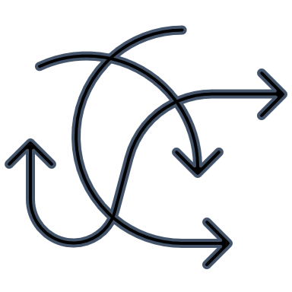
Challenges for staff development
multiple policies, processes, teams and cultures to understand
at a distance from other University teams
rarely included in University staff development initiatives
not feeling valued
Notes:
This complexity can lead to challenges:
We need to understand two different University processes policies and teams
We can find ourselves at a distance from other University teams because of the dynamic of being in a different organization
Although it is improving, we can be excluded from University staff development activities
Because of the dynamic of being in a separate organization, staff can feel undervalued

Slide 5
Student and Library Services
Wellbeing
Accessibility and Inclusion
Academic Skills
Chaplaincy
Library
Notes:
In 2018-19 the Student Services directorate was merged with the Library directorate.
Student Services were already running a one-stop helpdesk. In 2019-20 this was moved into the libraries and a shared SLS frontline team created.
I don’t manage the frontline team. I manage the Library & archives team and the frontline team is managed by my colleagues James.
They answer (and refer) enquiries for all SLS teams - that includes wellbeing, accessibility & inclusion, academic skills, library and chaplaincy
, as well as other teams such as accommodation, finance, student records
But we knew that making changes to location and organisational chart was not enough to make everyone feel like they belonged in the new directorate

Slide 6
Learning Weeks 2020
What was the problem?
What did we do?
Organised a two week period of training sessions delivered by staff within SLS
Encouraged people from all teams to offer a session, and arranged sessions from University teams
Delivered 15 sessions
Switched to online training via MS Teams when moved to remote working
Invited all SLS staff to attend the sessions
Rinse and repeat for 2021, 2022 and 2023...
Not enough staff development opportunities for SLS staff
Funding for external training/conferences limited
Expertise within SLS hidden and not shared outside of local teams
Staff within SLS don’t know each other well enough to collaborate and build up trust
Notes:
In our first year as a new directorate I led a 'ways of working' group
We took and action learning approach to see how we could better collaborate across the directorate.
One of the enduring actions of that group was the Learning Weeks.
We identified some problems including lack of access to training, poor understanding between teams and a lack of trust because of that, and a feeling that there was expertise in the teams that was not being shared.
We put on a two week programme of training, invited everyone to contribute and a couple of other University teams. That first year we had 15 sessions and because it was 2020 we switched the whole thing from in-person to online during the planning period and then we put the programme out and got really good attendance and feedback and we’ve repeated the same model with some changes every year since..

Slide 7
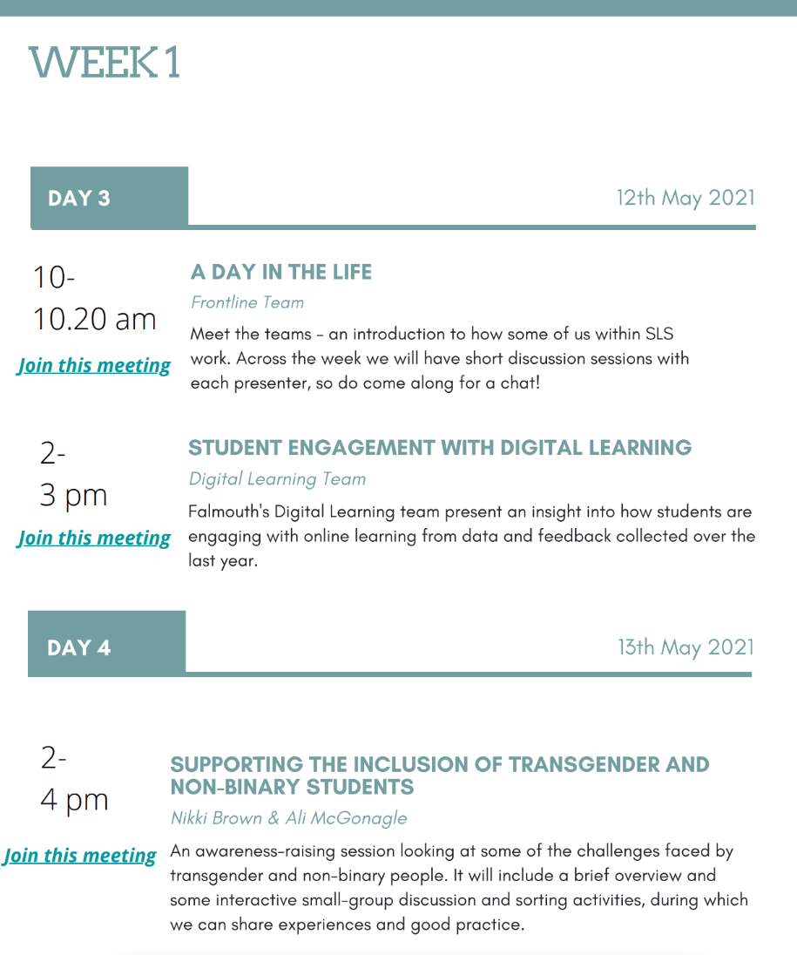
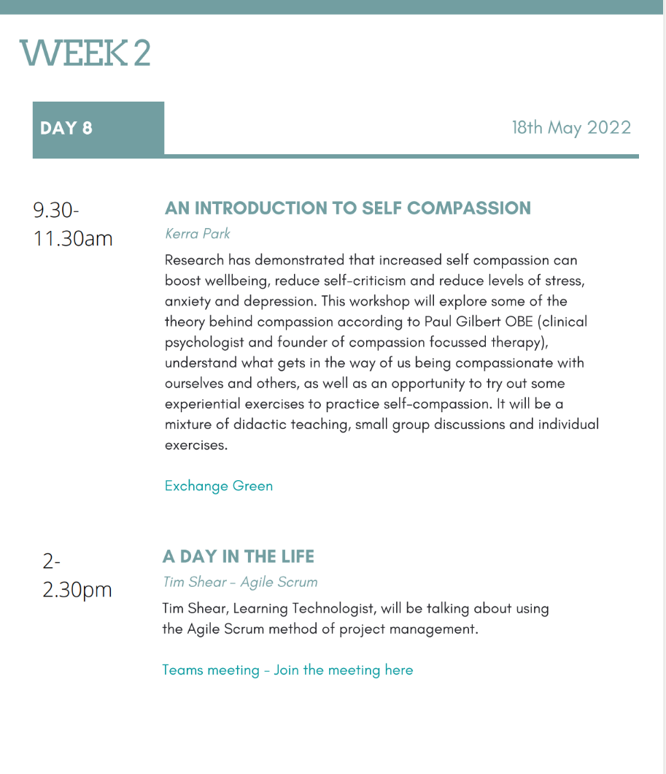
Notes:
We have 3 different types of sessions –
in depth sessions that might take the form of a workshops, panel or presentation. These are very varied and we’ve had presenters from within Student & Library Services as well as professional services, academics and students from both of the Universities
Day in the Life (individuals, enduringly popular – passive and short) It’s a 15 minute presentation on your work life followed by 15 minutes Q&A
Socials (nice idea, not easy to do)
You can see just from these two pages some of the core themes that we have – diversity, wellbeing, learning design and digital are all common topics we cover.

Slide 8
February - start
Send out form – wants and offers
Store all notes in One Note
Plan
Do
Reflect
Generate ideas
June - Reflection meeting
Charm, encourage and support presenters
Build programme
Evaluation form
Book rooms, send invites, get kit
Share programme (week -4)
Take bookings
Record and share sessions
Send a reminder every day
May - host and support
Notes:
This diagram just gives you an idea of the cycle of work involved.
We start by asking people what they want and what they can offer through a simple Microsoft form. We then generate ideas and reach out to people who may be able to meet the wants – so we try to make it the programme driven from the ground up.
This sounds like a lot of work, but actually it's only a few hours in the most of the planning period. Maybe a day to put the final programme together, a rota to send out the daily reminder during the Learning Weeks and to host some of the sessions.
We don’t have any budget, so we do rely quite heavily on charming and encouraging people.
3 woman team - Tess, Ailsa & Me (past 3 years)
Both Tess & Ailsa are a dream to work with and make everything look so calm and smooth
We got overwhelmed last year in the Weeks though due to sickness + hybrid sessions require more support - and so we have enlisted 2 new volunteers onto our team this year to help.

Slide 9
Feedback from the Frontline
Good range of topics and types of activity
Develop understanding of diverse students
Supports personal and team wellbeing
Gives staff a voice and showcases great work
Meeting other teams helps when making referrals
Understand how your work fits in the broader context
Wrong campus
Desk cover
Part-time
Notes:
We do a feedback form ever year, but for this session today I also asked Frontline staff in a particular how they found the Learning Weeks.
People enjoy the range of topics, and the different types of sessions. They feel valued and able to contribute to the sessions. Meeting other teams helps to understand them when making referrals, and to build that confidence and trust between the frontline and other teams. It also helps people to see their work in the broader context of the teaching and learning that is happening in the Universities.
So, some of the challenges that frontline staff have with attending in-person sessions is that they find themselves rota-d on the wrong campus to get to a session, they feel they can’t get away from the desk, or they miss sessions on days they don’t work.
What is really great is that frontline team leaders really do support attendance at the Learning Weeks.
- they make changes in the rota to allow people to attend
- the early release of the programme helps with this – we send it out 4 weeks in advance to help any teams with rota-ing appts or desks
- they encourage staff to watch recordings at quiet times like evenings and weekends.

Slide 10
“I thought stammering is a subject that you don’t hear that much about in a HE or workplace setting, and it would be good to do something to raise awareness.
I also wanted to improve my presentation skills and do something I wouldn’t usually do.
I think the Learning Weeks offer an excellent opportunity, and a friendly environment, to present on topics not strictly in your area of work, and to push yourself out of your comfort zone. I did feel very nervous about doing it … but the feedback I received was really positive and heartening. The main thing I learned was that your own perception of your ability to do something can be quite different, and overly negative, compared to the positive reality.”
Lucy, Librarian
Notes:
Looking at it from the presenter side…
A colleague in the library who has a stammer said she wanted to do a session on Stammering Awareness. I was so proud at that moment, because I felt it was exactly what the Learning Weeks was about. It was about we have experience within ourselves that we can share and would be useful for our colleagues. Whether that is personal experience, or professional experience.
What this quote shows is that not only did she share something she cared about, and was useful for everybody else, but that she also gained confidence at the same time. Personally I believe that delivering staff development has the capacity to empower you.

Slide 11
Further benefits
Placeholder for staff development
Values the individual and the team – our expertise and our diversity
If a team is feeling misunderstood ’Day in the Life’ sessions are used to talk about the world from their perspective
Safe space to deliver your first workshop or presentation

Slide 12
What we’ve learnt
Listen to what people want
Get support from line managers
Publish the programme early
Remind people daily
Make it hybrid and record
Be social in work time
Note your reflections
Notes:
The ethos about delivering what people want really helps to motivate staff to deliver sessions and to create a feeling of a ‘gift’ being offered
As I said a moment ago, it’s really important for line managers to encourage attendance, we have seen low take up in some teams where this isn’t actively done.
Publish early enough so that teams canchange rotas and appointment schedules
Remind people first thing every day – gets a little more attendance and irons out any last minute confusion about rooms or online links
People do want to meet in person, but if possible we also need to allow people to join online if they are on another campus, we also need to record whenever we can so that part-time staff have an opportunity to catch up .
People have told us they don’t want all the social activities to be in lunchtimes or after work – they want to get paid for them!
Recording how it went and what we learnt afterwards has really helped us when we come back to it 8 months later to start again

Slide 13
Thank you
Laura Lay
Head of Library & Archives
Falmouth University & University of Exeter Cornwall Campus
laura.lay@fxplus.ac.uk
Notes:
Thank you
If you have any questions we have a little time for those, and I can also answer them in the chat.

