Slide 1
Feedback reporting
Phil Segall
Information Assistant
Royal College of Nursing
Library and Archive Service
@RCNLibraries
Notes:
We introduced a feedback report last year at the RCN which combines the various types of feedback we collect within the Library and Archive Service. This presentation covers why we introduced this, some of the challenges involved and how we look to improve upon the work we have done.
The RCN is the largest Trade Union and professional association for nurses. We have over 435,000 members, including registered nurses, midwives and students.
Pictures:
NobleDame (Tenor) - International Day of Happiness GIF: https://tenor.com/view/smile-international-day-of-happiness-gif-13761546
Faceboook logo – https://commons.wikimedia.org/wiki/File:Facebook_Logo_(2019).png
Twitter logo - https://about.twitter.com/en_gb/company/brand-resources.html
Instagram logo - https://instagram-brand.com/assets/

Slide 2
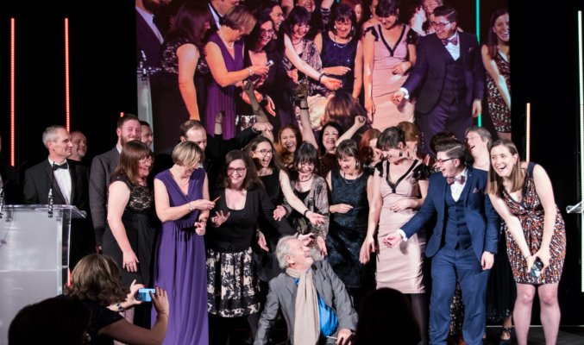
Overview
RCN Library and Archive Service and Customer Service Excellence
Recording enquiry stats
Enquiries Survey
Creating the Feedback Report
Closing the feedback loop
Notes:
Commitment to Customer Service Excellence:
We are an award winning service and are committed to ongoing improvement through Customer Service Excellence.
Recording enquiry Stats
We have changed how we record our enquiry stats this over the last four years – this presentation gives a short history of those changes and the reasons for them
Enquiries Survey
We moved to an enquiries survey which we use to record all enquiries received via the Library and Archive services’ main channels – phone, email, web chat and face to face
Creation of the Feedback Report
Reports created from the enquiries survey evolved into the Feedback Report which includes other forms of feedback received through other channels too.
Closing the feedback loop
This part of the presentation will cover how the outcomes of each quarterly report are fed back to users.
Picture: RCN Libraries - RCN Team of the Year: the Library and Archive Service team being handed their award by Sir Ian McKellen

Slide 3
The RCN Library and Archive Service
Customer Service Excellence – ongoing commitment & review
Covers Library & Heritage Centre - London
+ Archive - mainly based in Edinburgh
Achieved 16 compliance pluses in 2019!
Notes:
In our 2019 CSE assessment we fully met all of the criteria and achieved 16 compliance pluses (areas where we have gone above and beyond expectations) – our best result yet!
Examples of areas were we excelled, relevant to this work, include:
1.2 Engagement and consultation – specifically about ensuring that processes are regularly reviewed to make sure that they are effective.
2.1.4 We ensure that all customers and customer groups are treated fairly and this is confirmed by feedback and the measurement of customer experience
2.2.2 Staff understand customer needs
(Other examples: 1.3.2 We analyse & publicise satisfaction levels for the full range of customers for all main areas of our service & we have improved services as a result
4.3.5 We regularly review and improve our complaints procedure, taking account of the views of customers, complainants and staff.
“We have a strategy for engaging and involving customers using a range of methods appropriate to the needs of identified customer groups.”
2.2.4 We can demonstrate how customer facing staffs’ insight and experience is incorporated into internal processes, policy development and service planning.)
The RCN library service has its largest library in London with 30 staff and a footfall of 72,500 in 2018
We have a big online presence as most of our library users are remote and don’t live anywhere near a library with just over 10,000 unique online users in Q4 2018.
We received 9,500 face-to-face enquiries last year.
Pictures:
Summit CPA Group - 5 star rating animated: https://www.summitcpa.net/blog/customer-service-and-your-business
Customer Service Excellence® - Customer Service Excellence® logo: https://www.rcn.org.uk/news-and-events/blogs/customer-service-excellence-ii

Slide 4
Recording enquiries - aims
Moving from spreadsheets to an online survey
Including all types of enquiries
Adding a free text option
Collecting and responding to feedback
Notes:
In 2016 we used two Excel spreadsheets to record enquiries - this had several drawbacks including:
data being overwritten
It was only available to one user at a time and was always open on the main helpdesk
spreadsheets were frequently left unsaved
only numerical data could be recorded
only face-to-face and phone enquiries were being recorded
Initially looked into whether there was anything in-house we could use but the main RCN enquiries system was not suited to what were doing.
We set about deciding upon the aims of a new system for recording enquiries - this needed to include web chat and email enquiries too. A free text option would also allow us to find out more about what our users were telling us.
Picture:
CleanPNG - 3D background: https://www.cleanpng.com/png-powerpoint-animation-computer-clip-art-2056485/preview.html

Slide 5
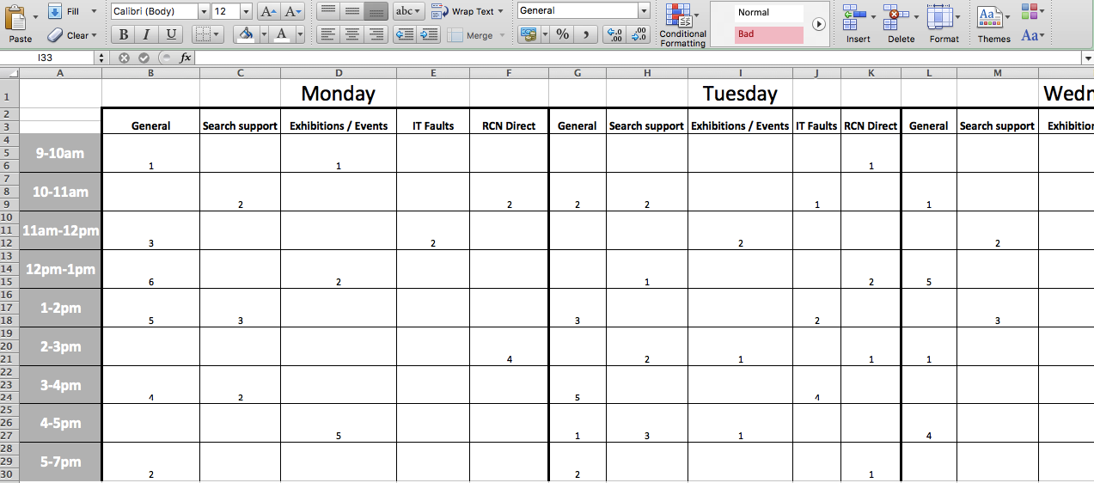
Enquiries Spreadsheets
Notes:
How the spreadsheets used to look!
Picture:
Hercules cliparts – thumbs down free clip art https://retohercules.com/explore/thumbs-up-clipart-png.html

Slide 6
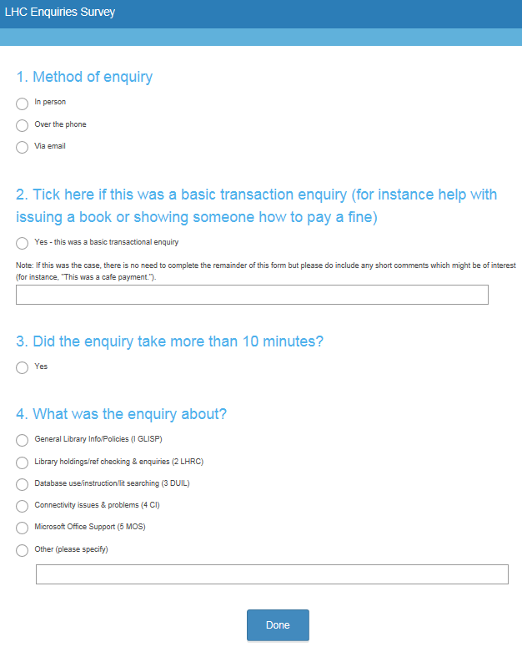
Survey Monkey trial
Accessible from anywhere
Quick and easy to complete
Staff found descriptive field useful
Time-consuming when recording multiple enquiries
Retrieving data not straightforward
Notes:
We tried Survey Monkey first as a quick, free option and asked for staff comments on how they found using this.
This included “In person”, “Over the phone” and “Via email” enquiries – web chat was added in later.
Also included an option to show if the enquiry took over 10 minutes.
Staff responded positively but found it more difficult to use during busier shifts when they had more than one enquiry to record

Slide 7
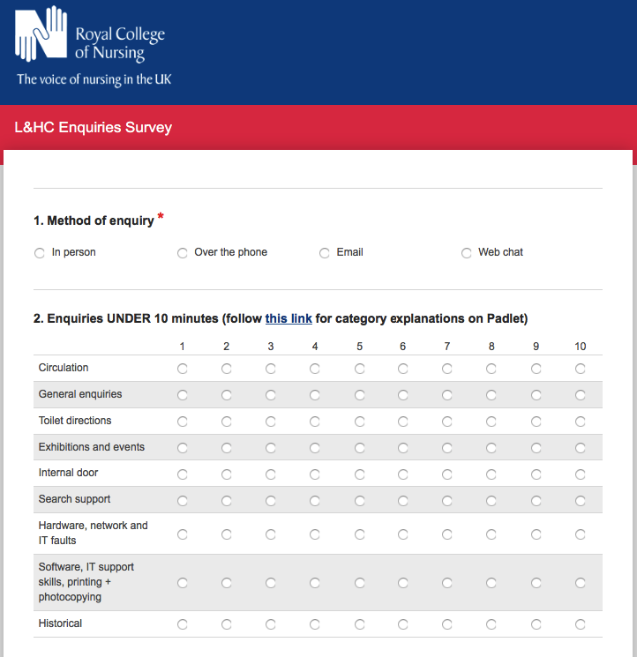
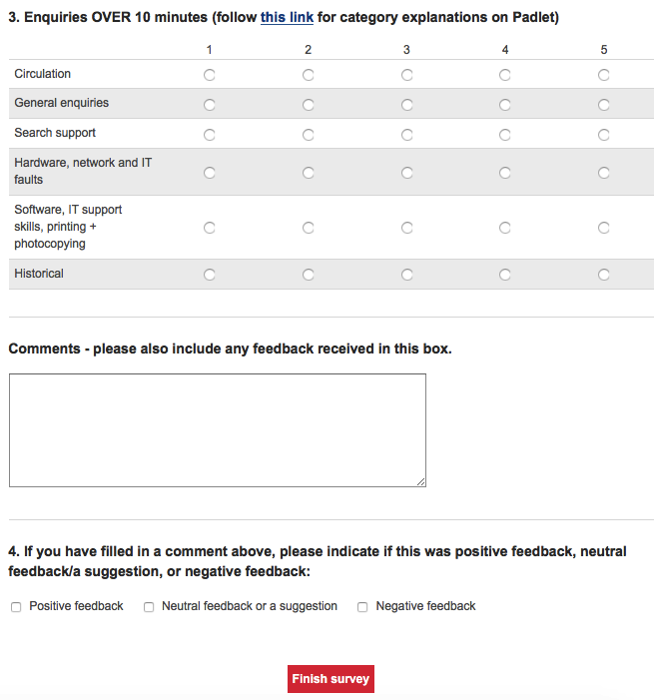
Notes:
The comments we received become the basis for our Library and Heritage Centre enquiries survey which we use on SmartSurvey (which is the survey software we use RCN-wide).
This simplified things, allowing multiple enquiries to be recorded at the same time.
If you would like me to send a test version of the Enquiries Survey which you can try for yourself, please send an email to me at philip.segall@rcn.org.uk

Slide 8
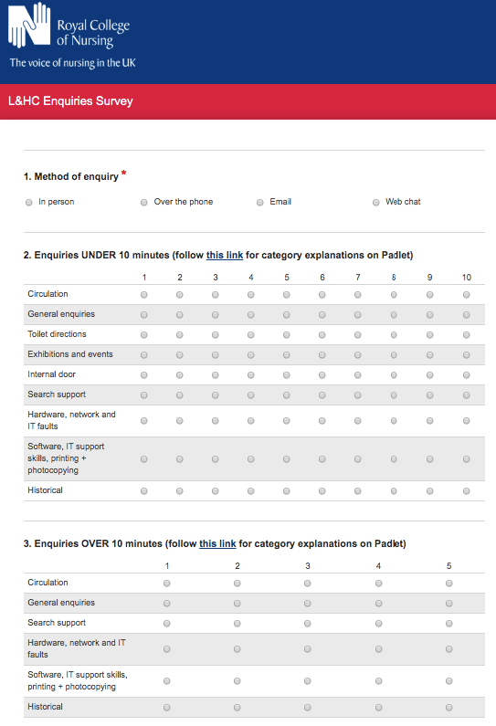
Enquiries Survey
Quick and easy to use
Simple to record multiple enquiries
Easy to retrieve + sort data
Staff can record type of feedback
Notes:
Enquiries are still separated according to whether they took under or over 10 minutes.
An option was added to allow staff to indicate whether the feedback they are supplying is positive, negative or neutral (which is usually a suggestion but could also an observation a library user has made).

Slide 9
Survey analysis
Separating out responses
Codifying into topics
Counting the frequency of each
Picking out key quotes
Identifying suggestions
Notes:
Data from survey exported to Excel and analysed on a monthly basis (now reported back every quarter but it is useful to do by month)
Separated into positive, neutral and negative feedback and these are counted
Useful quotes, unusual comments and suggestions are picked out
Categories are assigned to each piece of feedback according to their topic
Results are tabulated into overall totals and totals for each category
Category headings are changeable – still evolving

Slide 10
Reporting back
Agenda item at month meetings
Year-on-year comparisons
Identified areas to improve
Evidence of key trends
Provoked useful discussions
Notes:
Reports created from this feedback were taken to Customer Service meetings each month
These were summarised and individual comments were also picked out
Discussions were had about what we could improve ourselves or work with other teams to improve
Once this had been done for several months, key trends could be identified
On the downside, a lot of the same things were coming up again and again

Slide 11
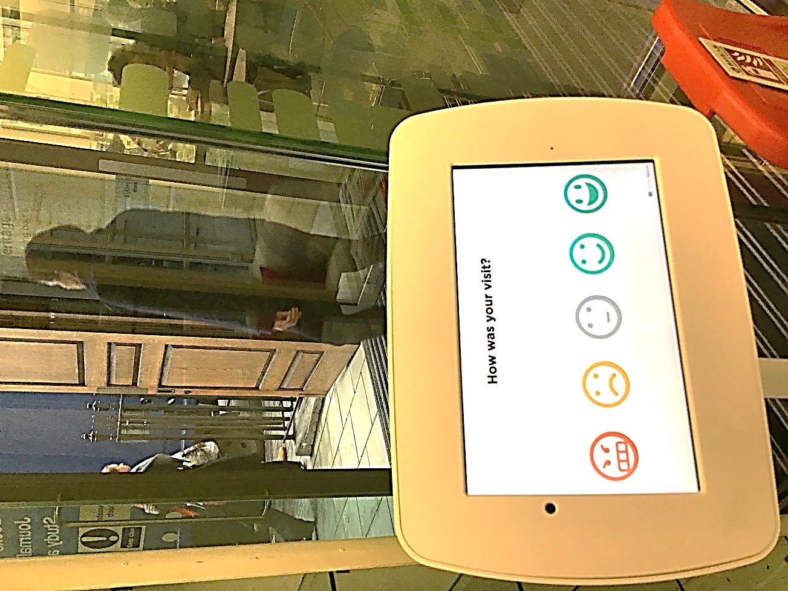
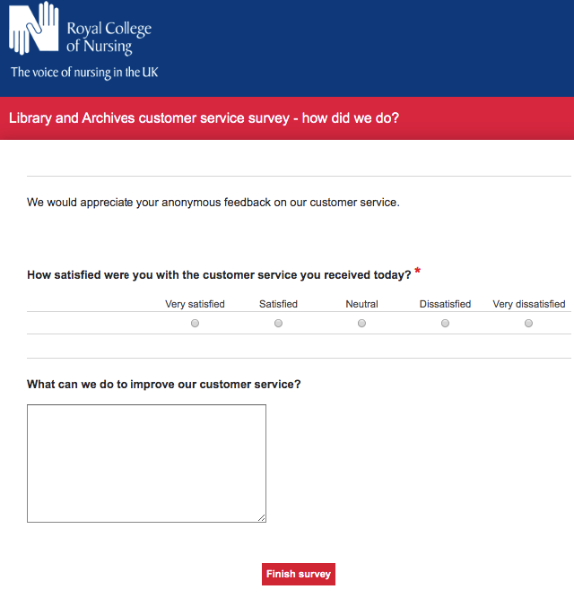
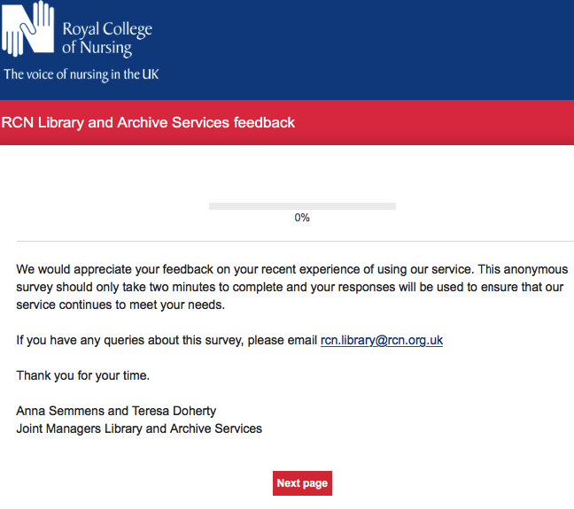
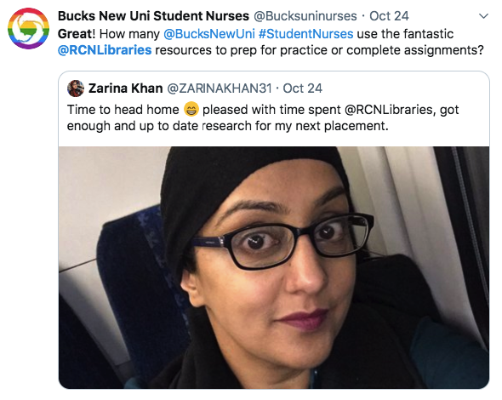
Adding other feedback
User feedback survey
Social media feedback
Smiley Survey Tablet App
Website feedback
Visitor book comments
Event feedback forms
Customer Service Lightning Feedback Survey
“
Notes:
On the back of the success of the Enquiries Survey, the basic format of the report was extended to other areas of library user feedback.
At the RCN, those who attend events and training sessions are asked to complete an online form. Physical feedback forms are given to those not confident using the online version and we use visitors’ books to record feedback too. This was added, along with other, less formalised types of feedback; these include a tablet with different smiley faces on it, allowing users to give their feedback and to type comments about suggested improvements. We also seek feedback using a whiteboard in the library space. In September 2018 we also introduced a ‘Lightning Survey’ within Customer Services which is added via a line of text sent to enquirers at the end of emails and when closing web chats.
Picture:
Free Image on Pixabay - Feedback, White Male, 3D Model: https://www.pinterest.co.uk/pin/30969291187162528

Slide 12
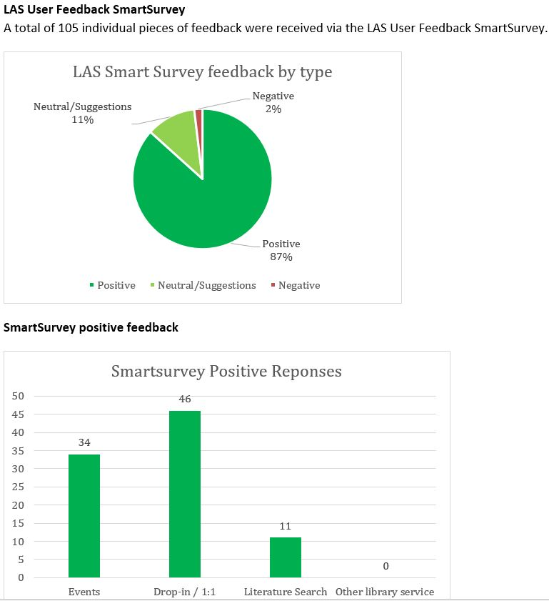
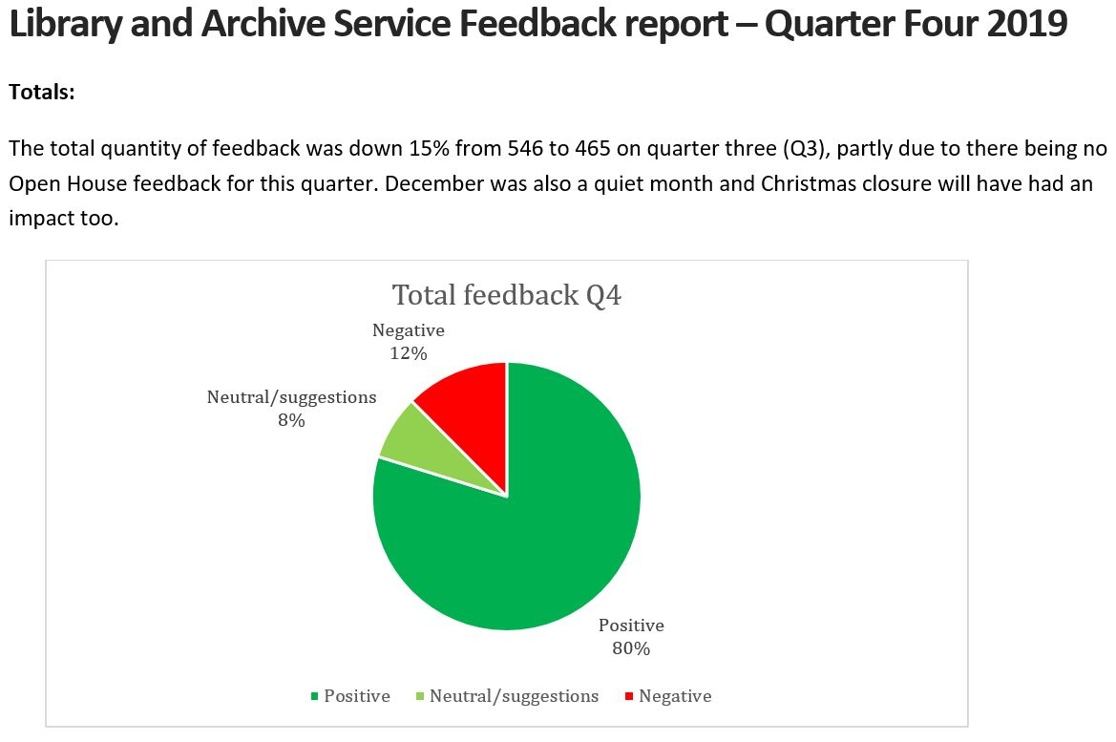
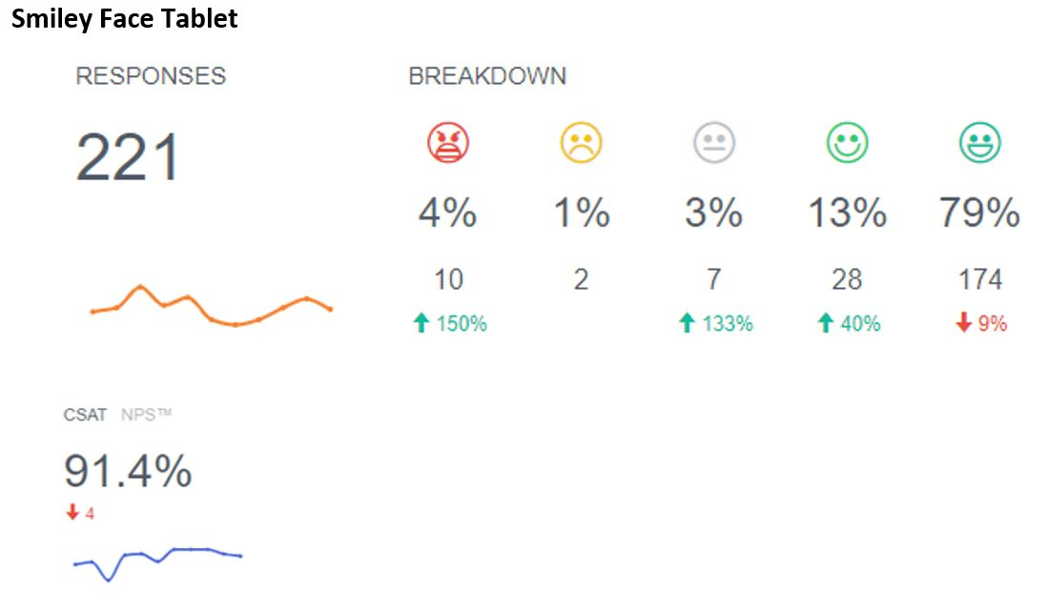
Notes:
The report includes a feedback summary, showing how many of each type of feedback has been recorded and how much is positive, negative or neutral.
The actions which come out of the report are communicated through a noticeboard and also online via a ‘You said, we did….’ section on the website.
The reports have now also started to include progress on actions from previous reports.

Slide 13
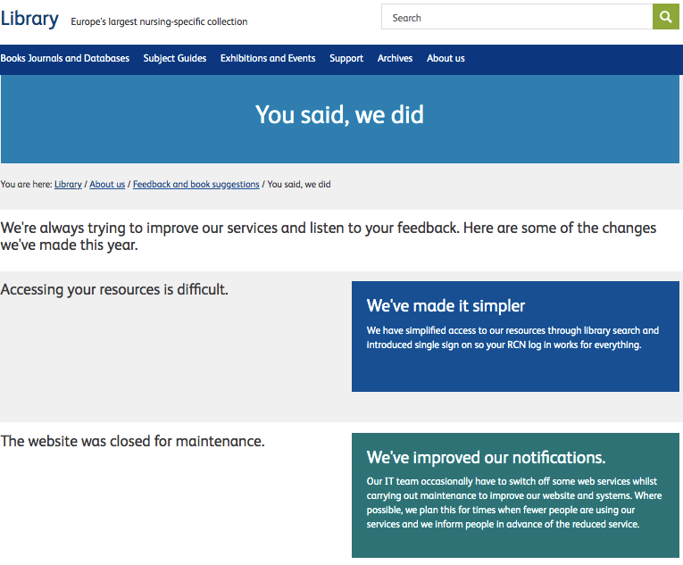
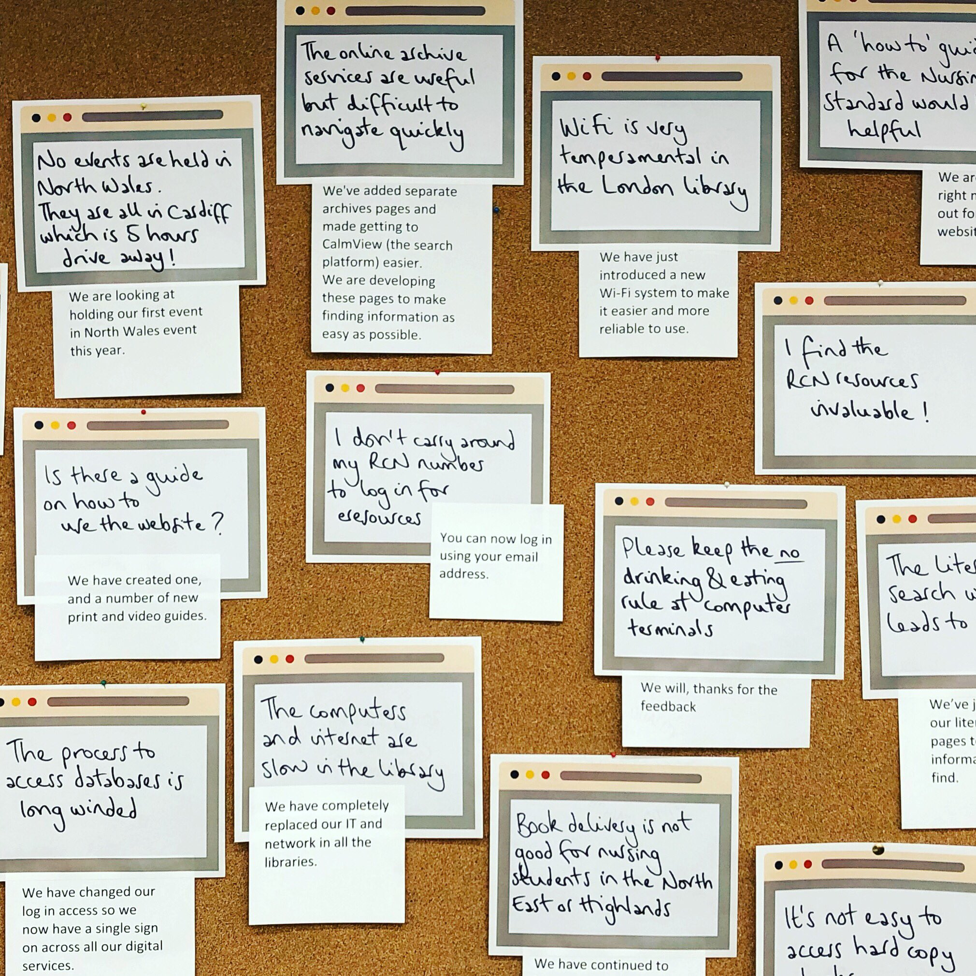
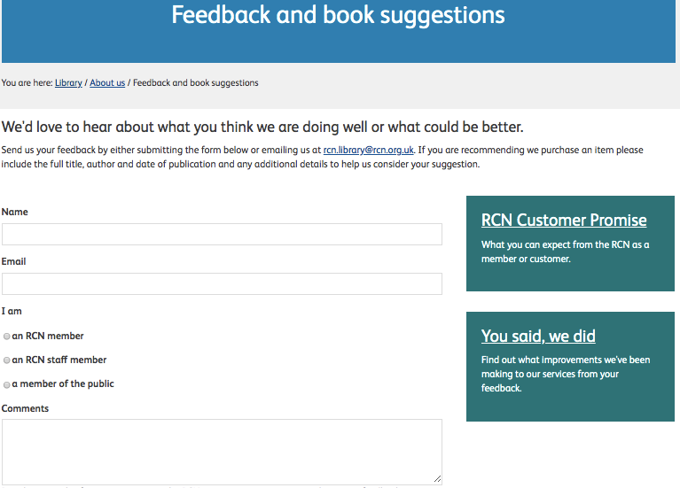
You said, we did….
Feedback summary + response
Noticeboard in library and online
Provide cards for more feedback
Link to online feedback form
Notes:
The feedback communicated via “You said, we did” is also linked to an online feedback and suggestions form which provides further feedback in an ongoing process.
Link to “You said, we did”: https://www.rcn.org.uk/library/about-us/feedback-and-book-suggestions/you-said-we-did
Example – members were saying our sign-in process for accessing resources was complicated so we changed this to a single sing-on.
Computers were slow in the Library and Heritage Centre. We were able to replace these

Slide 14
Questions?
www.facebook.com/RCNLibraries
@RCNLibraries
@RCNLibraries
Philip.segall@rcn.org.uk
Notes:
Follow us on social media!
Facebook: www.facebook.com/RCNLibraries
Twitter: www.twitter.com/RCNLibraries
Instagram: www.Instagram.com/RCNLibraries
Picture:
Career Coach Academy – YouTube: https://www.youtube.com/channel/UCaERHmpNOSrB7cqIIx5mQ8g

