Slide 1
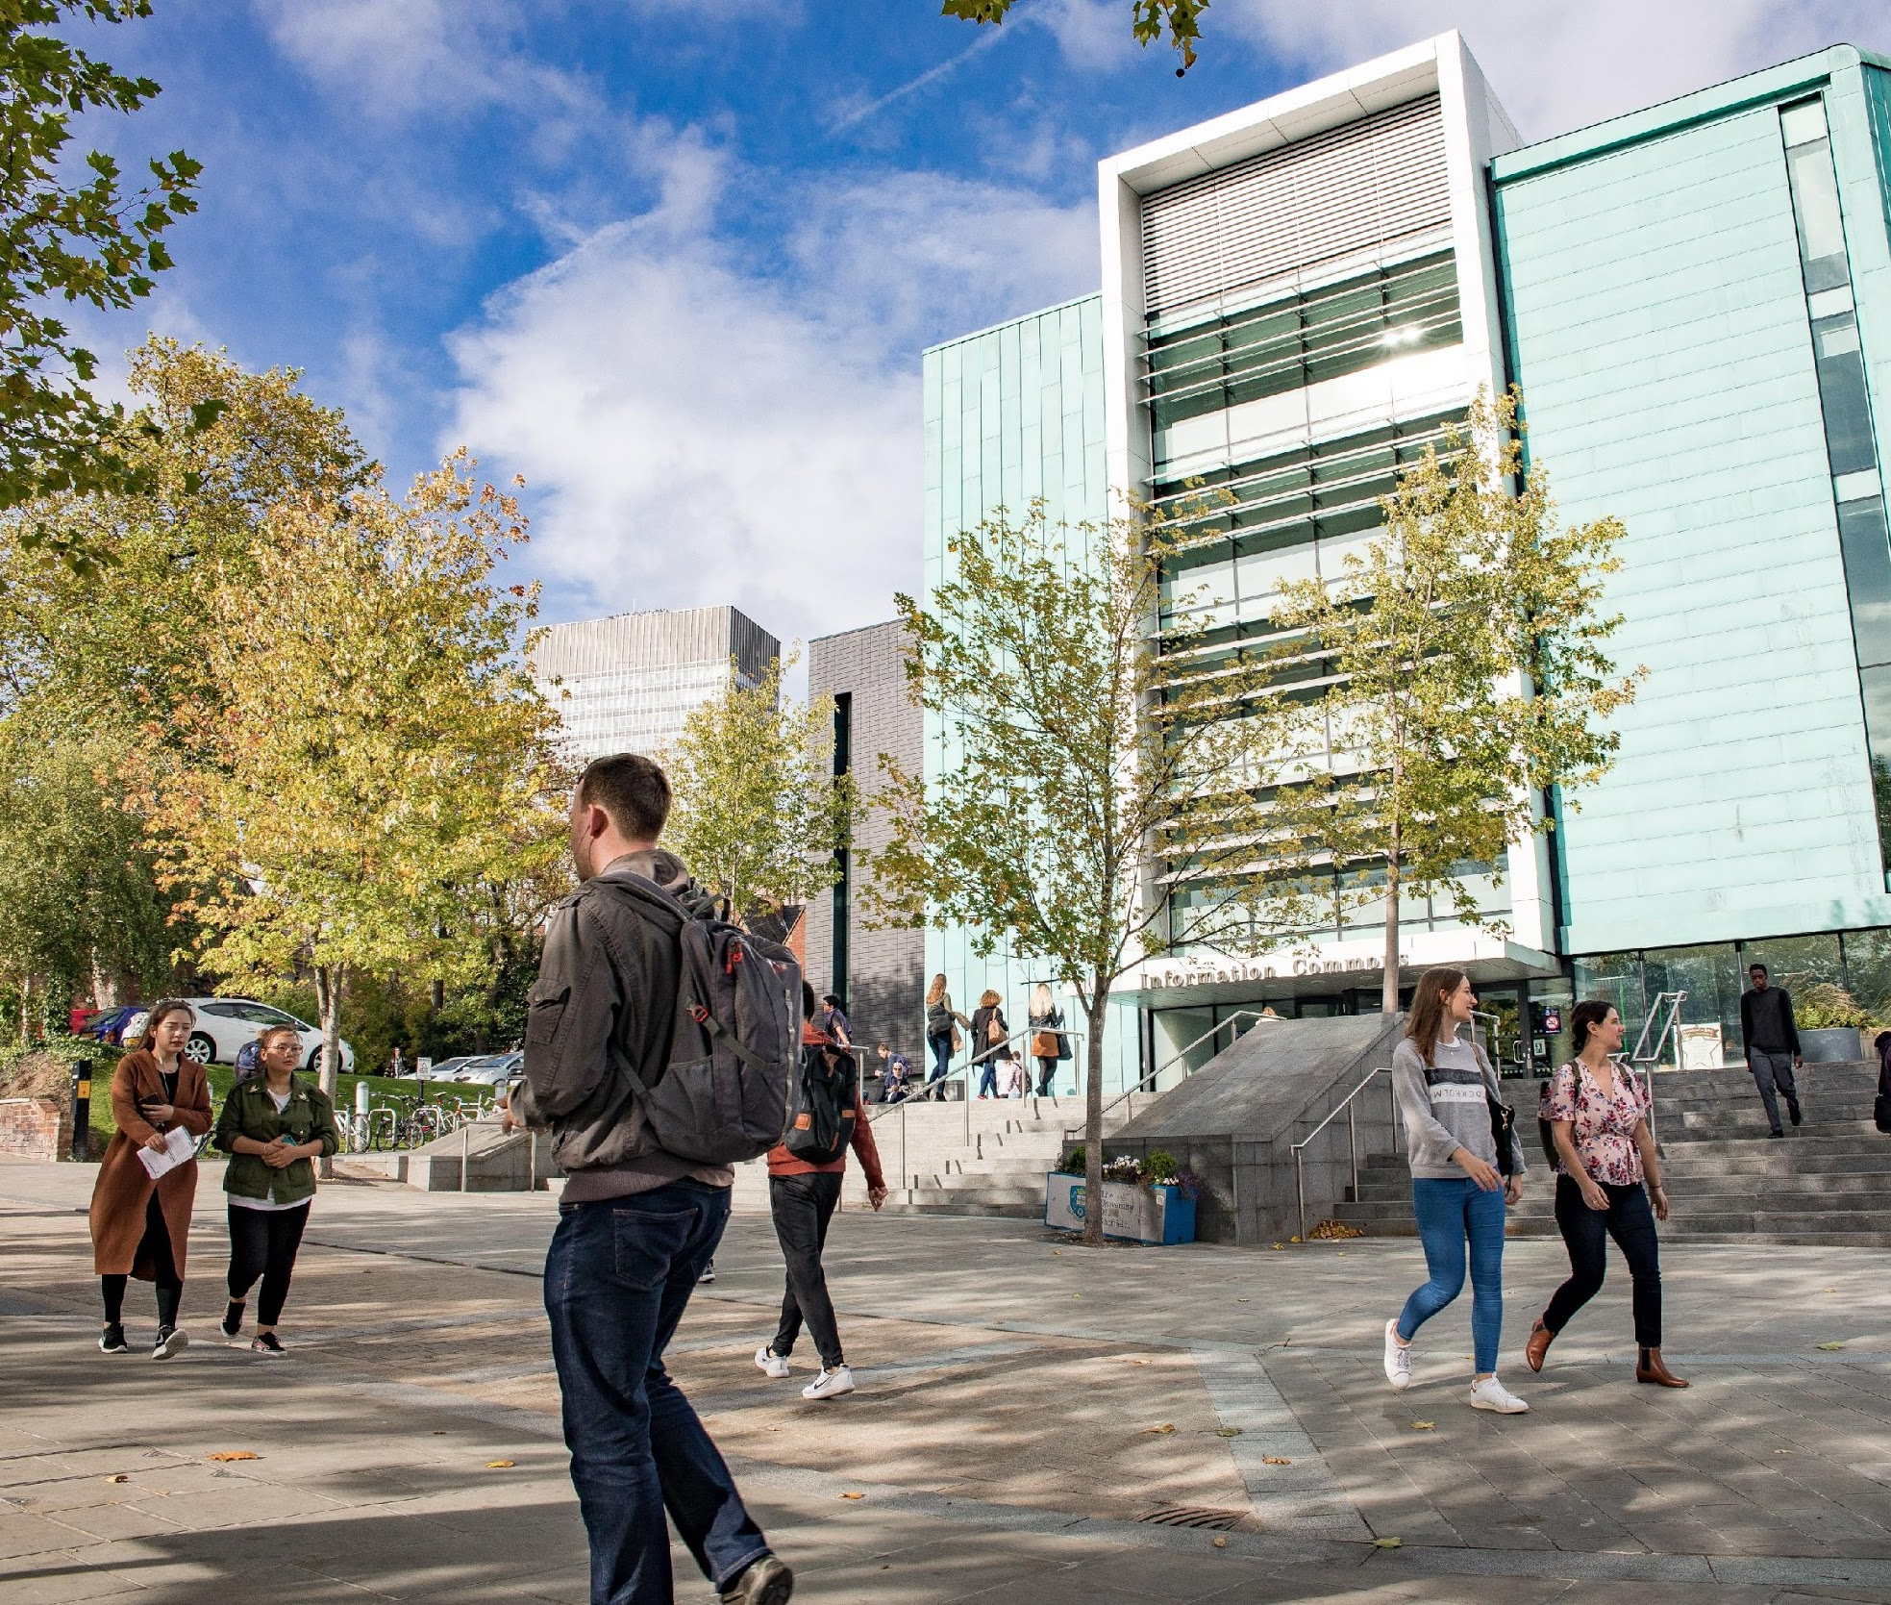
Virtual Library Commons
Ange Greenwood and
Rhian Whitehead-Wright

Slide 2
Come Together, Write Now.

Slide 3
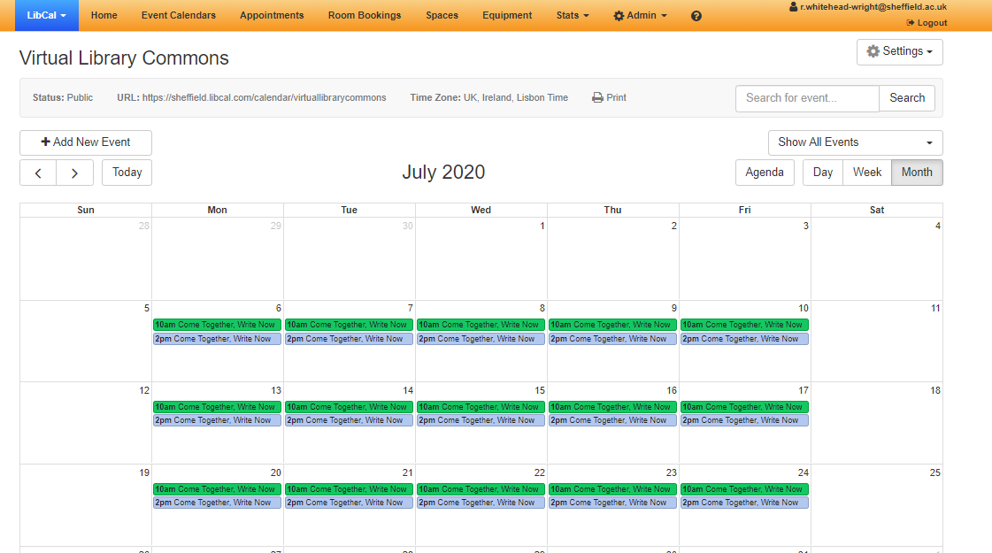
LibCal

Slide 4
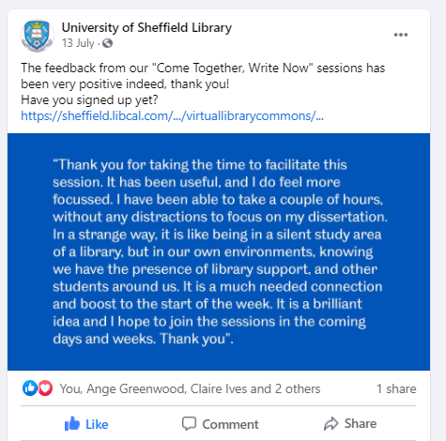
Promotion

Slide 5
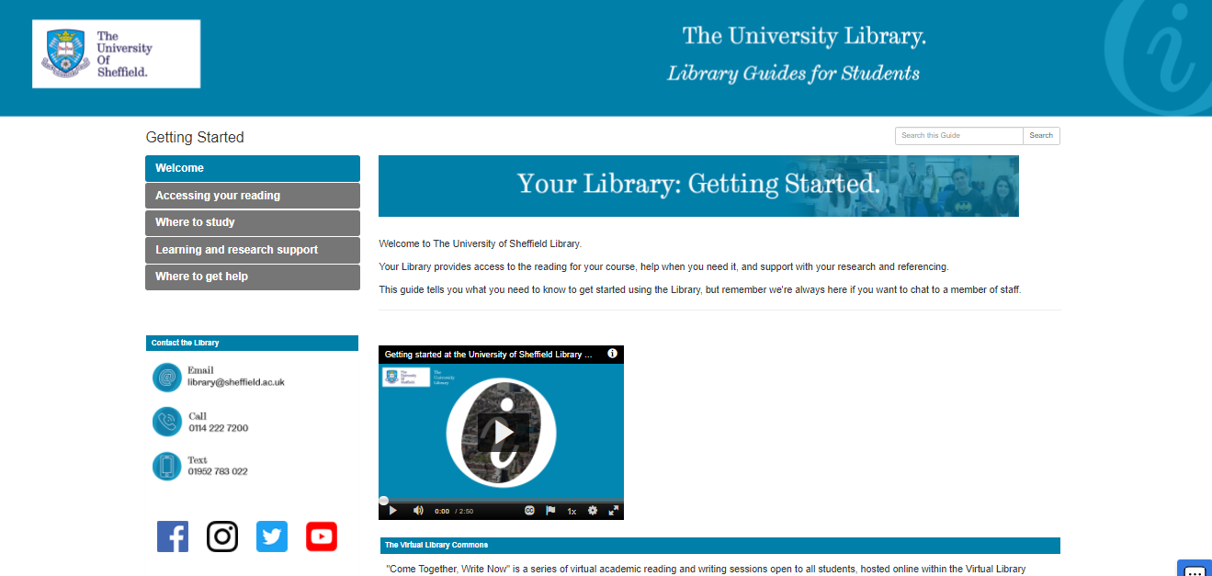

Slide 6
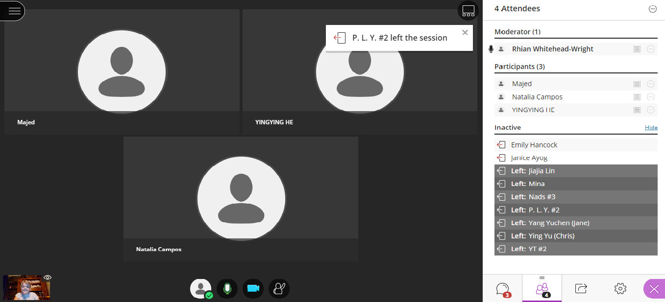
Blackboard

Slide 7
Format

Slide 8
Statistics
Over 520 attendees attended across 96 sessions.
Average of 5.4 students per session.

Slide 9
Feedback
Helped students to focus
Increased productivity
Students helped each other
More/longer/
later sessions
Longer time to book sessions
Feeling connected to others

Slide 10
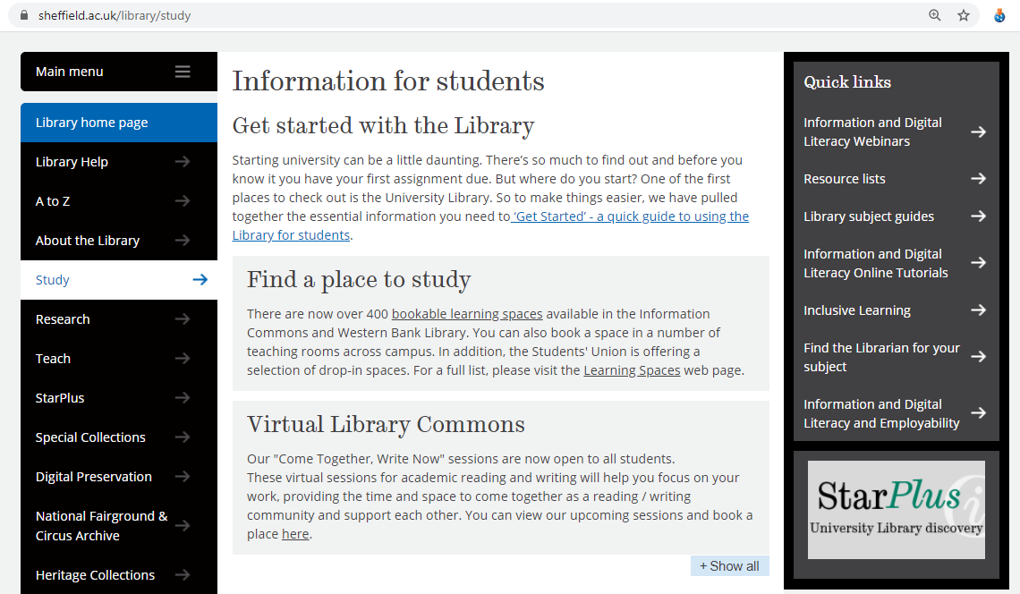
VLC 2.0
Enquiries from staff and students about if we would run them again.
One longer session, staffing restraints, more staff on campus.
Automated email reminders – allows us to keep sign up open longer, less admin responsibilities
Started running during second lockdown so advertised with the ‘book a seat in the library’ or ‘book a virtual seat’
Wellbeing Wednesday

Slide 11
Reflections and conclusions
We have provided a successful service!
Review and look at feedback again after Christmas.
Consider more collaborations within the VLC.

