Slide 1

Welcome to Bedford
Teaching Practice Collection
Notes:
My name is Laura and I look after the teaching practice collection

Slide 2

The History of Teacher Training in Bedford
1903 – Bedford Physical Training College (BPTC) was founded by Margaret Stansfeld with just 13 students
1952 – BPTC went under the control of the LEA and was renamed Bedford College of Physical Education (BCPE)
1976 – BCPE became Bedford College of Higher Education (BCHE)
1994 – BCHE leaves the LEA and becomes part of De Montfort University
2006 – De Montfort leaves Bedford. The University of Luton merges with Bedford and UOB is born
Notes:
We have a long and illustrious history of teaching in Bedford

Slide 3
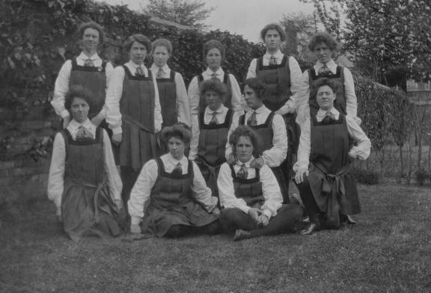
Bedford Physical Training College Set 1 (1903-1905)
Notes:
First set 1903
One missing, probably holding the camera, affluent families with means to support them
We have an archive, which goes right back to the 1903

Slide 4
What is ‘The Collection’
The collection is made up of resources and books that trainee teachers can borrow, and take into their placement schools to use in their lessons
It is on the top floor of the Bedford Campus Library

Slide 5
The Collection
The TP collection has existed since at least 1989
The room is set up to resemble a classroom
It has a SmartBoard (interactive whiteboard)
The resources and books are term time loans
All students can borrow 20 items on top of their 20 items from the main collection
Notes:
Probably since 1976, but 1989 is as far back as currant staff can recall

Slide 6
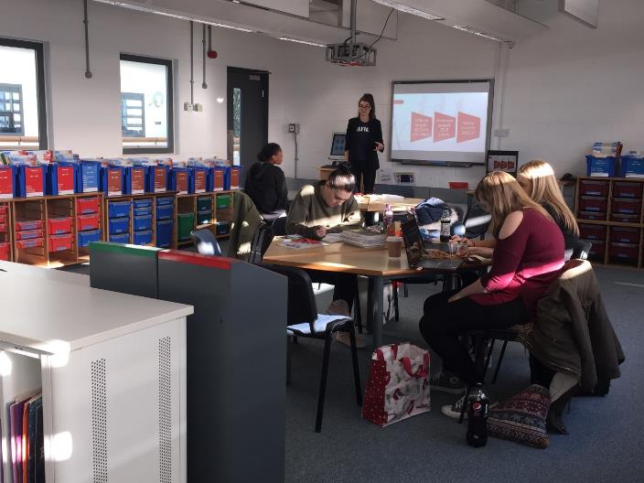
The Collection
Notes:
Anyone can make use of this room, nurses use it a lot

Slide 7
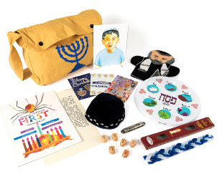
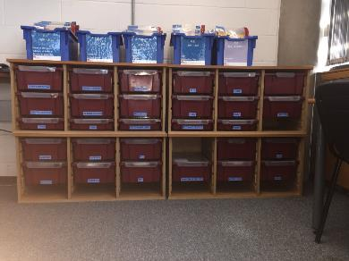
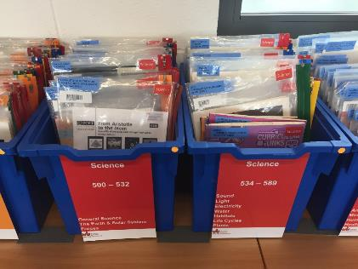
Topic Boxes & Flip Boxes
Notes:
Examples of types of resources

Slide 8

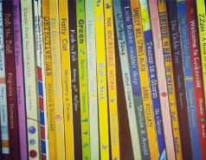

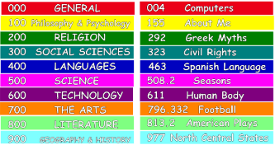
Books -
Fiction, Non-fiction,
Picture Books & Big Books

Slide 9
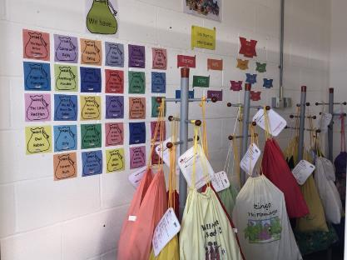
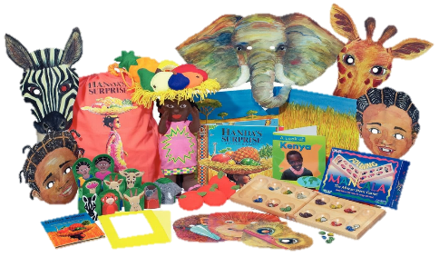
Storysacks
Notes:
This display shows how storysacks can be used and linked into whole topic learning

Slide 10
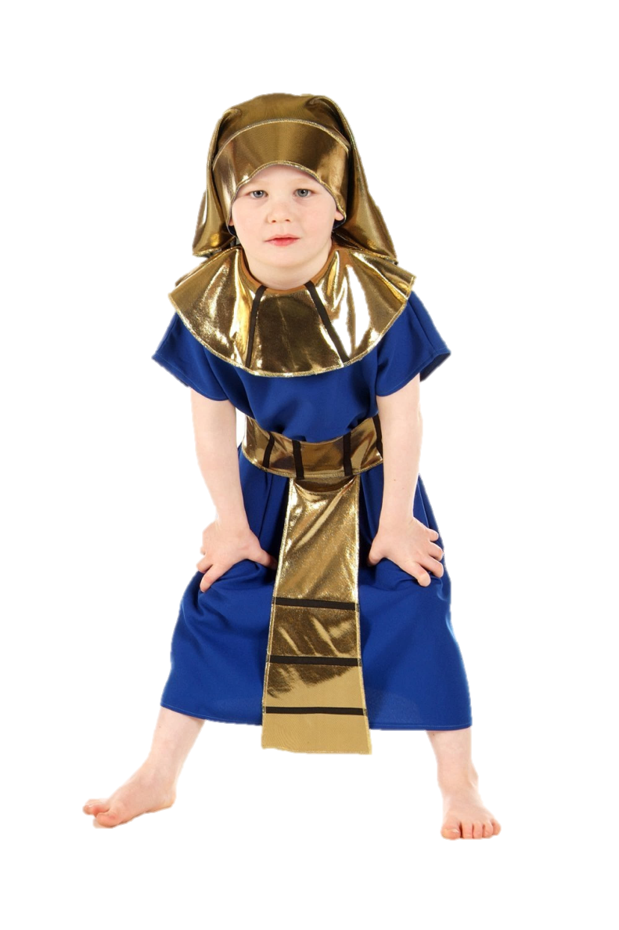
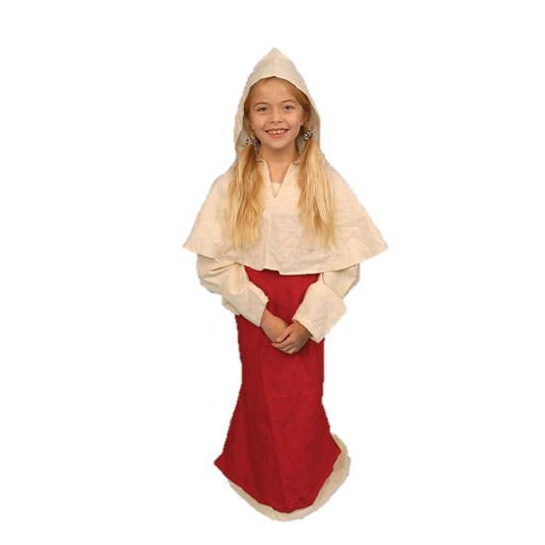
Historical
Costumes

Slide 11
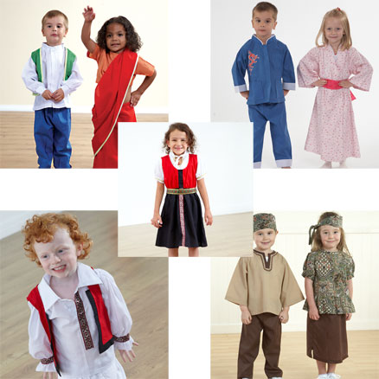
Multicultural Costumes

Slide 12
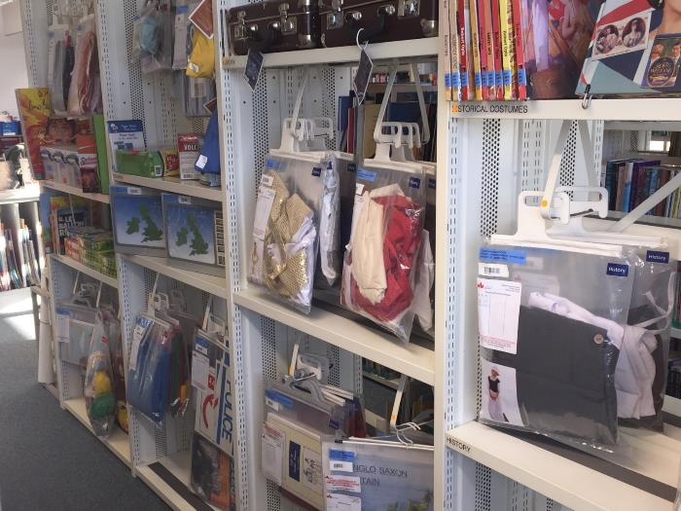
Shelving with Hanging Bags

Slide 13
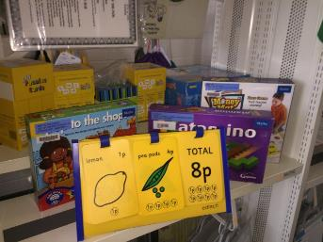
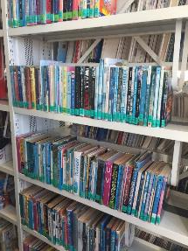
The Collection
All our items have either a green or blue label – green for books, blue for resources
We have put subject stickers in the top right corner
These make it easier for colleagues to locate the items for both pickings and shelving

Slide 14
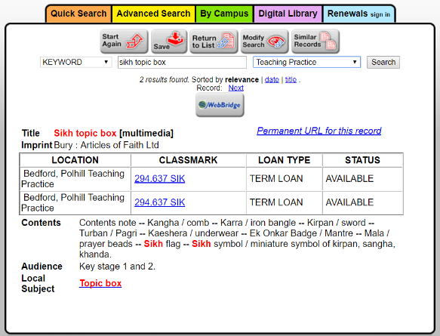
The Collection
The catalogue shows the pack contents
The Keystage
The type of storage it’s in i.e. hanging bag, flip box, topic box
Notes:
Most of our items are KS 1& 2 as we are a primary ed university
(Talk about the catalogue record)
(Show topic box and draw attention to photo and contents tick list)

Slide 15
So what do we actually do?
Jo and I look after the Teaching Practice Collection
Alongside Adele who is the Academic Librarian for Education
We try to see things through the eyes of the student
Clean, mend and label where necessary
Promote the collection to colleagues and students at other sites
Summer jobs i.e. washing, deep cleaning ect.
Notes:
3) bags and box’s larger to smaller, less cumbersome
4) reduce and standardise the formatting of labels (show topic box, re-labels, pics, tick list)
Rub out pencil marks
Meet Elizabeth, lady in waiting to Anne Boleyn. Show examples of Tudor dress for repairs and new hat, hooped skirt
Items still have De Montfort stamps. Gradually replacing them with UOB
Important to have ownership and pride
Reduced the length of Classmark
Make resources – Sparklebox
Summer jobs – i.e. last year deep cleaned topic boxes and washed dressing up clothes

Slide 16
Check returned items
If there’s a problem, email the
student asking them to return
or replace the missing or
damaged item, include a link
where they can obtain a
replacement
We ask them to replace it rather
than pay, as the money gets
swallowed up into the general
coffers, it’s then difficult to get a
replacement due to time
involved and procurement
procedures
Notes:
Firm but don’t want to discourage use
( show teachable touchables - replacement leather and mirror)

Slide 17
We try to be aware of trends e.g. big books and photopacks are not as popular as they once were
We regularly change displays. We have a board and table outside the TP room and a small table on the ground floor. These help to promote the collection
We’ve created new areas – Early Years, EAL & MFL

Slide 18
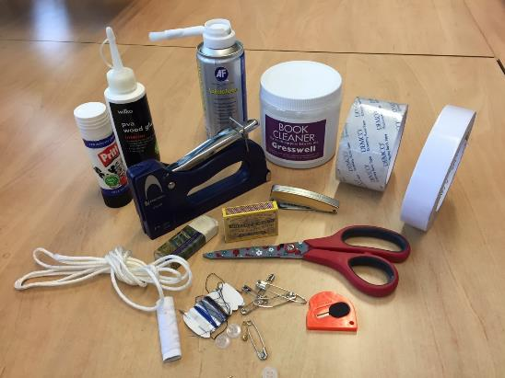
My Essential Kit List
Sewing kit
Pritt stick
Cord for drawstrings
Matches
Sticky-stuff remover
Double-sided tape
Craft knife
Stapler
Paper towels
Book cleaner

Slide 19
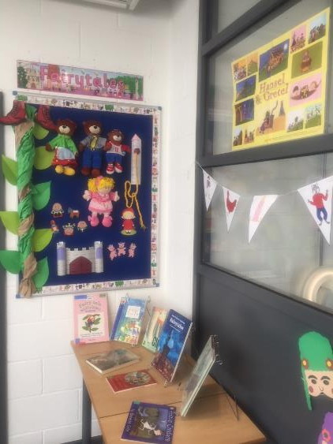
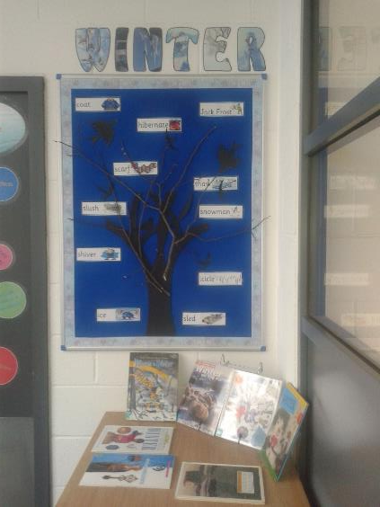

Slide 20
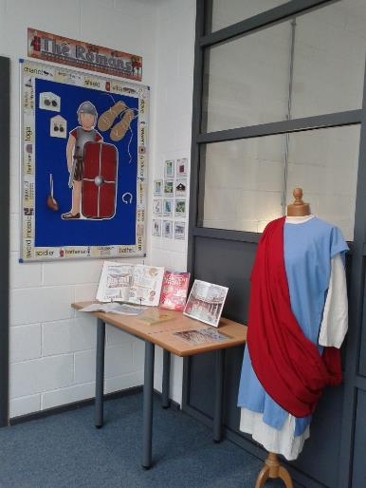
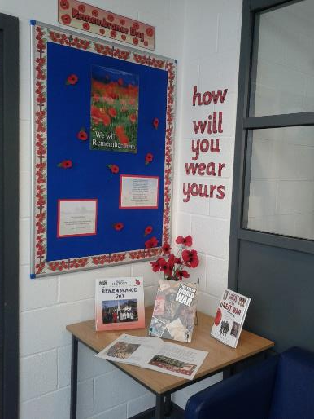

Slide 21
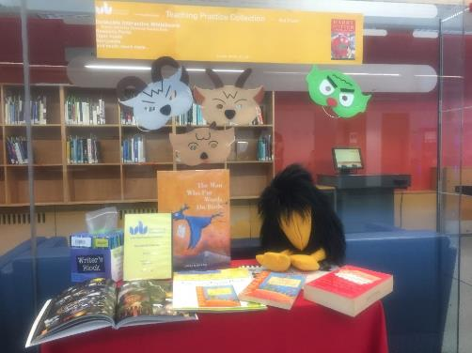
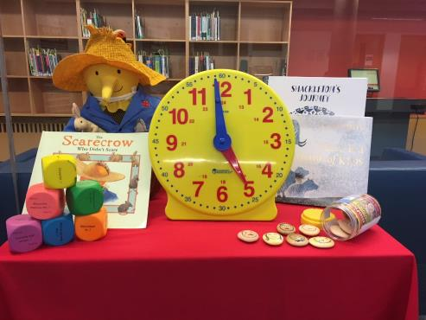

Slide 22

Posters
This is a poster we have up at the Milton Keynes site promoting the Teaching Practice resources
We have recently produced a photograph album which is going to the other sites and out to the staff inductions

Slide 23
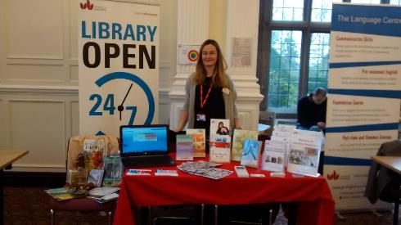
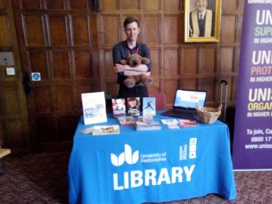
Staff Inductions
At staff inductions, we send a representative from the LR team. They take examples of resources, run a PowerPoint that we use on open days and the photograph album of resources
Notes:
Matt and Sarah

Slide 24
On open days we encourage students who hope to be Teachers to look at the collection and offer them a guided tour
In September when the new starters arrive, we will give a guided tour which takes in the Teaching Resource room, especially if the course they’re on is QTS or Education Studies
Notes:
Show album

Slide 25
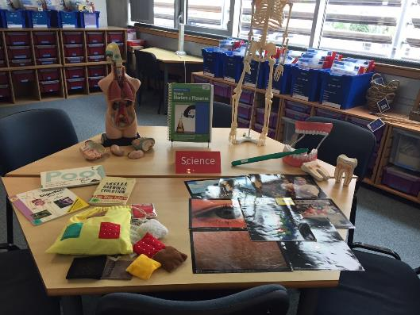
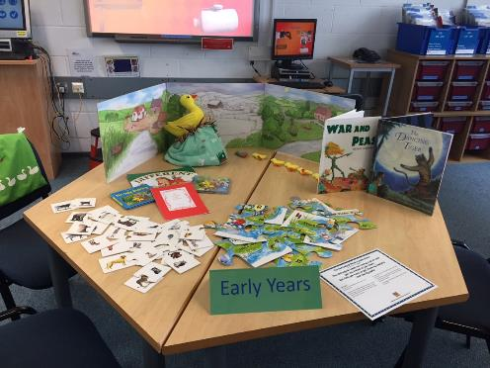
Open Days

Slide 26

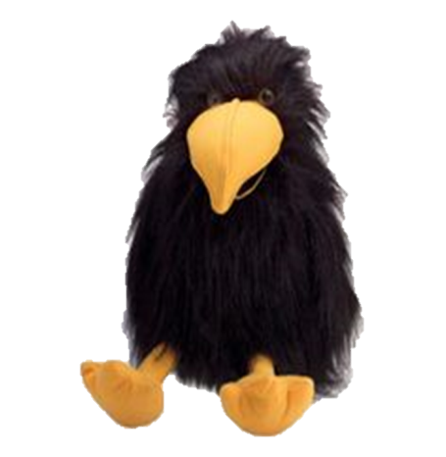
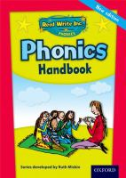
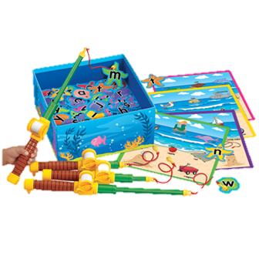
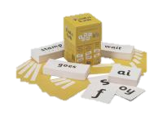
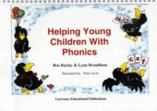
Phonics
Notes:
We hold two phonics schemes, Jolly Phonics and Read Write Inc

Slide 27


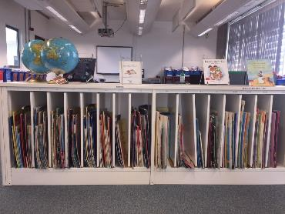
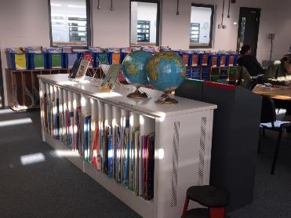
Big Books

Slide 28






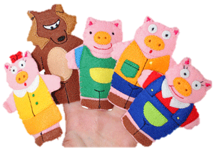
English

Slide 29
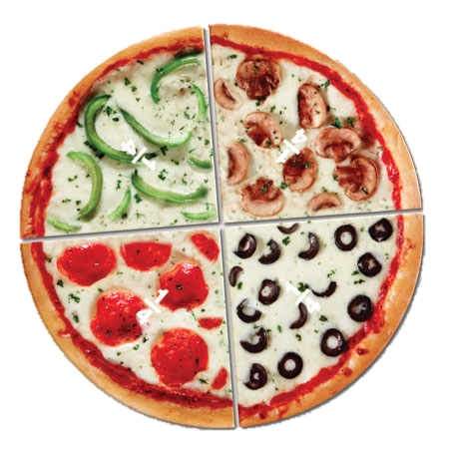


Maths

Slide 30
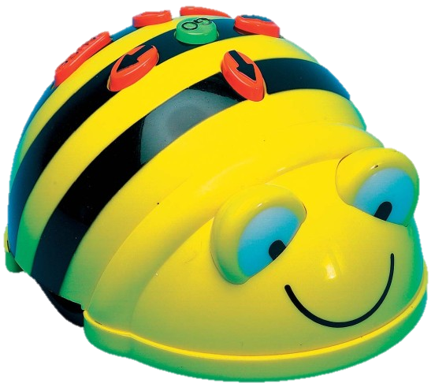
ICT

Slide 31
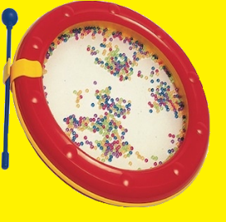

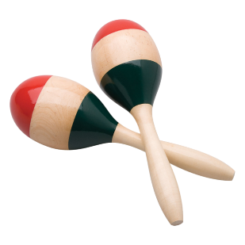
Music
Notes:
Very popular

Slide 32

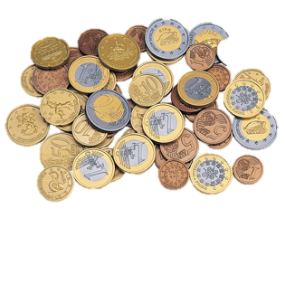
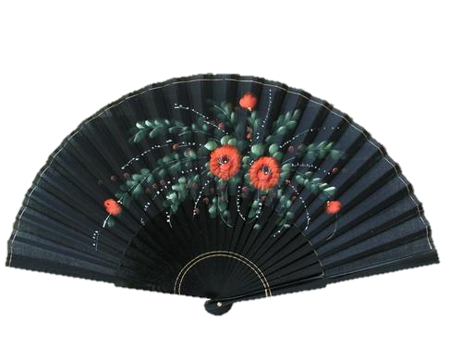
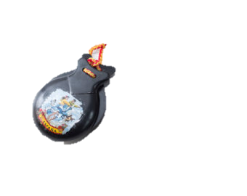
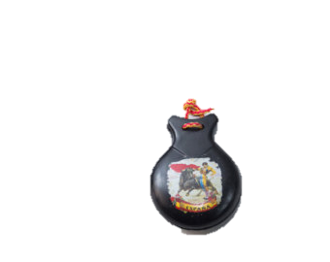
MFL & EAL
Notes:
Dual language books too

Slide 33
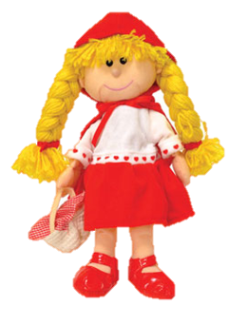
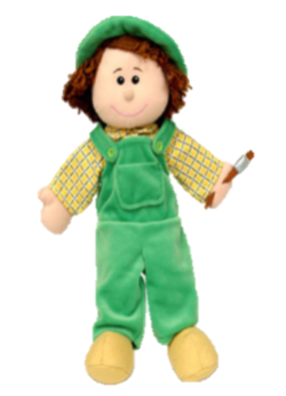

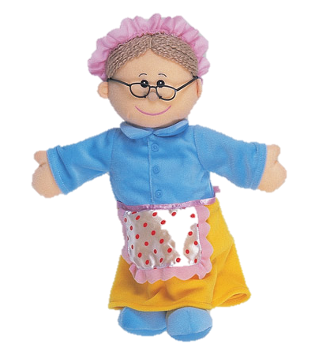
Glove Puppets

Slide 34
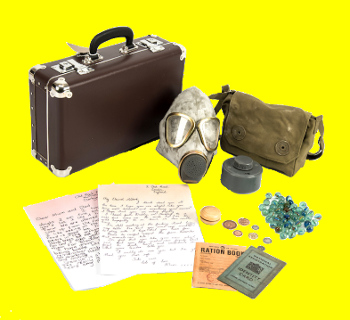
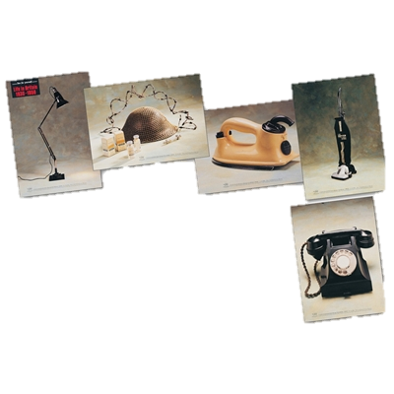

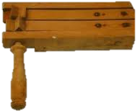
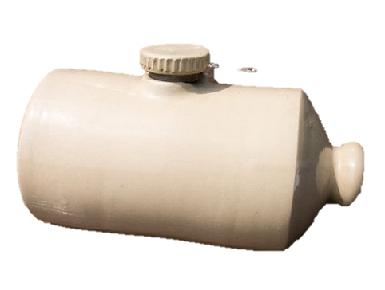
History
Notes:
We’ve simplified the Dewey system where we can too, to just 3 digits after the decimal point

Slide 35


Geography
Notes:
Science and geography overlap. We decided to move all items into one or the other, thus being easier for the student to locate

Slide 36


Science

Slide 37


RE
Notes:
Used a lot,
Many people find teaching RE difficult as they have little personal knowledge of the different religious beliefs

Slide 38


PSE
Notes:
emotistones

Slide 39

PE
Notes:
We only have the parachutes now, as schools are well equipped with sports equipment.
The parachutes can be used for PE, PSHE, after schools clubs and wet play times
To summerise, theTP can be borrowed by any student or staff, to be used tin schools

