Slide 1
Inspired ideas from the sharp end – a knowledge sharing event
Maria Elvin & Louise Bailey
Notes:
I am the Senior Adviser here at UCA Epsom and I have a team of six advisers who support a converged service with a single point of entry to the library and student services. Our aim is to provide both a seamless and agile service to students, as they engage and navigate the range of services on offer. A priority is to be a visible and accessible service for the student community.
Our key objectives are to support learning and promote student independence in an inclusive way within the diverse community. We also signpost to other departments of the University and to services outside in the local community.
To maintain levels of customer service at pinch points during the academic year we have implemented a number of mechanisms to ease the demand on the service, such as waiting lists which allow students on the list to have stand by appointments at short notice with academic support services – this includes learning development tutors and learning & teaching academic librarians. This has proven to be highly successful and relies on excellent communication between staff and students to manage the expectations of the students, who can often be stressed and more delicate during deadline time.

Slide 2
Managing student demands and delivering student support in a converged service.
Notes:
I am the Senior Adviser here at UCA Epsom and I have a team of six advisers who support a converged service with a single point of entry to the library and student services. Our aim is to provide both a seamless and agile service to students, as they engage and navigate the range of services on offer. A priority is to be a visible and accessible service for the student community.
Our key objectives are to support learning and promote student independence in an inclusive way within the diverse community. We also signpost to other departments of the University and to services outside in the local community.
To maintain levels of customer service at pinch points during the academic year we have implemented a number of mechanisms to ease the demand on the service, such as waiting lists which allow students on the list to have stand by appointments at short notice with academic support services – this includes learning development tutors and learning & teaching academic librarians. This has proven to be highly successful and relies on excellent communication between staff and students to manage the expectations of the students, who can often be stressed and more delicate during deadline time.

Slide 3
I'm paying all this money and the service is not that good!
Young Consumers
Notes:
I am the Senior Adviser here at UCA Epsom and I have a team of six advisers who support a converged service with a single point of entry to the library and student services. Our aim is to provide both a seamless and agile service to students, as they engage and navigate the range of services on offer. A priority is to be a visible and accessible service for the student community.
Our key objectives are to support learning and promote student independence in an inclusive way within the diverse community. We also signpost to other departments of the University and to services outside in the local community.
To maintain levels of customer service at pinch points during the academic year we have implemented a number of mechanisms to ease the demand on the service, such as waiting lists which allow students on the list to have stand by appointments at short notice with academic support services – this includes learning development tutors and learning & teaching academic librarians. This has proven to be highly successful and relies on excellent communication between staff and students to manage the expectations of the students, who can often be stressed and more delicate during deadline time.

Slide 4
Mature 8%
Female students 70%
Declared Disability& SpLD 24.4%
BME 24.8%
International students 17%
Retention 89.7%
Notes:
I am the Senior Adviser here at UCA Epsom and I have a team of six advisers who support a converged service with a single point of entry to the library and student services. Our aim is to provide both a seamless and agile service to students, as they engage and navigate the range of services on offer. A priority is to be a visible and accessible service for the student community.
Our key objectives are to support learning and promote student independence in an inclusive way within the diverse community. We also signpost to other departments of the University and to services outside in the local community.
To maintain levels of customer service at pinch points during the academic year we have implemented a number of mechanisms to ease the demand on the service, such as waiting lists which allow students on the list to have stand by appointments at short notice with academic support services – this includes learning development tutors and learning & teaching academic librarians. This has proven to be highly successful and relies on excellent communication between staff and students to manage the expectations of the students, who can often be stressed and more delicate during deadline time.

Slide 5
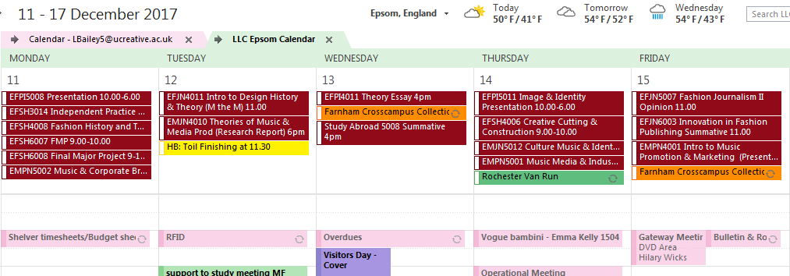
Deadline Week
Notes:
I am the Senior Adviser here at UCA Epsom and I have a team of six advisers who support a converged service with a single point of entry to the library and student services. Our aim is to provide both a seamless and agile service to students, as they engage and navigate the range of services on offer. A priority is to be a visible and accessible service for the student community.
Our key objectives are to support learning and promote student independence in an inclusive way within the diverse community. We also signpost to other departments of the University and to services outside in the local community.
To maintain levels of customer service at pinch points during the academic year we have implemented a number of mechanisms to ease the demand on the service, such as waiting lists which allow students on the list to have stand by appointments at short notice with academic support services – this includes learning development tutors and learning & teaching academic librarians. This has proven to be highly successful and relies on excellent communication between staff and students to manage the expectations of the students, who can often be stressed and more delicate during deadline time.

Slide 6
The departments busiest resource
One to one tutorials and embedded sessions in courses
Learning Development Tutors
understanding project briefs and assignments
reading and writing on your course
organisation and time management
critical thinking, analysis and reflection
language development for your course
presenting your ideas
getting the most from your lectures, seminars and tutorials
visual practice
Notes:
I am the Senior Adviser here at UCA Epsom and I have a team of six advisers who support a converged service with a single point of entry to the library and student services. Our aim is to provide both a seamless and agile service to students, as they engage and navigate the range of services on offer. A priority is to be a visible and accessible service for the student community.
Our key objectives are to support learning and promote student independence in an inclusive way within the diverse community. We also signpost to other departments of the University and to services outside in the local community.
To maintain levels of customer service at pinch points during the academic year we have implemented a number of mechanisms to ease the demand on the service, such as waiting lists which allow students on the list to have stand by appointments at short notice with academic support services – this includes learning development tutors and learning & teaching academic librarians. This has proven to be highly successful and relies on excellent communication between staff and students to manage the expectations of the students, who can often be stressed and more delicate during deadline time.

Slide 7
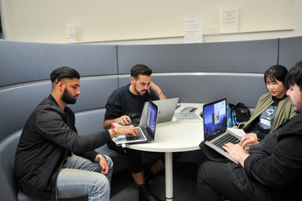
The words just aren’t coming…! I don’t know where to start even though I've written a mind map
Just book a one to one appointment with a Learning development tutor
You'll be lucky they're all fully booked….
Notes:
I am the Senior Adviser here at UCA Epsom and I have a team of six advisers who support a converged service with a single point of entry to the library and student services. Our aim is to provide both a seamless and agile service to students, as they engage and navigate the range of services on offer. A priority is to be a visible and accessible service for the student community.
Our key objectives are to support learning and promote student independence in an inclusive way within the diverse community. We also signpost to other departments of the University and to services outside in the local community.
To maintain levels of customer service at pinch points during the academic year we have implemented a number of mechanisms to ease the demand on the service, such as waiting lists which allow students on the list to have stand by appointments at short notice with academic support services – this includes learning development tutors and learning & teaching academic librarians. This has proven to be highly successful and relies on excellent communication between staff and students to manage the expectations of the students, who can often be stressed and more delicate during deadline time.

Slide 8
Problem…(student information on website/VLE)
“Booking a one to one tutorial
If you'd like to book a tutorial with a Learning Development Tutor please contact the Gateway - you'll find their details at the bottom of the page”
Notes:
I am the Senior Adviser here at UCA Epsom and I have a team of six advisers who support a converged service with a single point of entry to the library and student services. Our aim is to provide both a seamless and agile service to students, as they engage and navigate the range of services on offer. A priority is to be a visible and accessible service for the student community.
Our key objectives are to support learning and promote student independence in an inclusive way within the diverse community. We also signpost to other departments of the University and to services outside in the local community.
To maintain levels of customer service at pinch points during the academic year we have implemented a number of mechanisms to ease the demand on the service, such as waiting lists which allow students on the list to have stand by appointments at short notice with academic support services – this includes learning development tutors and learning & teaching academic librarians. This has proven to be highly successful and relies on excellent communication between staff and students to manage the expectations of the students, who can often be stressed and more delicate during deadline time.

Slide 9
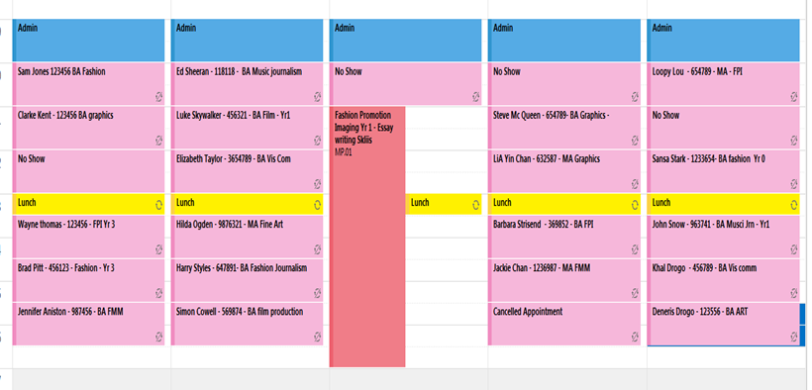
A typical diary view for a Learning Development Tutor
Notes:
I am the Senior Adviser here at UCA Epsom and I have a team of six advisers who support a converged service with a single point of entry to the library and student services. Our aim is to provide both a seamless and agile service to students, as they engage and navigate the range of services on offer. A priority is to be a visible and accessible service for the student community.
Our key objectives are to support learning and promote student independence in an inclusive way within the diverse community. We also signpost to other departments of the University and to services outside in the local community.
To maintain levels of customer service at pinch points during the academic year we have implemented a number of mechanisms to ease the demand on the service, such as waiting lists which allow students on the list to have stand by appointments at short notice with academic support services – this includes learning development tutors and learning & teaching academic librarians. This has proven to be highly successful and relies on excellent communication between staff and students to manage the expectations of the students, who can often be stressed and more delicate during deadline time.

Slide 10
Solution… Waiting list for LDT’s
A live Google docs spreadsheet with editing rights for all
Notes:
I am the Senior Adviser here at UCA Epsom and I have a team of six advisers who support a converged service with a single point of entry to the library and student services. Our aim is to provide both a seamless and agile service to students, as they engage and navigate the range of services on offer. A priority is to be a visible and accessible service for the student community.
Our key objectives are to support learning and promote student independence in an inclusive way within the diverse community. We also signpost to other departments of the University and to services outside in the local community.
To maintain levels of customer service at pinch points during the academic year we have implemented a number of mechanisms to ease the demand on the service, such as waiting lists which allow students on the list to have stand by appointments at short notice with academic support services – this includes learning development tutors and learning & teaching academic librarians. This has proven to be highly successful and relies on excellent communication between staff and students to manage the expectations of the students, who can often be stressed and more delicate during deadline time.

Slide 11
The success of the waiting list relies on the following
Collaborative working – robust communication
Up to date information
Student flexibility
Gateway advisers managing student expectation – at point of contact
Inter department communication – Gateway Advisers and Learning Development Tutors
Notes:
I am the Senior Adviser here at UCA Epsom and I have a team of six advisers who support a converged service with a single point of entry to the library and student services. Our aim is to provide both a seamless and agile service to students, as they engage and navigate the range of services on offer. A priority is to be a visible and accessible service for the student community.
Our key objectives are to support learning and promote student independence in an inclusive way within the diverse community. We also signpost to other departments of the University and to services outside in the local community.
To maintain levels of customer service at pinch points during the academic year we have implemented a number of mechanisms to ease the demand on the service, such as waiting lists which allow students on the list to have stand by appointments at short notice with academic support services – this includes learning development tutors and learning & teaching academic librarians. This has proven to be highly successful and relies on excellent communication between staff and students to manage the expectations of the students, who can often be stressed and more delicate during deadline time.

Slide 12
Questions ?
Notes:
I am the Senior Adviser here at UCA Epsom and I have a team of six advisers who support a converged service with a single point of entry to the library and student services. Our aim is to provide both a seamless and agile service to students, as they engage and navigate the range of services on offer. A priority is to be a visible and accessible service for the student community.
Our key objectives are to support learning and promote student independence in an inclusive way within the diverse community. We also signpost to other departments of the University and to services outside in the local community.
To maintain levels of customer service at pinch points during the academic year we have implemented a number of mechanisms to ease the demand on the service, such as waiting lists which allow students on the list to have stand by appointments at short notice with academic support services – this includes learning development tutors and learning & teaching academic librarians. This has proven to be highly successful and relies on excellent communication between staff and students to manage the expectations of the students, who can often be stressed and more delicate during deadline time.

