Slide 1
Recruiting Tomorrow’s Leaders Today
Teesside’s approach to succession planning

Slide 2
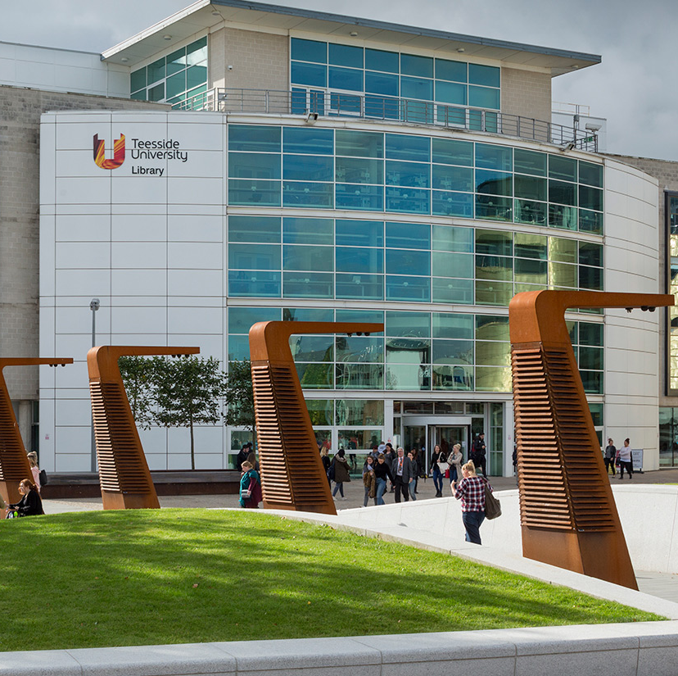
Teesside University
Post 92 University
22,500 + students
Middlesbrough
Darlington satellite
TU London

Slide 3
Customer Services at Teesside
Experience and Engagement Team
Rota pool
Challenges:
Gaps in structure
Recruitment challenges
Rota pool demographic
Skills / knowledge / energy and enthusiasm

Slide 4
Teesside’s Approach
Recruiting from student worker pool / wider graduate pool
Work experience and training opportunities for student workers:
Internships / volunteering opportunities
Careers and employability funding
GRIT training (funded through the University’s APP funding)
More general training and development opportunities
Existing talent pool
Accelerated promotional opportunities
Reconsidering existing skills – re-purpose in other roles

Slide 5
Contact Details
j.oliver@tees.ac.uk
@jackoliver40
linkedin.com/in/jackie-oliver

