Slide 1
Chatbot
Gwen Couch & Taran Johal

Slide 2
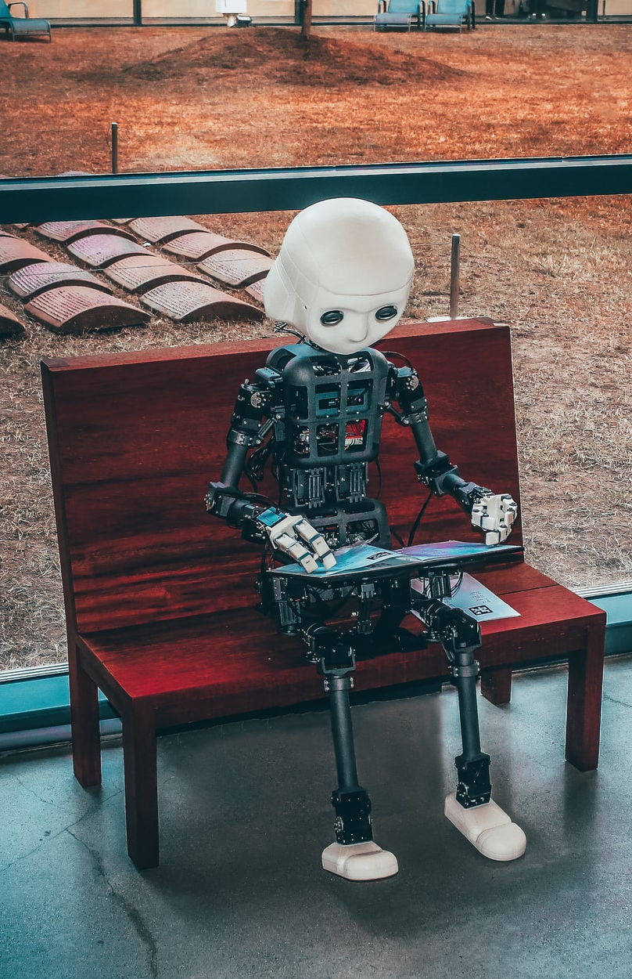
Content
Why we chose this style of chatbot?
The benefits of our approach to chatbot
The outlook for the chatbot
The process of developing it & the company we are using

Slide 3
Why we need this chatbot?
Learners
Barriers
Need and want to succeed.
Complete their work.
Progress through their studies.
Academic landscape
Workload (in and out of college)
Failed by previous education
Returning to education (apprehension due to long hiatus)

Slide 4
Why we chose this chatbot
Virtual service that can be used 24/7 by students, meet the needs of a range of learners and their schedules.
We were given a grant to develop this chatbot for FE.
No queues waiting for an answer.
Support staff in helping provide greater service for learners.
Access at any time and place

Slide 5
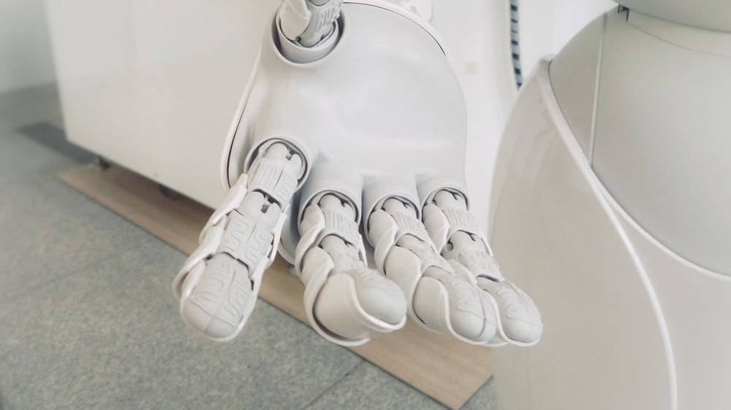
The benefits of the chatbot
'Jargon free' the language used by libraries and librarians is often inaccessible e.g., periodicals, journals, catalogue.
It’s a self-learning AI, the more we put in the more it learns.
Less labour intensive when running at optimal.
Easily edited and the background workings are easy to navigate.

Slide 6
AI Development
Chatbot development & Emotion robotics
We gathered data, by accumulating questions asked of us in emails and in person.
We developed a spreadsheet and answered the Q.
Approach was to provide more questions than answers to the AI to help it learn.
We also added (google) key words, links to our website, and videos.
The chatbot can be easily edited.
The company we are working with is Emotional Robotics. Who specialise in this format of chatbot.

Slide 7
The Future
Incorporate more subject areas into the chatbot
Advertise to students and staff on induction
Advertise the chatbot to prospective learners (we are the first FE library to do this)
Share our knowledge with other colleges.

Slide 8
Thank you
Any questions?
Please contact us if you have any questions. gwennan.couch@gcs.ac.uk & tarandeep.johal@gcs.ac.uk

