Slide 1
Seeking & reacting to student feedback during the pandemic and beyond
Mercedes Malloy

Slide 2
Today’s session
Explore different ways of getting feedback
How BCU Library and Learning Resources uses feedback to improve our services
Survey writing (good/bad practice)
Source : http://www.willowwhite.com/

Slide 3
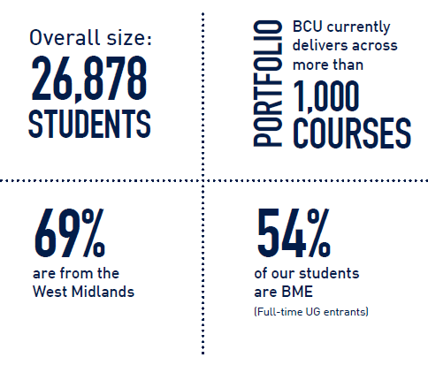
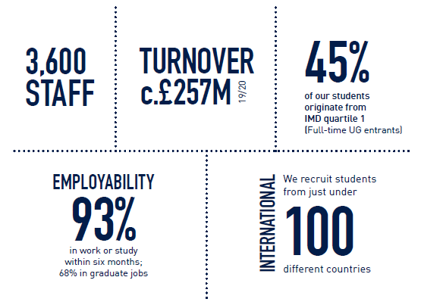
BCU in 2020

Slide 4
Why is feedback important to us?
Decision making
Department needs
NSS/CSE

Slide 5
Feedback channels
Before March 2020
In person interactions at the desk
Chat service feedback
Graffiti feedback wall
Student mentors/ambassadors
NSS/Post graduate taught experience survey
Meetings with academic faculties
After March 2020
Chat service feedback
Libwizard (surveys)
Lib ticket feedback
User experience sessions based on our new library search (Primo)
NSS/Post graduate taught experience survey
Meetings with academic faculties
Notes:
Loss of majority of face to face interactions.
Over 100% increase in number of chats and an increase in feedback too.
Libwizard surveys sent to students who booked a study space
Lib ticket feedback (started March 2021). Understand how we deal with more complex queries that may need to be referred to othr departments within LLR
UX sessions based on our new library system Primo
NSS
Departmental meetings similar to before but now online

Slide 6
Notes:
Pros: Quick to set up and results sit on springshare which is useful rather than having it in multiple locations. Decent display of results.

Slide 7
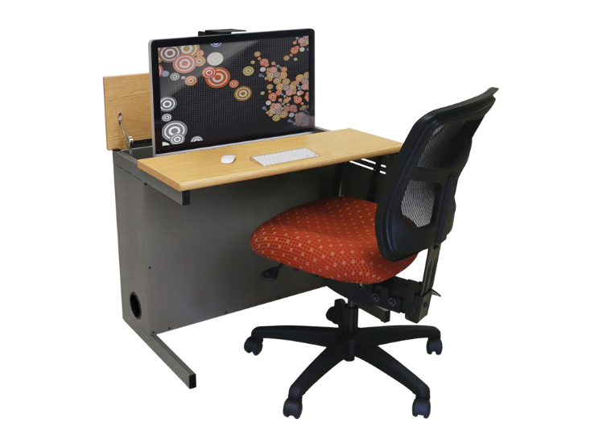
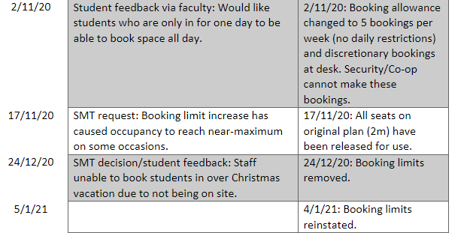
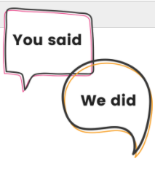
Notes:
During covid a lot of changes were made to the service at short notice and its useful to look back on why we made those changes and when. We will continue to log changes over time in this way.

Slide 8
Please go to menti.com and put in the following code : 1723 9920 See results here: https://www.mentimeter.com/s/c3352bd64bb77983c079ad3048bd3ecf/9c9bf01ae17e
Notes:
https://www.menti.com/5bog67iuii
Please go to menti.com and put in the following code : 1723 9920
Different ways of getting feedback -
Time or expertise to analyse the feedback?

Slide 9
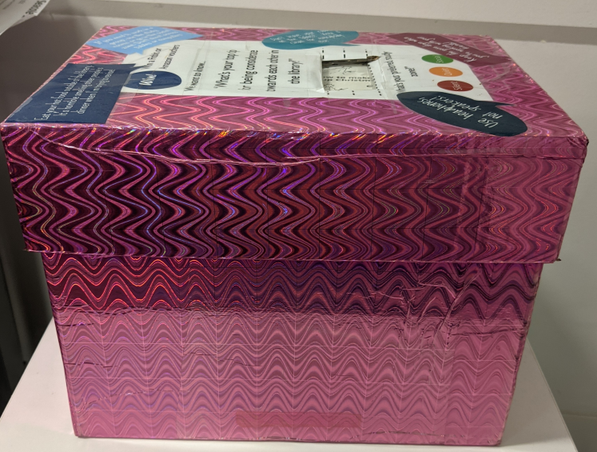
Plans for the future
Mystery shopping
Targeted surveys using libwizard
Suggestion boxes alongside displays
Engage with departments who gave us lower sores in NSS
Keep track of changes made based on feedback e.g. changes log
Notes:
Mystery shopping will start again. Online and in person ideally. We want to benchmark against similar institutions for some of the questions atleast.
Libswizard surveys were useful for changes in service so these will be used again but not too often as we don’t want to bombard the students. They are timely as they relate to an interaction they had with the library rather than asking about their general feelings/views on our wider service.
We are going to have a display in the new year aimed at enhanced students (those with disabilities) It will include a comments/suggestion box so we can get their ideas. It is important to reach students who may not be interested in completing an online survey but will be happy to fill out a paper comments slip.
During covid there were a lot of changes to the service and it was hard to keep track of what was changed when and why. For space bookings a change log was created which has proved really useful so we will contiune to use this type of thing.

Slide 10
LMS feedback
Form for staff to fill out issues or feedback based on the new systems (Alma/Primo).
We have a changes log for this.

Slide 11
Survey time!
Please follow the URL in the chat box to complete the survey questions.
Notes:
https://forms.office.com/r/bh4rhwxbYK

Slide 12
How did you interpret the question?
How many conferences have you attended in the last year?
1-4
5-10
11+
In the last calendar year or 12 months?
Did I need to attend whole event or just some of it?
Can you even remember how many you have attended?

Slide 13
How did you interpret the question?
In your opinion is MS Teams user friendly and the best tool for online conferencing?
Yes
No
I don’t know
This is a double barrelled question.
The respondent may agree it is user friendly BUT not the best tool for online conferencing. These questions should be asked separately.

Slide 14
How did you interpret the question?
Do you have a member of staff in the library whose main job is to focus on UX?
Yes
No
I don’t know
Is UX jargon? Would it be better to put user experience/customer journey?
Is the question too vague? Many people may focus on UX in their role so could it be asked in a better way?

Slide 15
Before writing your survey
Why are you creating a survey?
Who do you want to hear from?
What format to use
Notes:
Do you want feedback on a change in service?
Want to compare to another year or institution?
Is the survey aimed at postgrads or law students? How do you get the survey to them? Can you add in a question so it excludes respondants who don’t fit the target group?
Format- in person/online.In person takes up more staff times and excludes DL or those who don’t come into th elibrary often. Do we want to engage with regular users or those who don’t use us enough? Focus group, questionnaire. MS forms, Survey monkey, Libwizard, How will results be displayed?

Slide 16
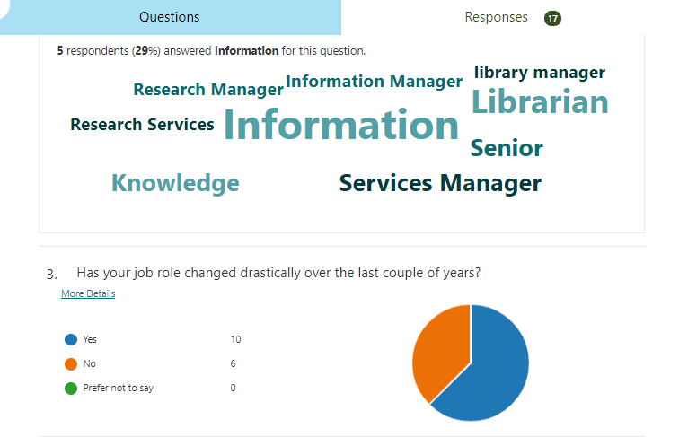
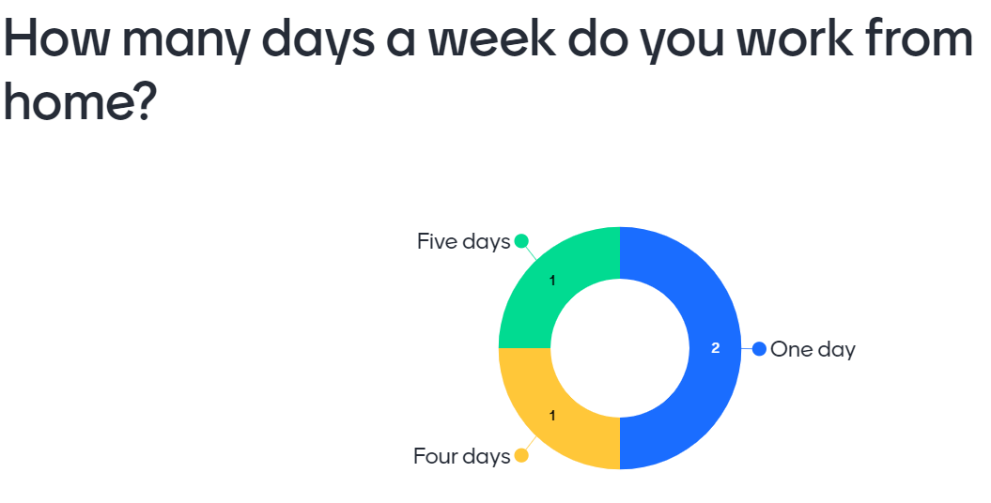
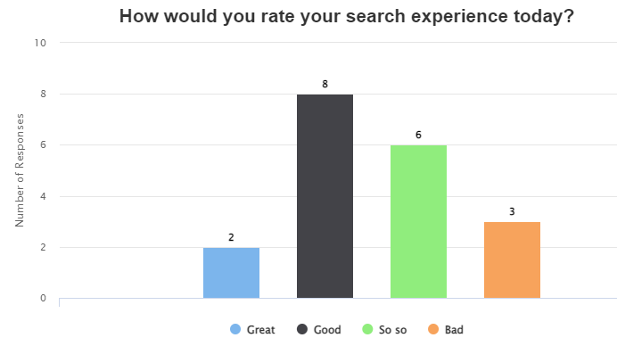
Format of results

Slide 17
Top tips for writing questions
Use precise words so the question can be consistently interpreted. Think about non native English speakers.
Use neutral language so you don’t impact results (avoiding socially desirable answers).
Notes:
Do you come to the BCU library in the evening to study? VS Do you come to the BCU library in the evening?

Slide 18
Test run the questions
Use cognitive interviewing to test out your survey questions
"In your own words, what is this question asking?"
"How did you arrive at your answer?"
"How sure are you of your answer?"
Notes:
In your own words, what is this question asking?“ Did they understand the question the way you intended it?
"How did you arrive at your answer?“ Did they have to guess because they cant remember the true answer? “
How sure are you of your answer?“ Are they giving a socially desirable answer rather than being truthful? It would be good to understand how they came to their answer.

Slide 19
Mercedes Malloy Customer Services Librarian Mercedes.malloy@bcu.ac.uk

