Slide 1
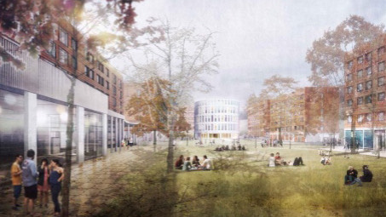
‘What are the Library Vibes?’ Student Engagement at the University of Sussex Library
Eleanor Ferguson
June 2022

Slide 2
My career ‘journey’
I am currently on secondment as a Senior Project Assistant, working on the design brief for a new library building on campus
Imperial War Museum library and archive
Public libraries in Glasgow and East Renfrewshire
University of Sussex Library: Frontline Services
3 years as a library assistant: I took on as many extra projects as I could…

Slide 3
Extra projects included…
Administrator for the Library’s CSE (Customer Service Excellence) submission
Facilitating the Library Assistant Forum and communicating feedback to senior managers
Social Media Champion
Active member of working groups within the Library including Decolonisation, UX, and Comms and Publicity
Delivering online workshops and presentations, both internally and externally

Slide 4
Skills gained
Excellent communication skills
Managing multiple projects at once
Sticking to deadlines!
Engaging and motivating other staff
Collaboration and team work
Enhanced understanding: of the Library as a holistic organisation and its place in the wider University community

Slide 5
The Library Pavilion vision
Run by students, for students
Student centred, student focused: student ‘voice’ will be embedded within the project
Accessible for all
Inclusive

Slide 6
The Library Pavilion vision
The new Library Pavilion is an extension of the current library rather than a different library: almost like an extra room
It will be bookless!
In April 2022, we opened our new Student Centre
Key that the Library Pavilion is different to and distinct from the Student Centre, since they will be situated quite close together on campus
However it is a different building, at the other end of the campus. How do we bridge that gap?
The essence of the library; in a new building… how do we recreate that?
The Library Vibes…

Slide 7
What are the ‘Library Vibes’?
Warmth (both temperate and atmospheric)
‘Homeness’
Sense of community/solidarity
Views of nature
Acoustics
Softer lighting
Muted colours
Variety!
BRICKS!

Slide 8
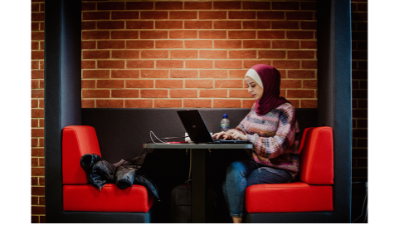

Slide 9
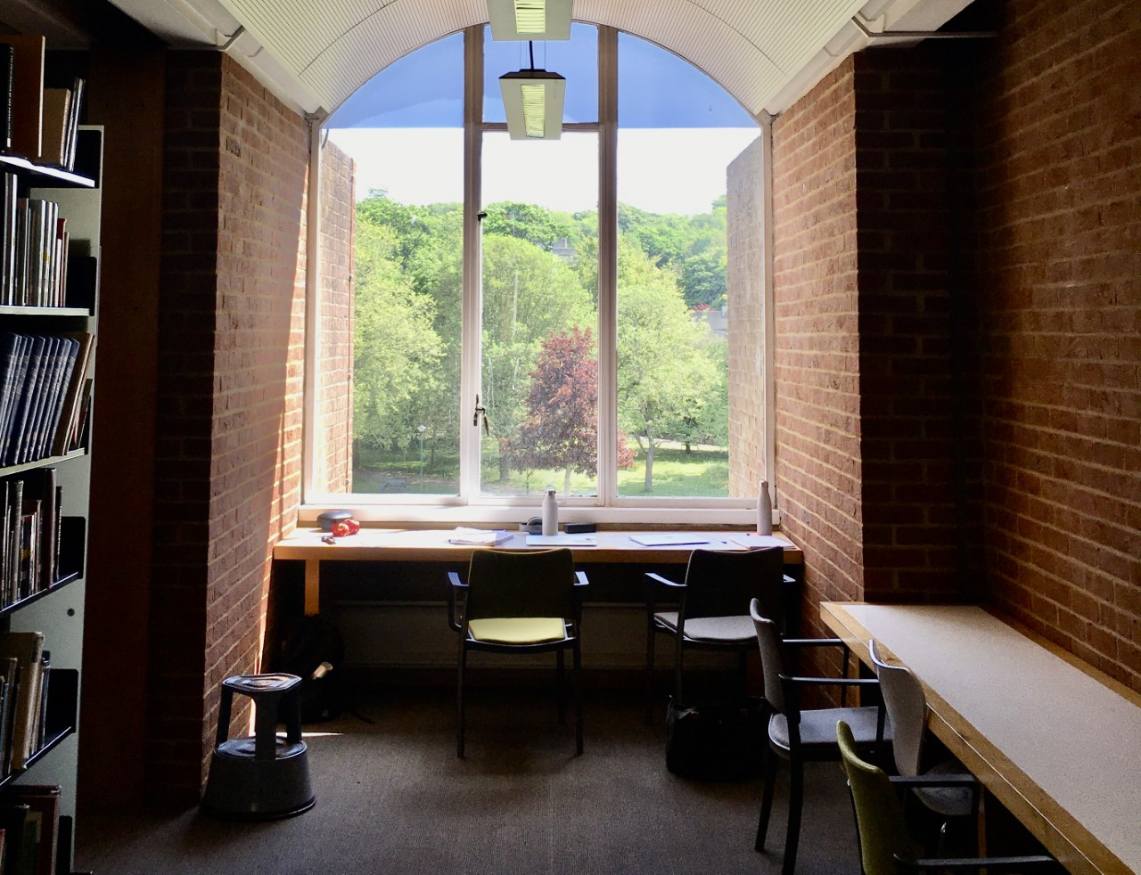

Slide 10
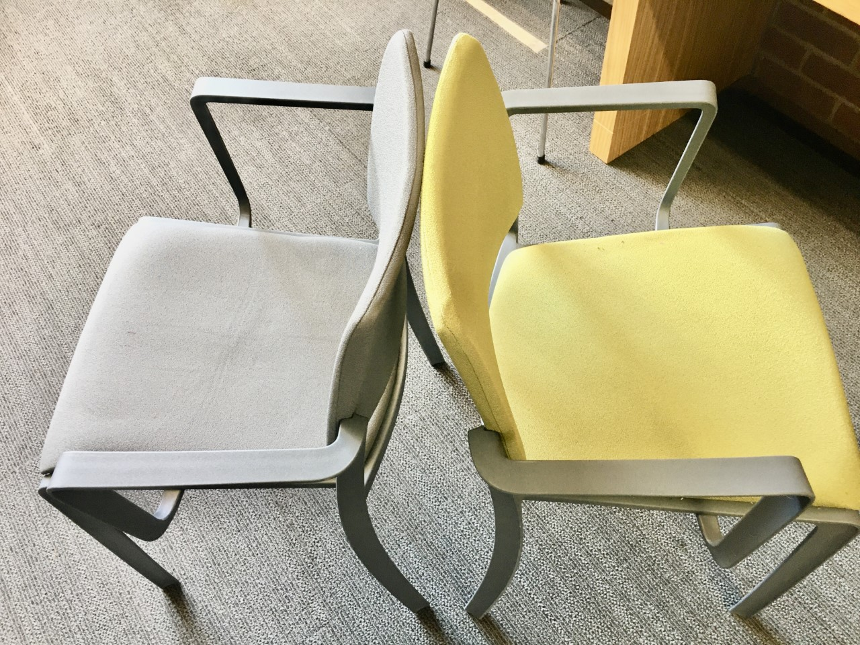

Slide 11
The student view and voice: findings
Engagement activities have included:
Ad hoc engagement outside the Library (Tea and Talk)
Peer-led sessions
Social media
Meetings with specific student groups
Recurring themes:
Power and connectivity
Study spaces and furniture
Clarity in zoning and signage
Ambience, ‘vibes’ and aesthetics
Should the Library function as a social space?
Collaboration with the Students Union
Touchstone Tours

Slide 12
The student view and voice: findings
Consultation with Access Sussex:
‘Access Sussex is a student-led campaign that aims to make the University of Sussex accessible to everyone, including to students and staff with visible or invisible disabilities, long-term conditions and those who are neurodivergent’.
Key concerns:
Accessible furniture
Lifts: distance from entrance; clear route
Lighting
Signage and way-finding
An alternative entrance

Slide 13
Student engagement and UX: how do we do it?
Put simply, engagement is a conversation
Speak to students on their platforms! Email? No. Paper? No. Students are ‘born digital’
Don’t underestimate the power of just talking to people!
Decide what you want to find out: but don’t be too prescriptive
Don’t presume or assume! What we find problematic is almost certainly different for our users
Ask for help! Collaboration is key.
Bookless…?

Slide 14
The future…?
Return to substantive grade 3 Library Assistant role?
Continuation of UX and student engagement work to enhance our customer service offer
Supporting and encouraging other staff to initiate and facilitate their own projects
Identifying useful training opportunities for the Frontline Services team
Utilising project management skills
Project management training and potential qualification!

